Slide 1
About:
“Blood flowing inside is life, blood flowing outside is death and blood donated in packets is responsibility”.
With this profound understanding of social duty, the platform "Veins 2 Village" was inaugurated in 2016 at Chitkara University, under the auspices of Vice-Chancellor, Dr. Madhu Chitkara.
Objectives:
Instigate a culture of blood donation
Organise blood donation camps
Establish connection with regional hospitals
Ensure a steady supply of blood
"Change in lives, hope in drops
Trust in roots, unity in veins”

Slide 2
Flow of Blood through
Veins 2 Village
Registration
Medical Checkup
Donation
Storage
Distribution
Hospital Connection

Slide 3
Registration of volunteers for blood donation
Step 2
Medical checkup of the volunteers
Step 3
If found fit, then the volunteers proceed towards blood donation
Step 4
Step 5
The collected blood is then transported and stored in concerned blood bank
The blood is made available to the needy patients
Lives Saved - Happiness Received @ Veins 2 Village
Step 6
Step 1

Slide 4
Statistical Data of Veins 2 Village Progress from 2016 to 2023
Year | No. of Camps | Registration Volunteers for Blood Donation | Donor
2016 | 2 | 280 | 225
2017 | 3 | 670 | 540
2018 | 2 | 695 | 600
2019 | 4 | 996 | 830
2020 | 1 | 711 | 676
2021 | 1 | 125 | 85
2022 | 1 | 136 | 100
2023 | 4 | 1532 | 1167

Slide 5
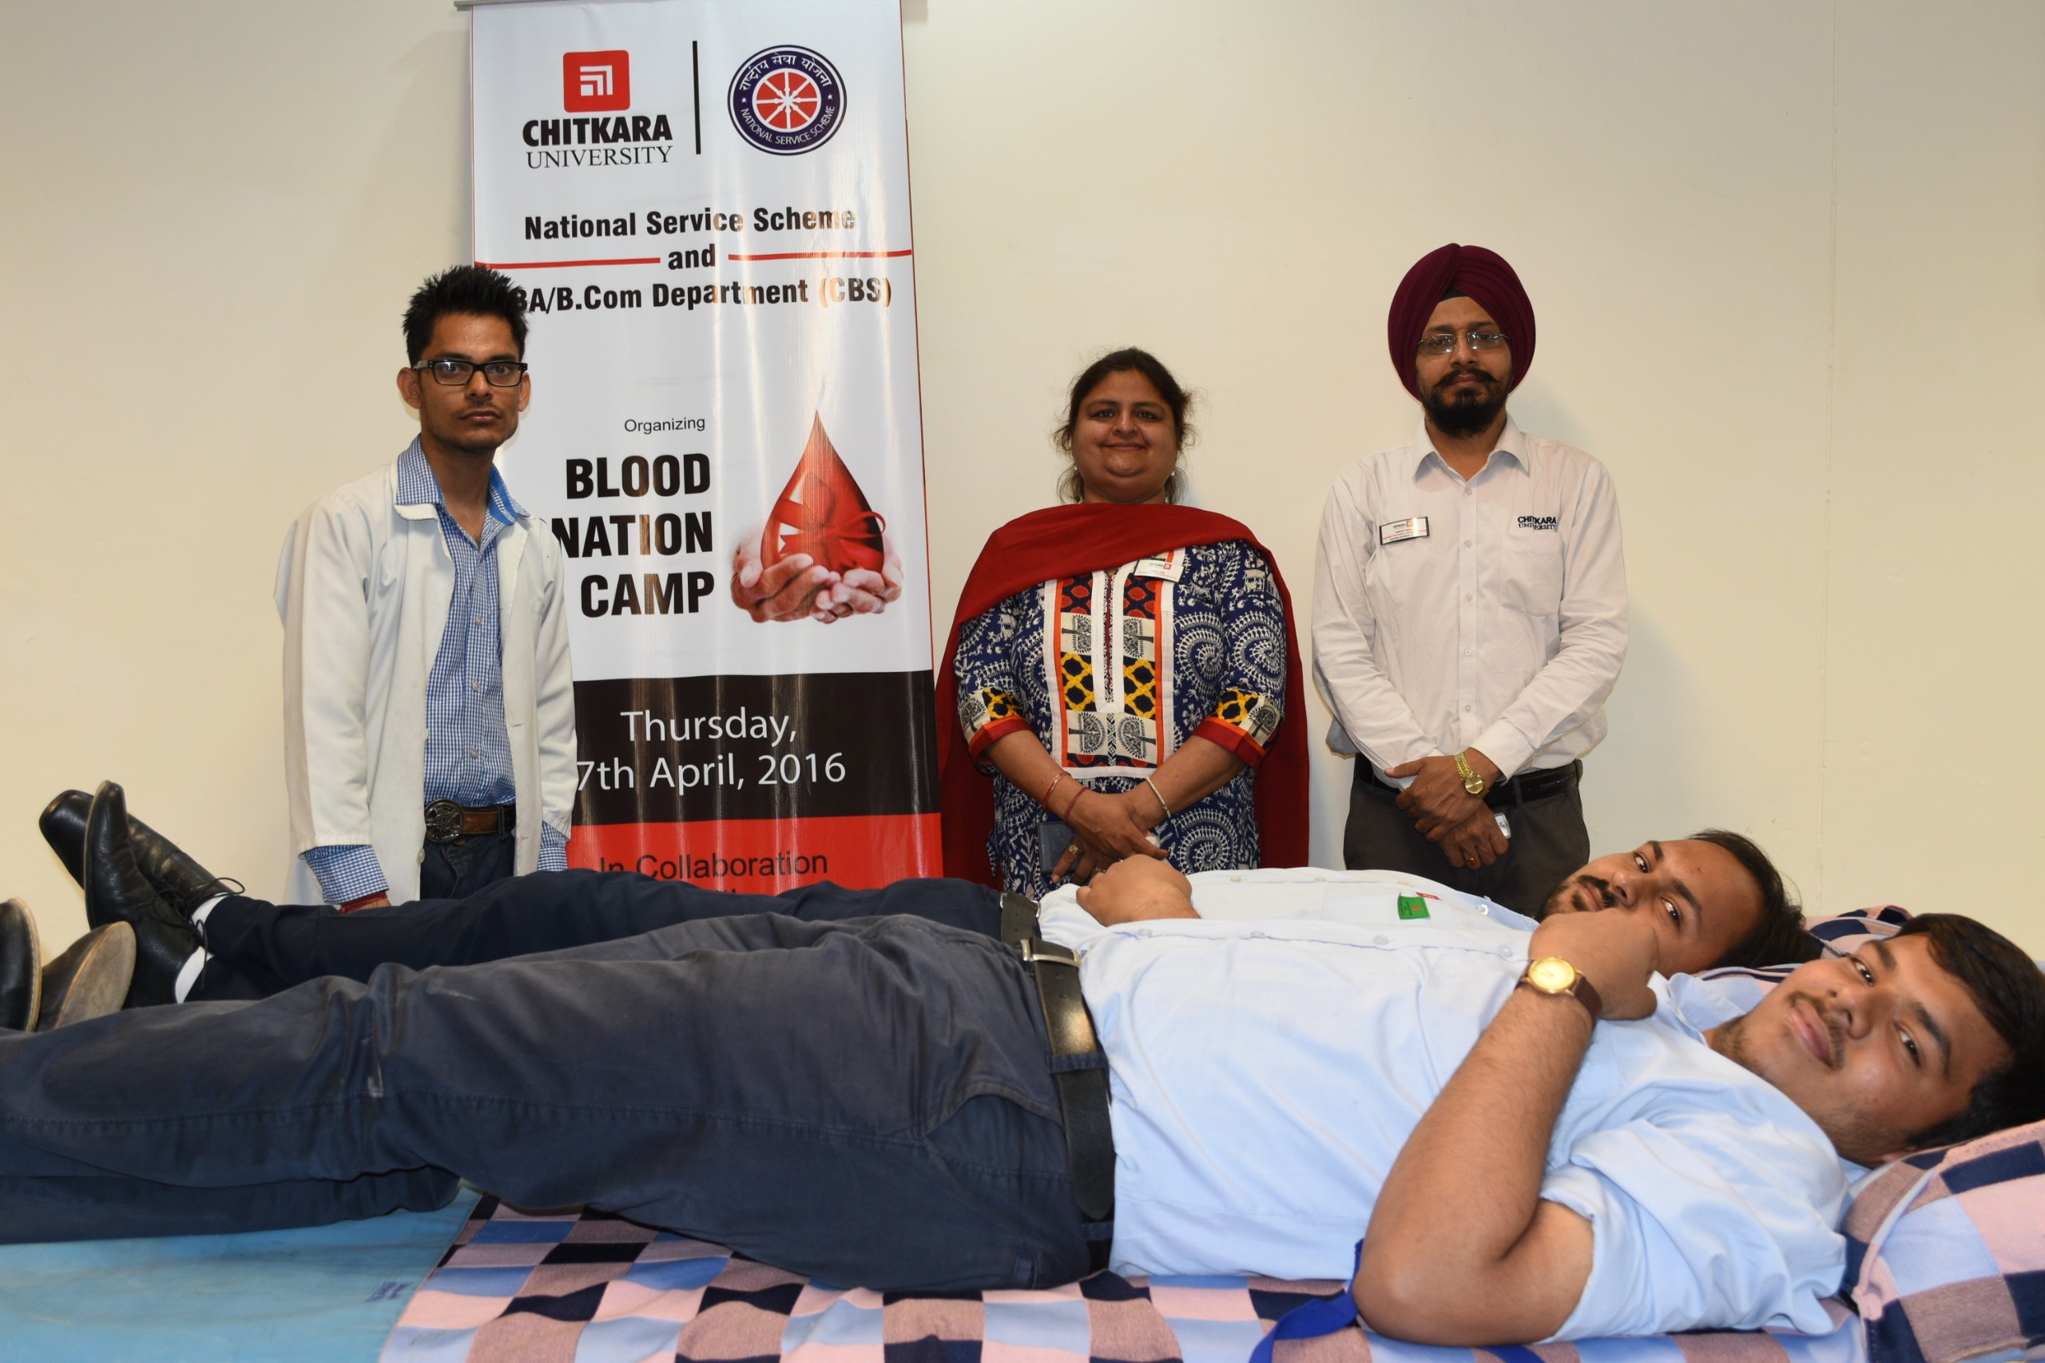
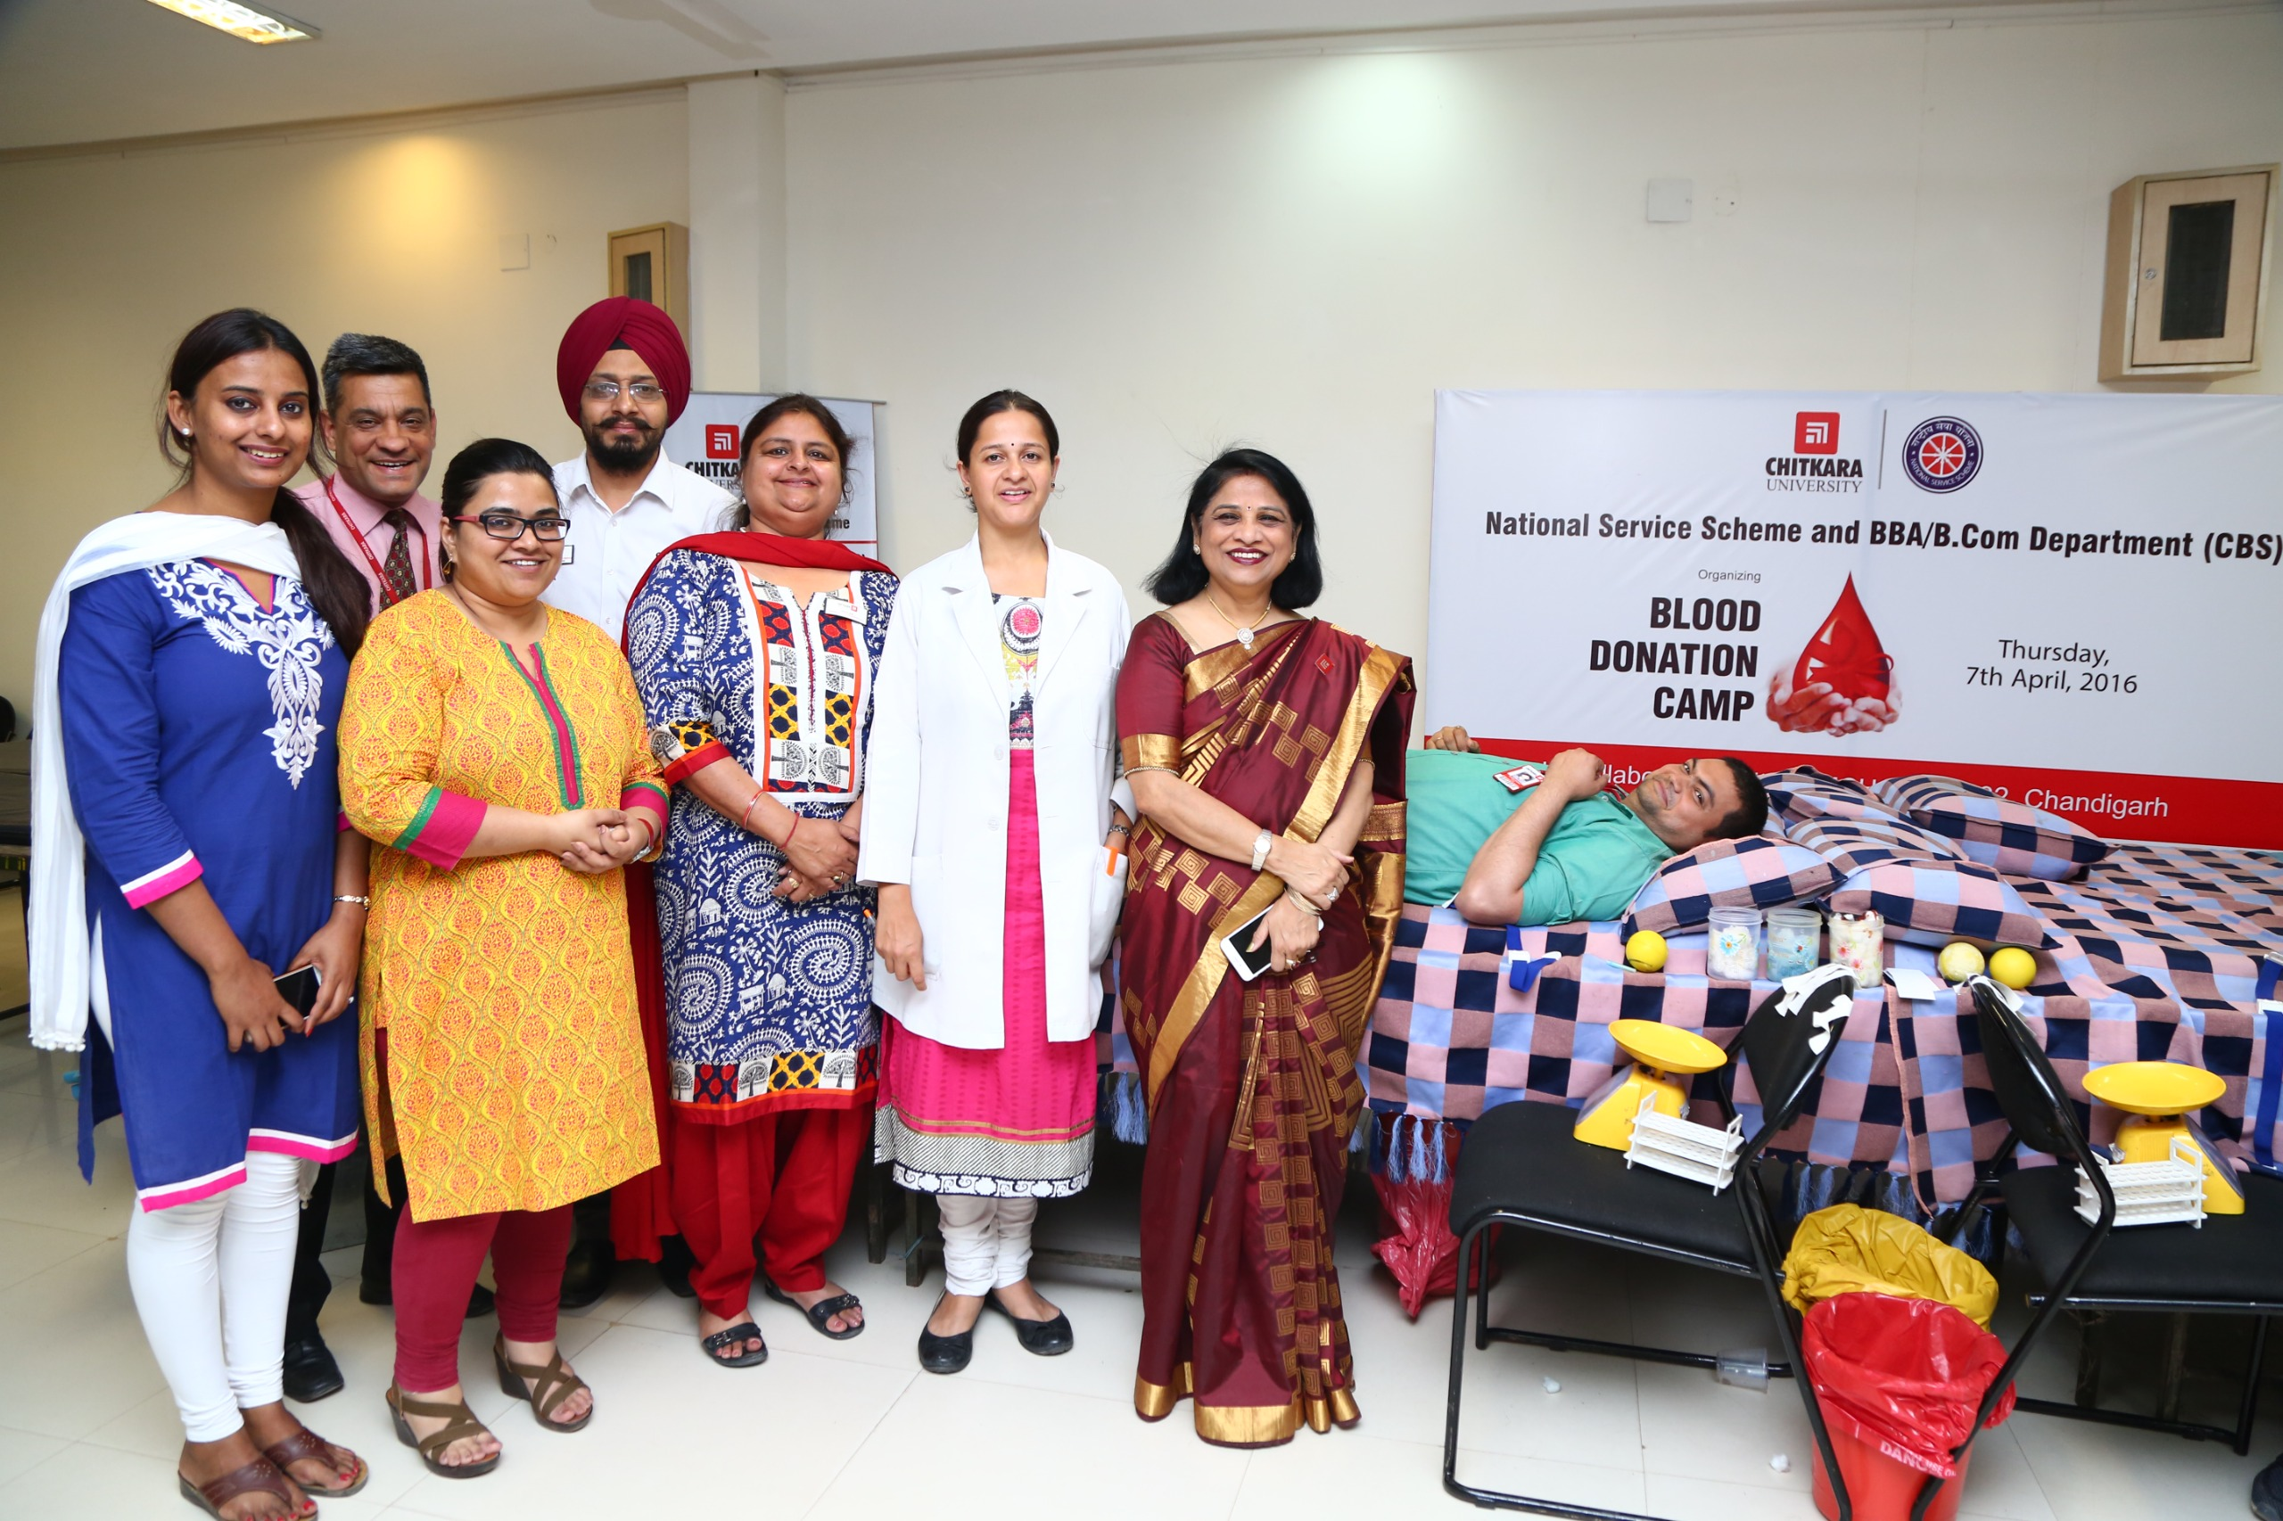
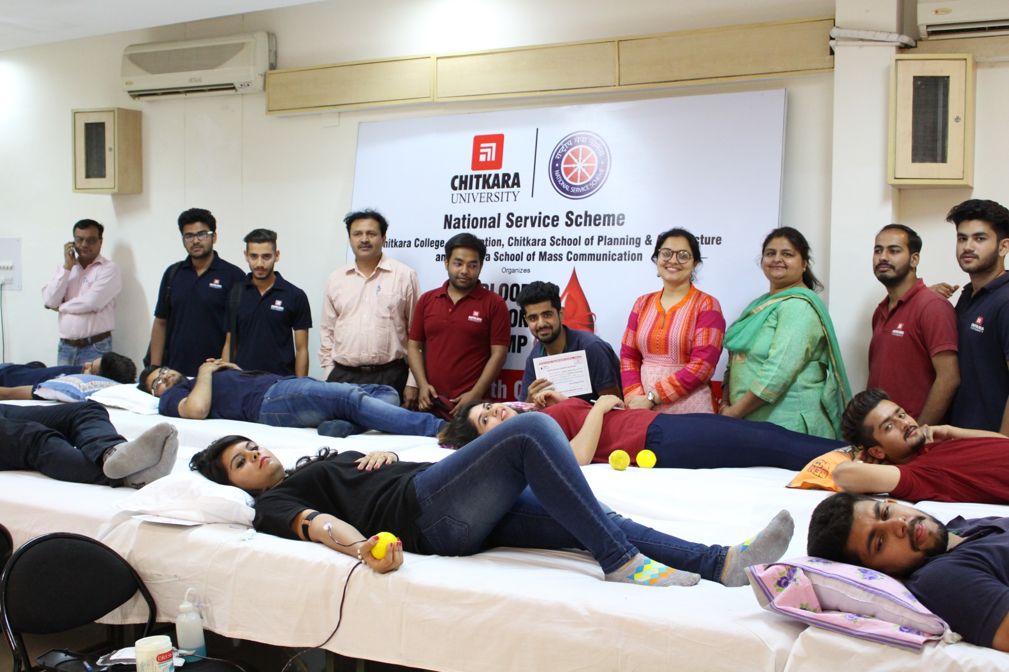
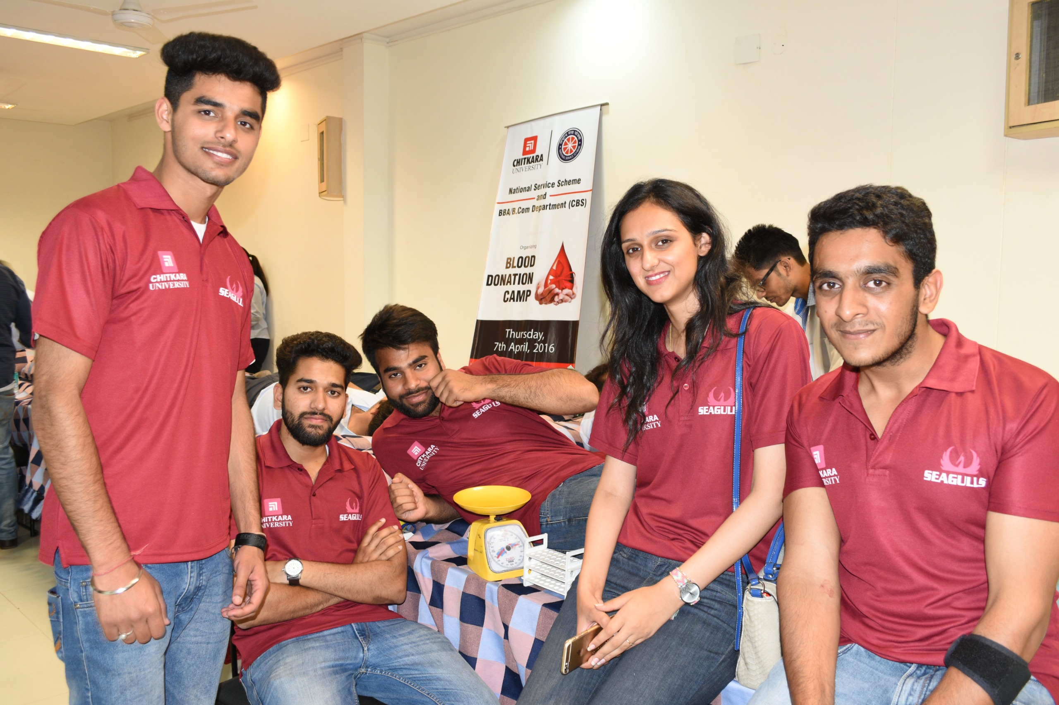
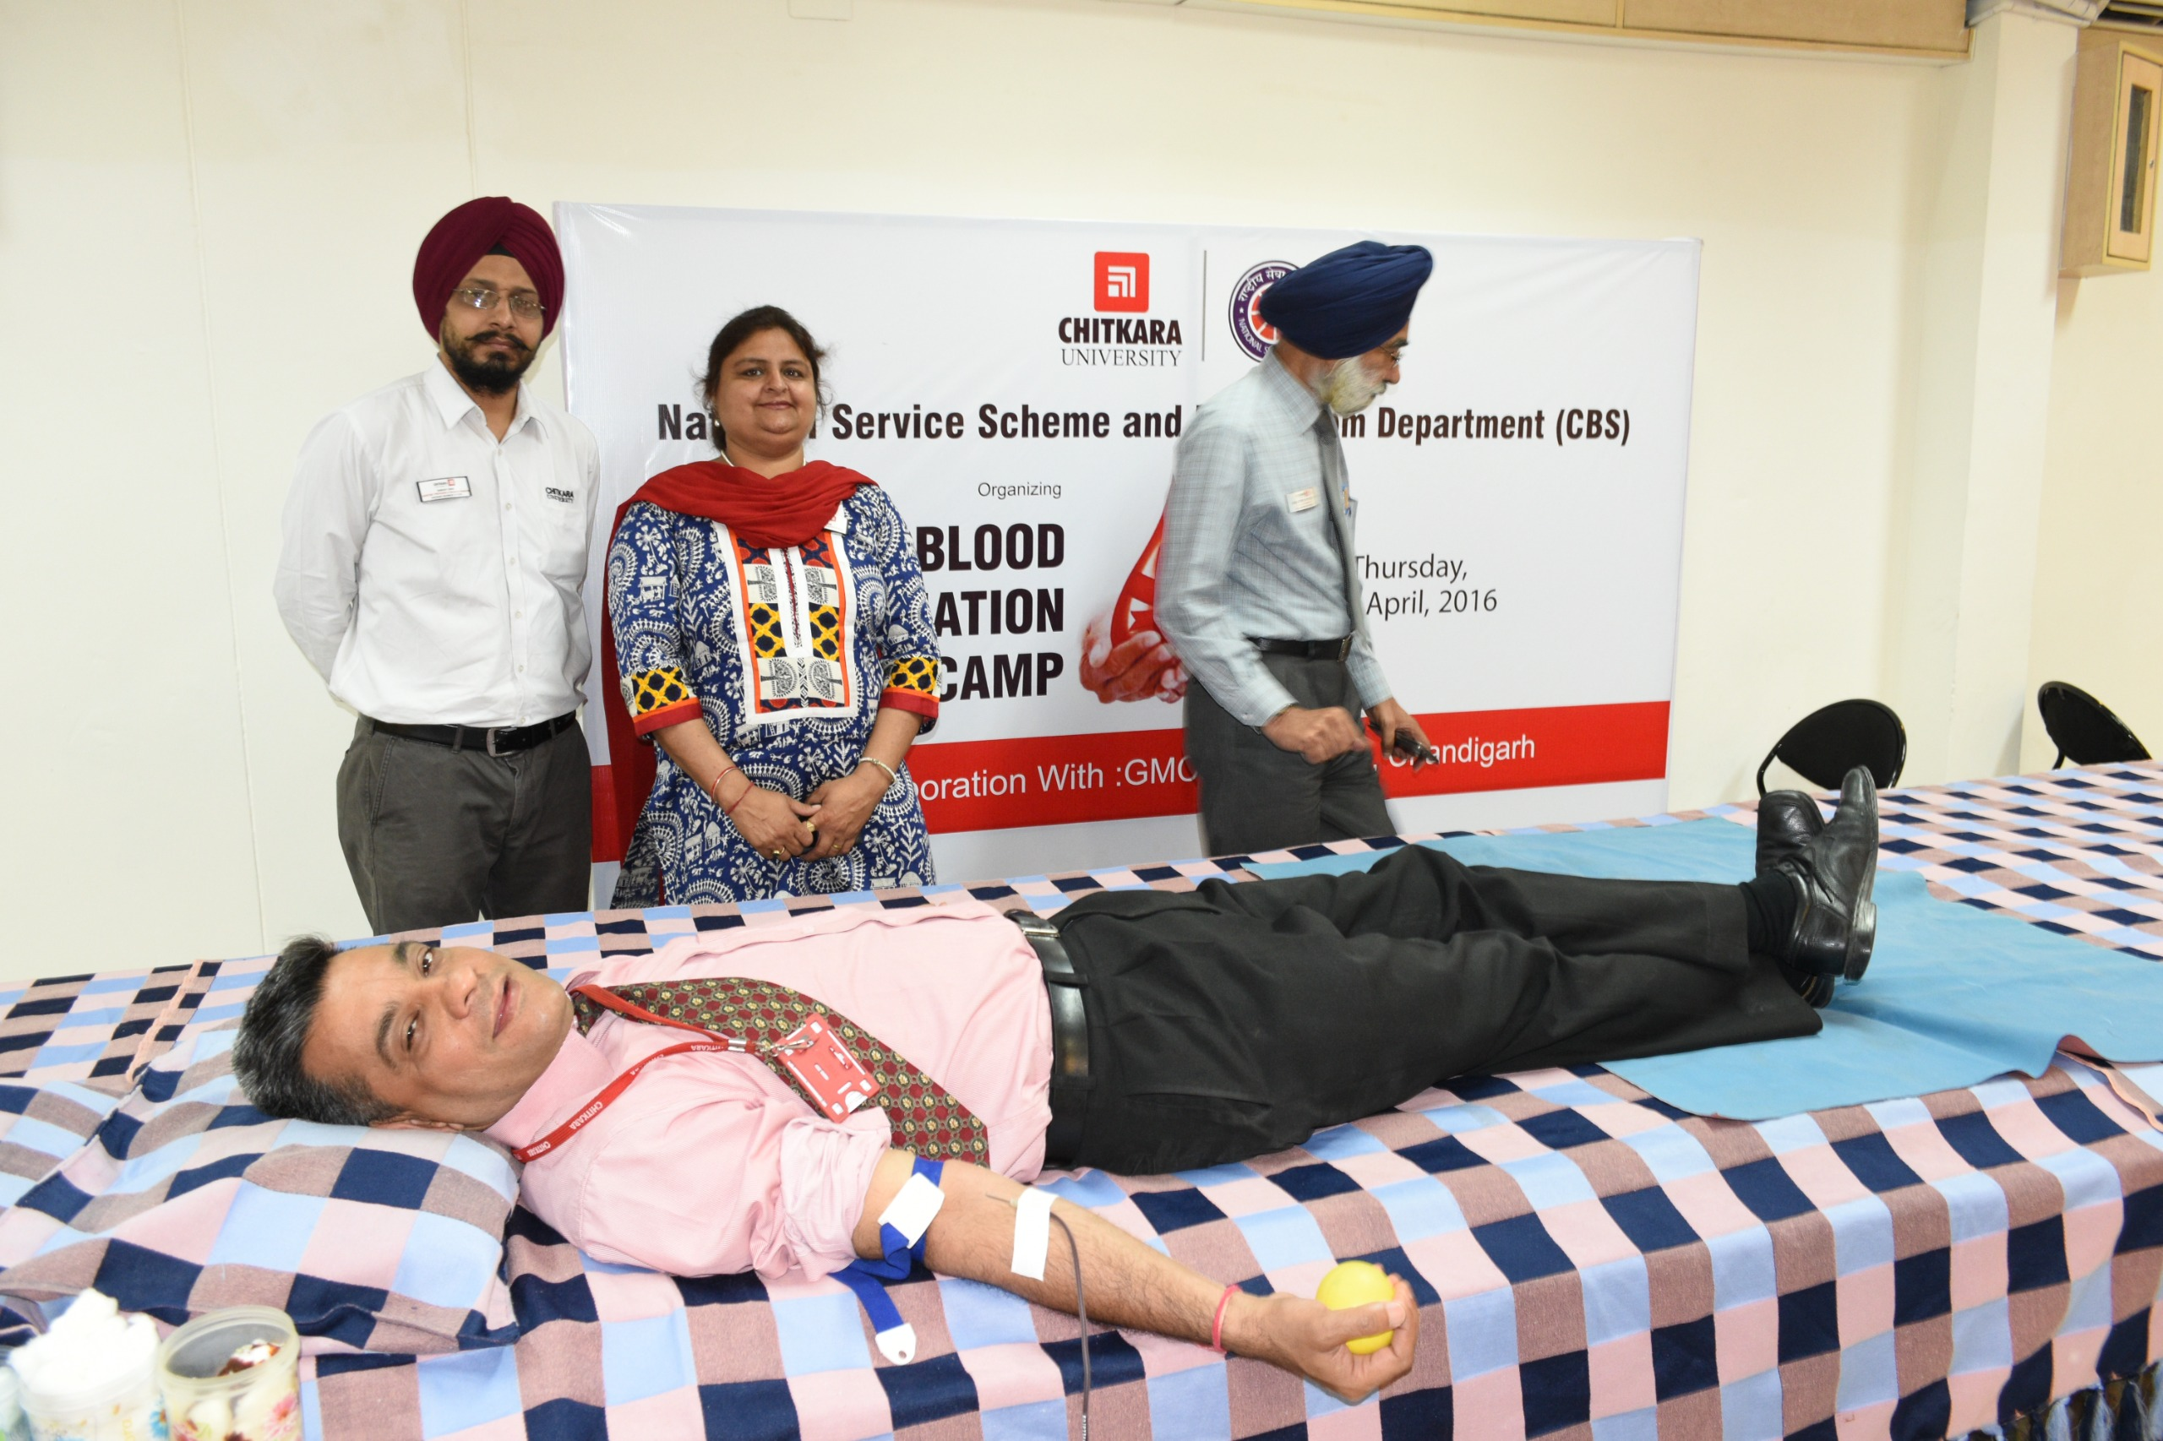
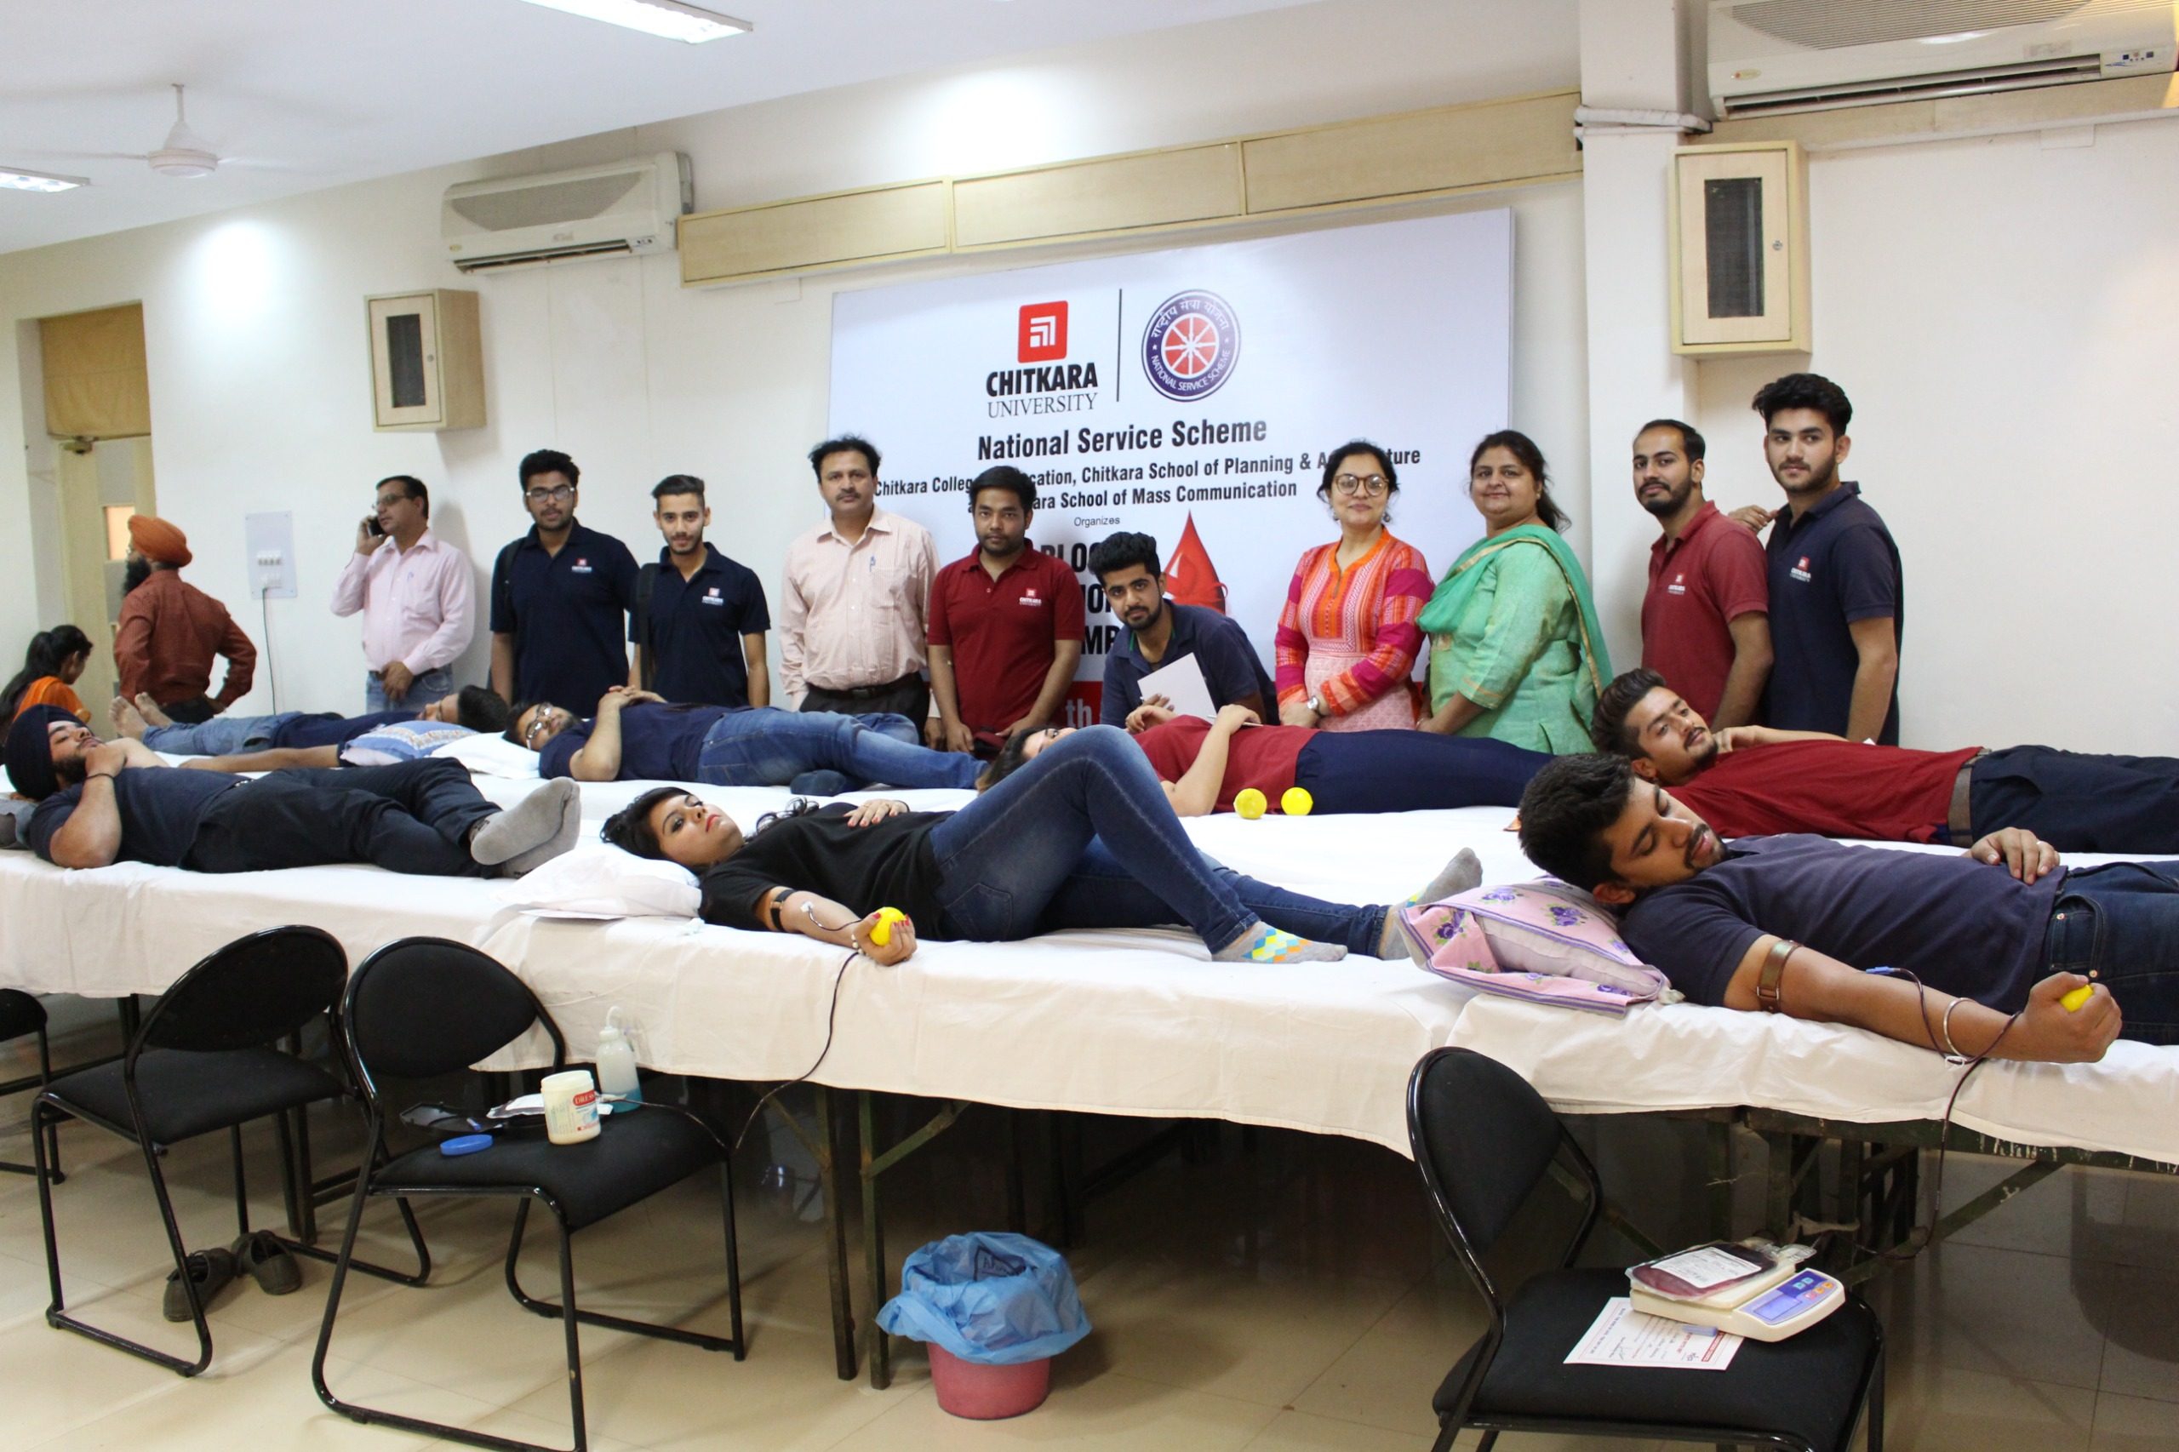
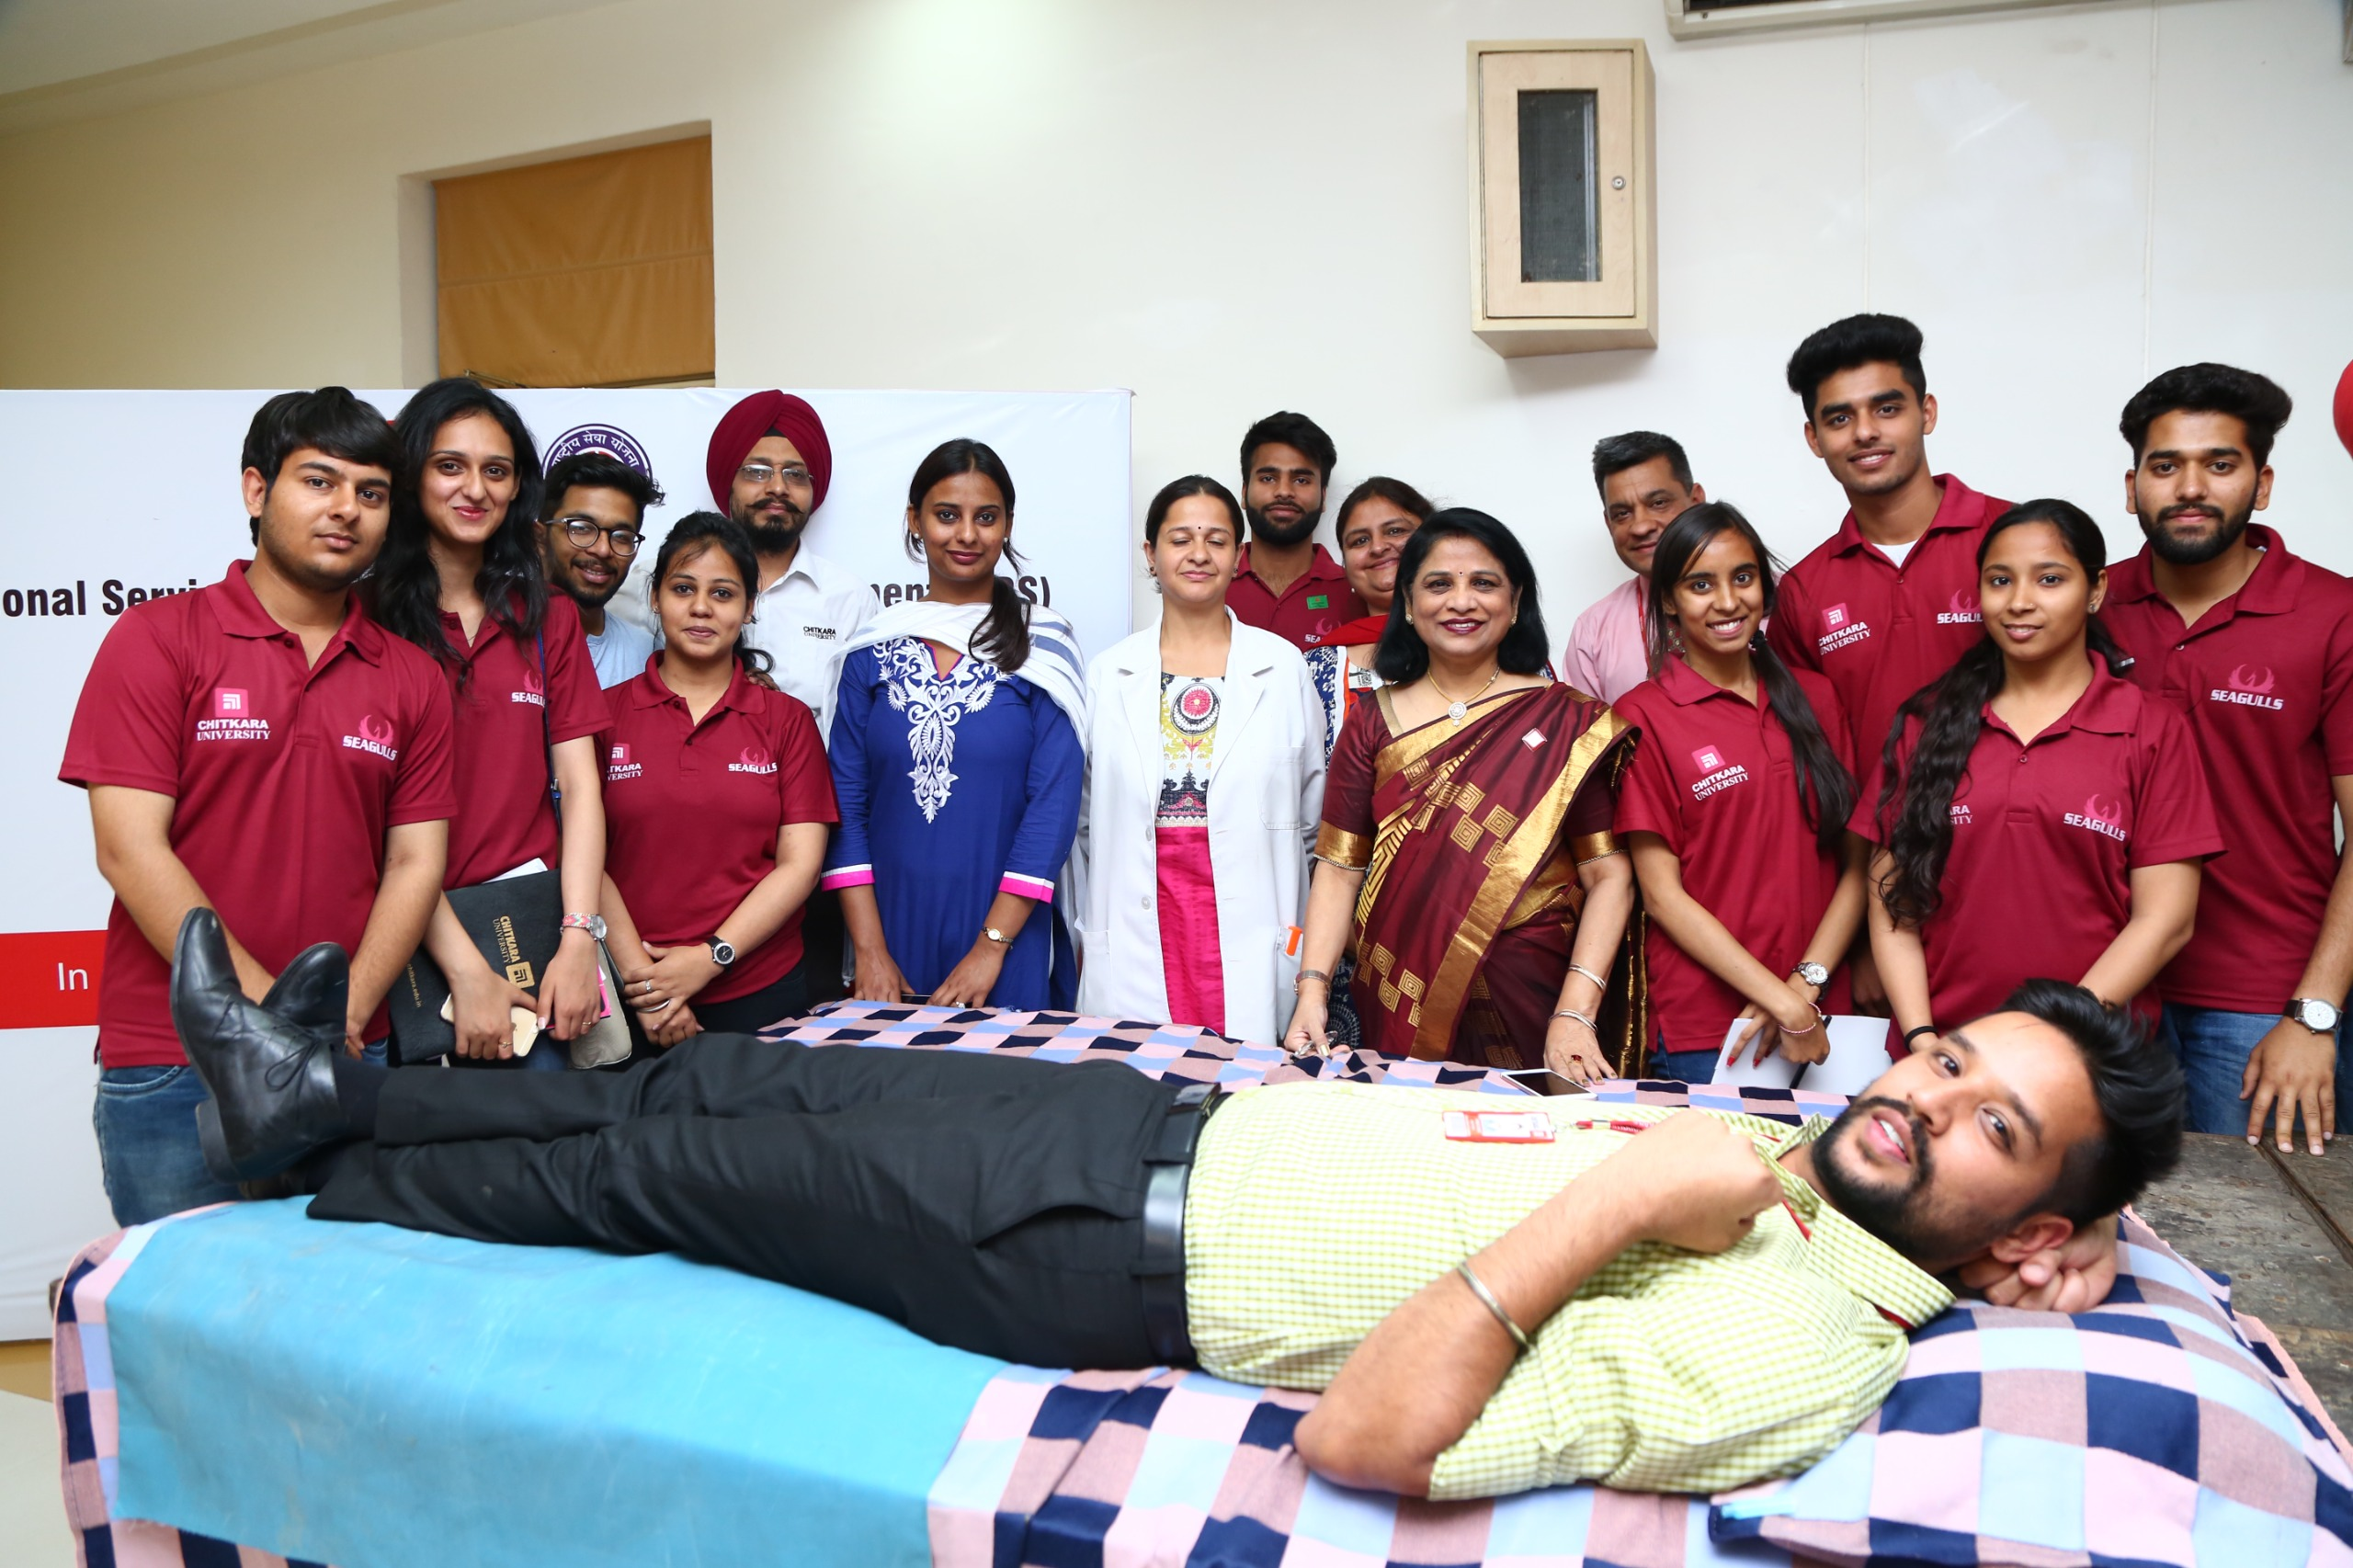
In association with
Govt. Medical College & Hospital
Sector 32,Chandigarh |07th April 2016
In association with
A P Jain Civil Hospital, Rajpura
12th April 2016

Slide 6
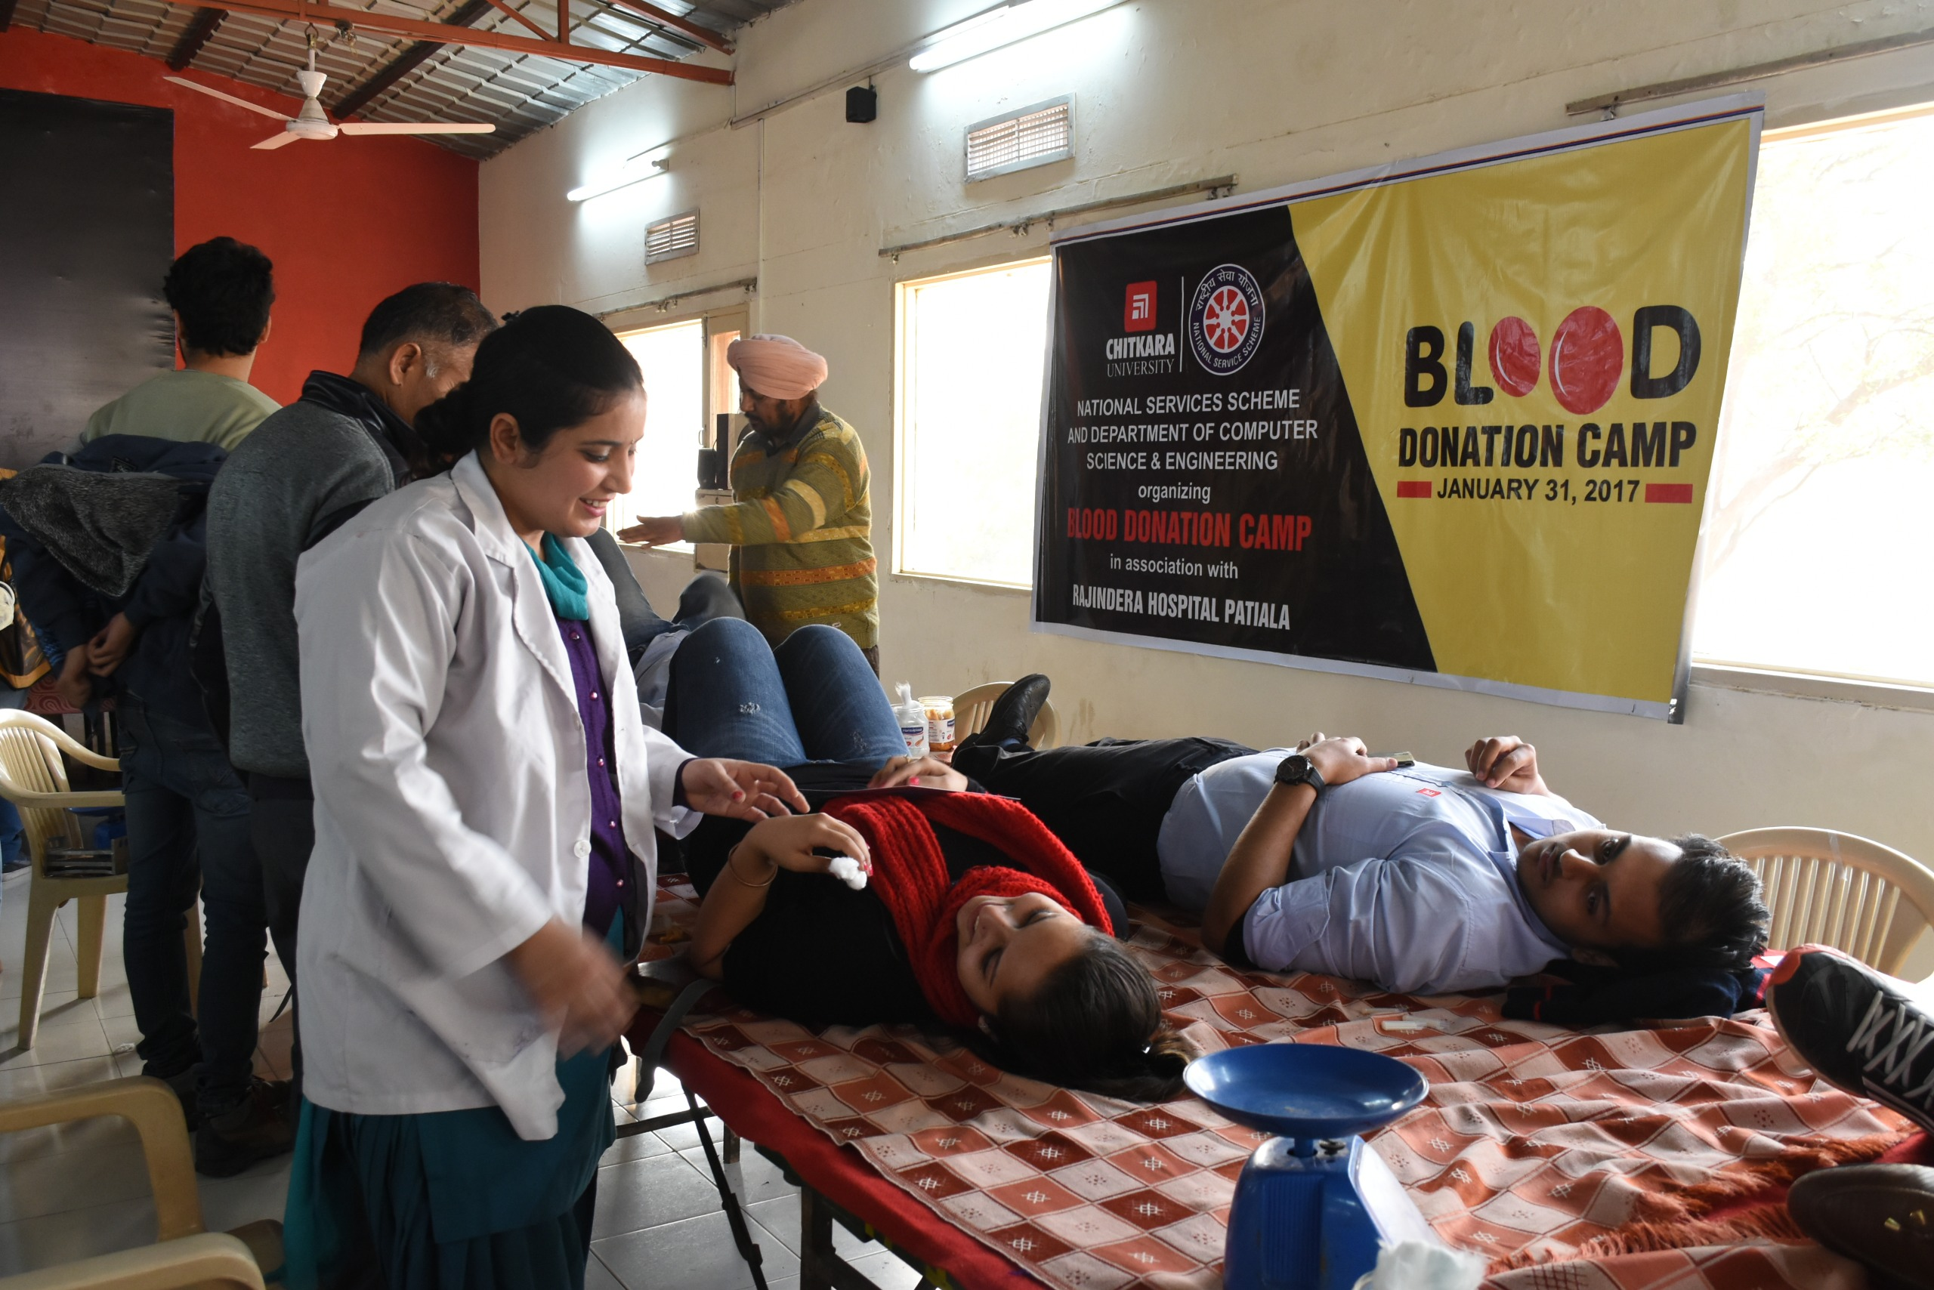
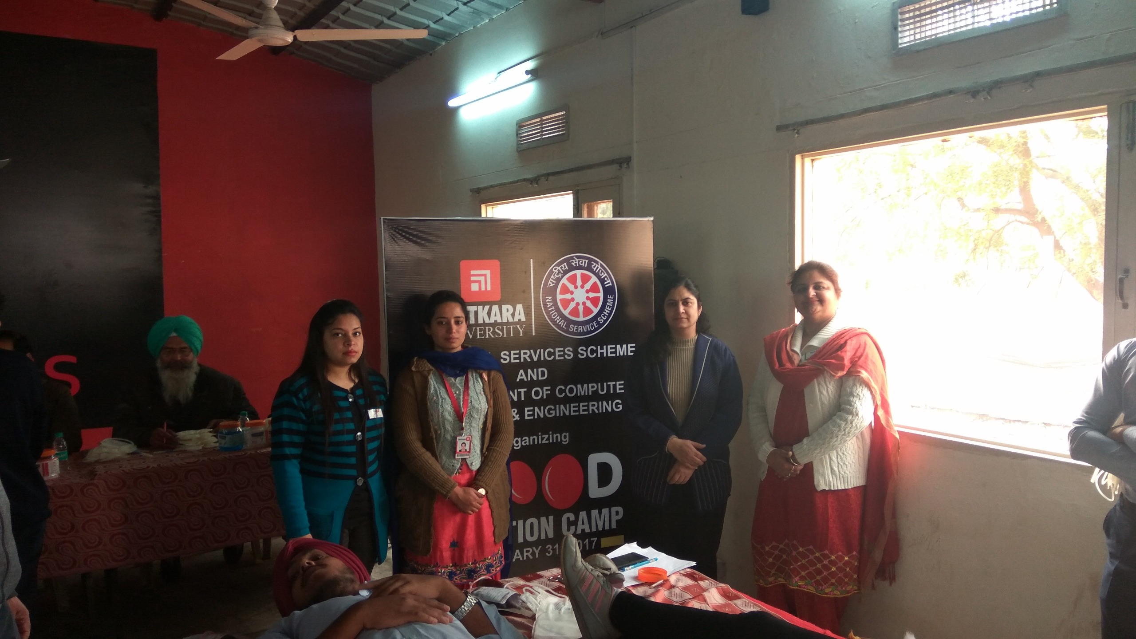
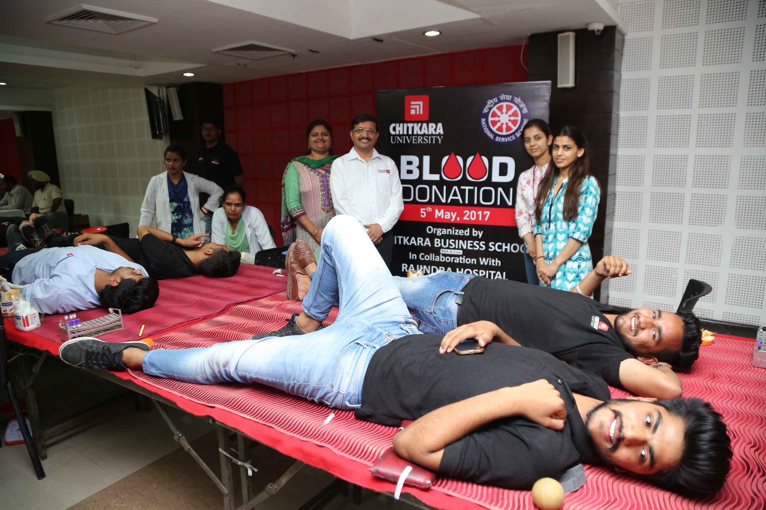
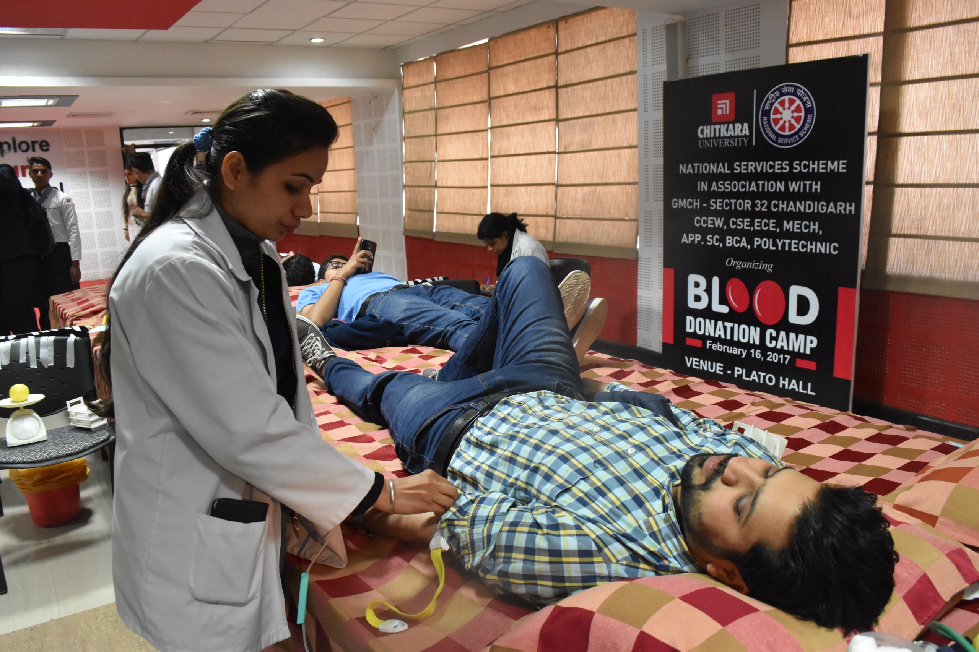
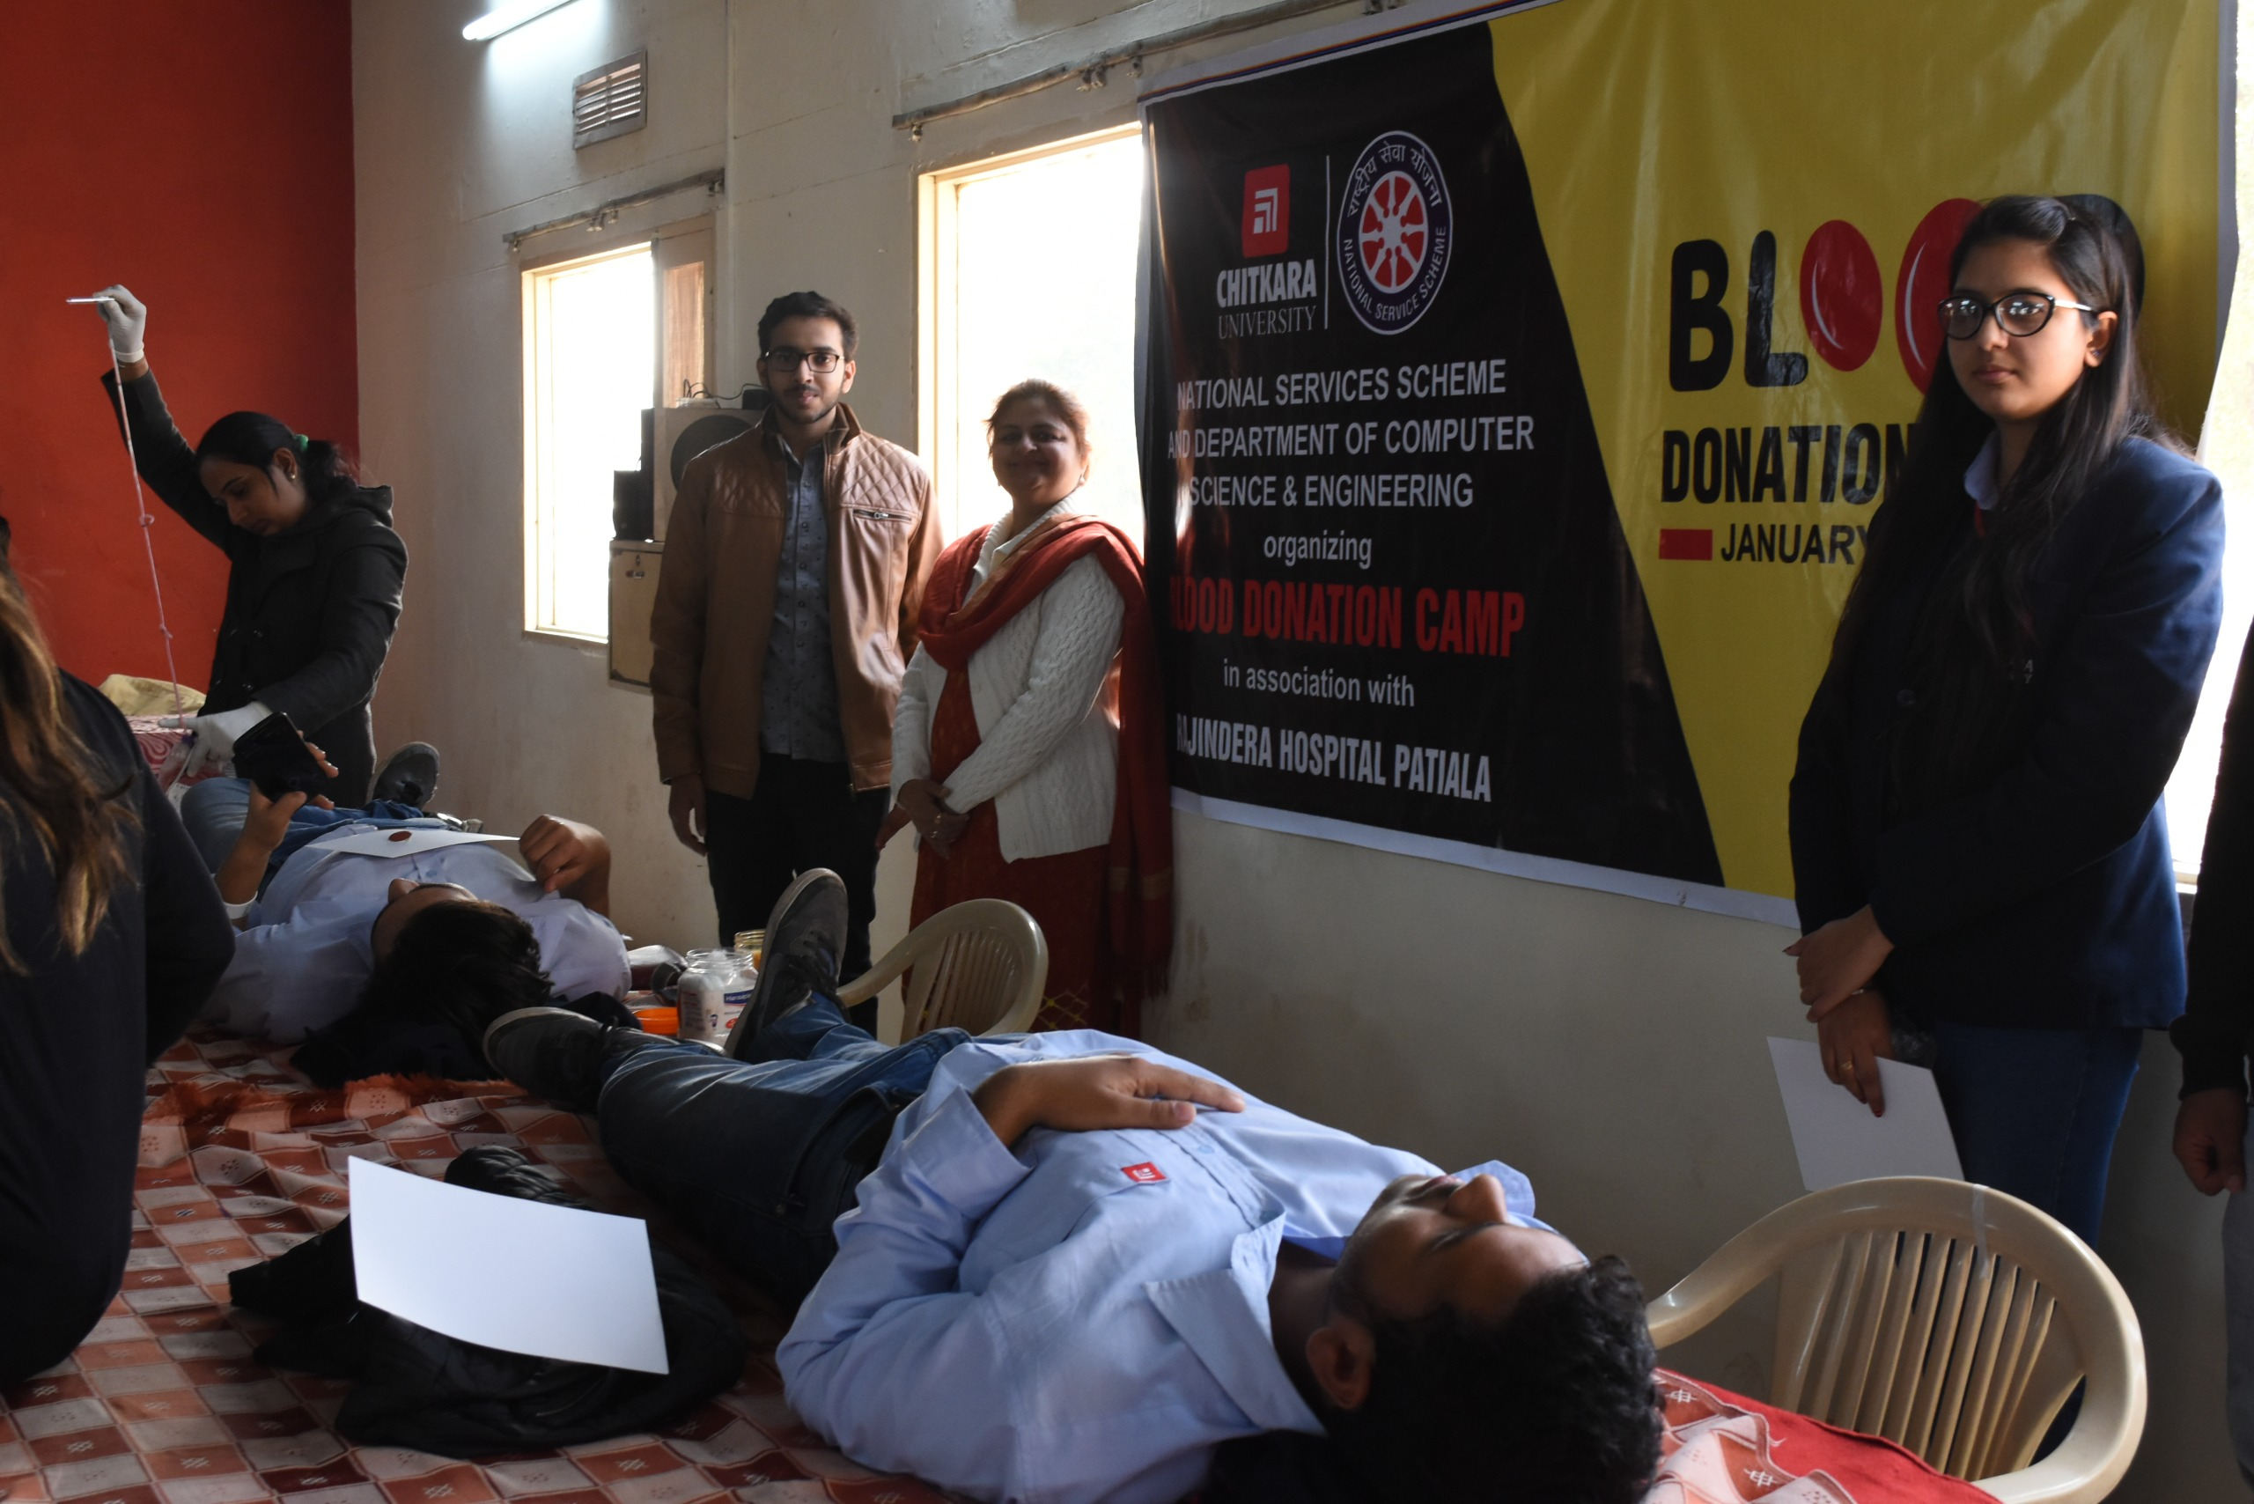
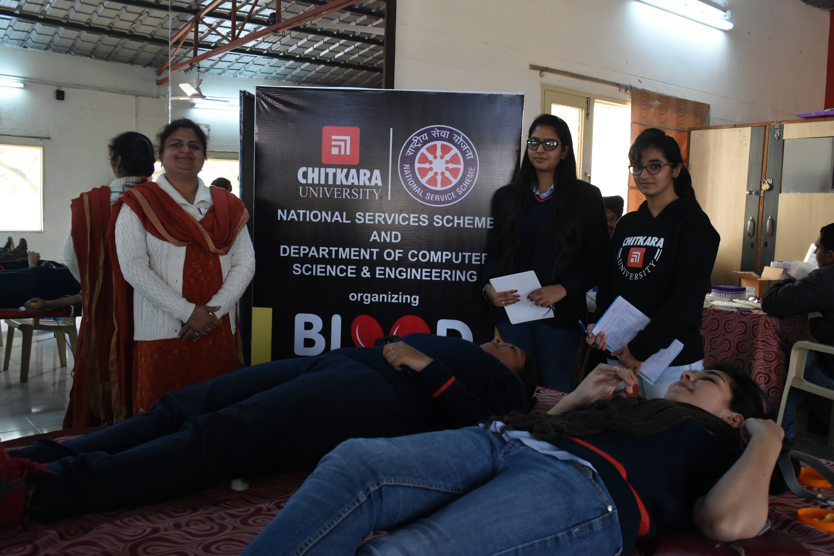
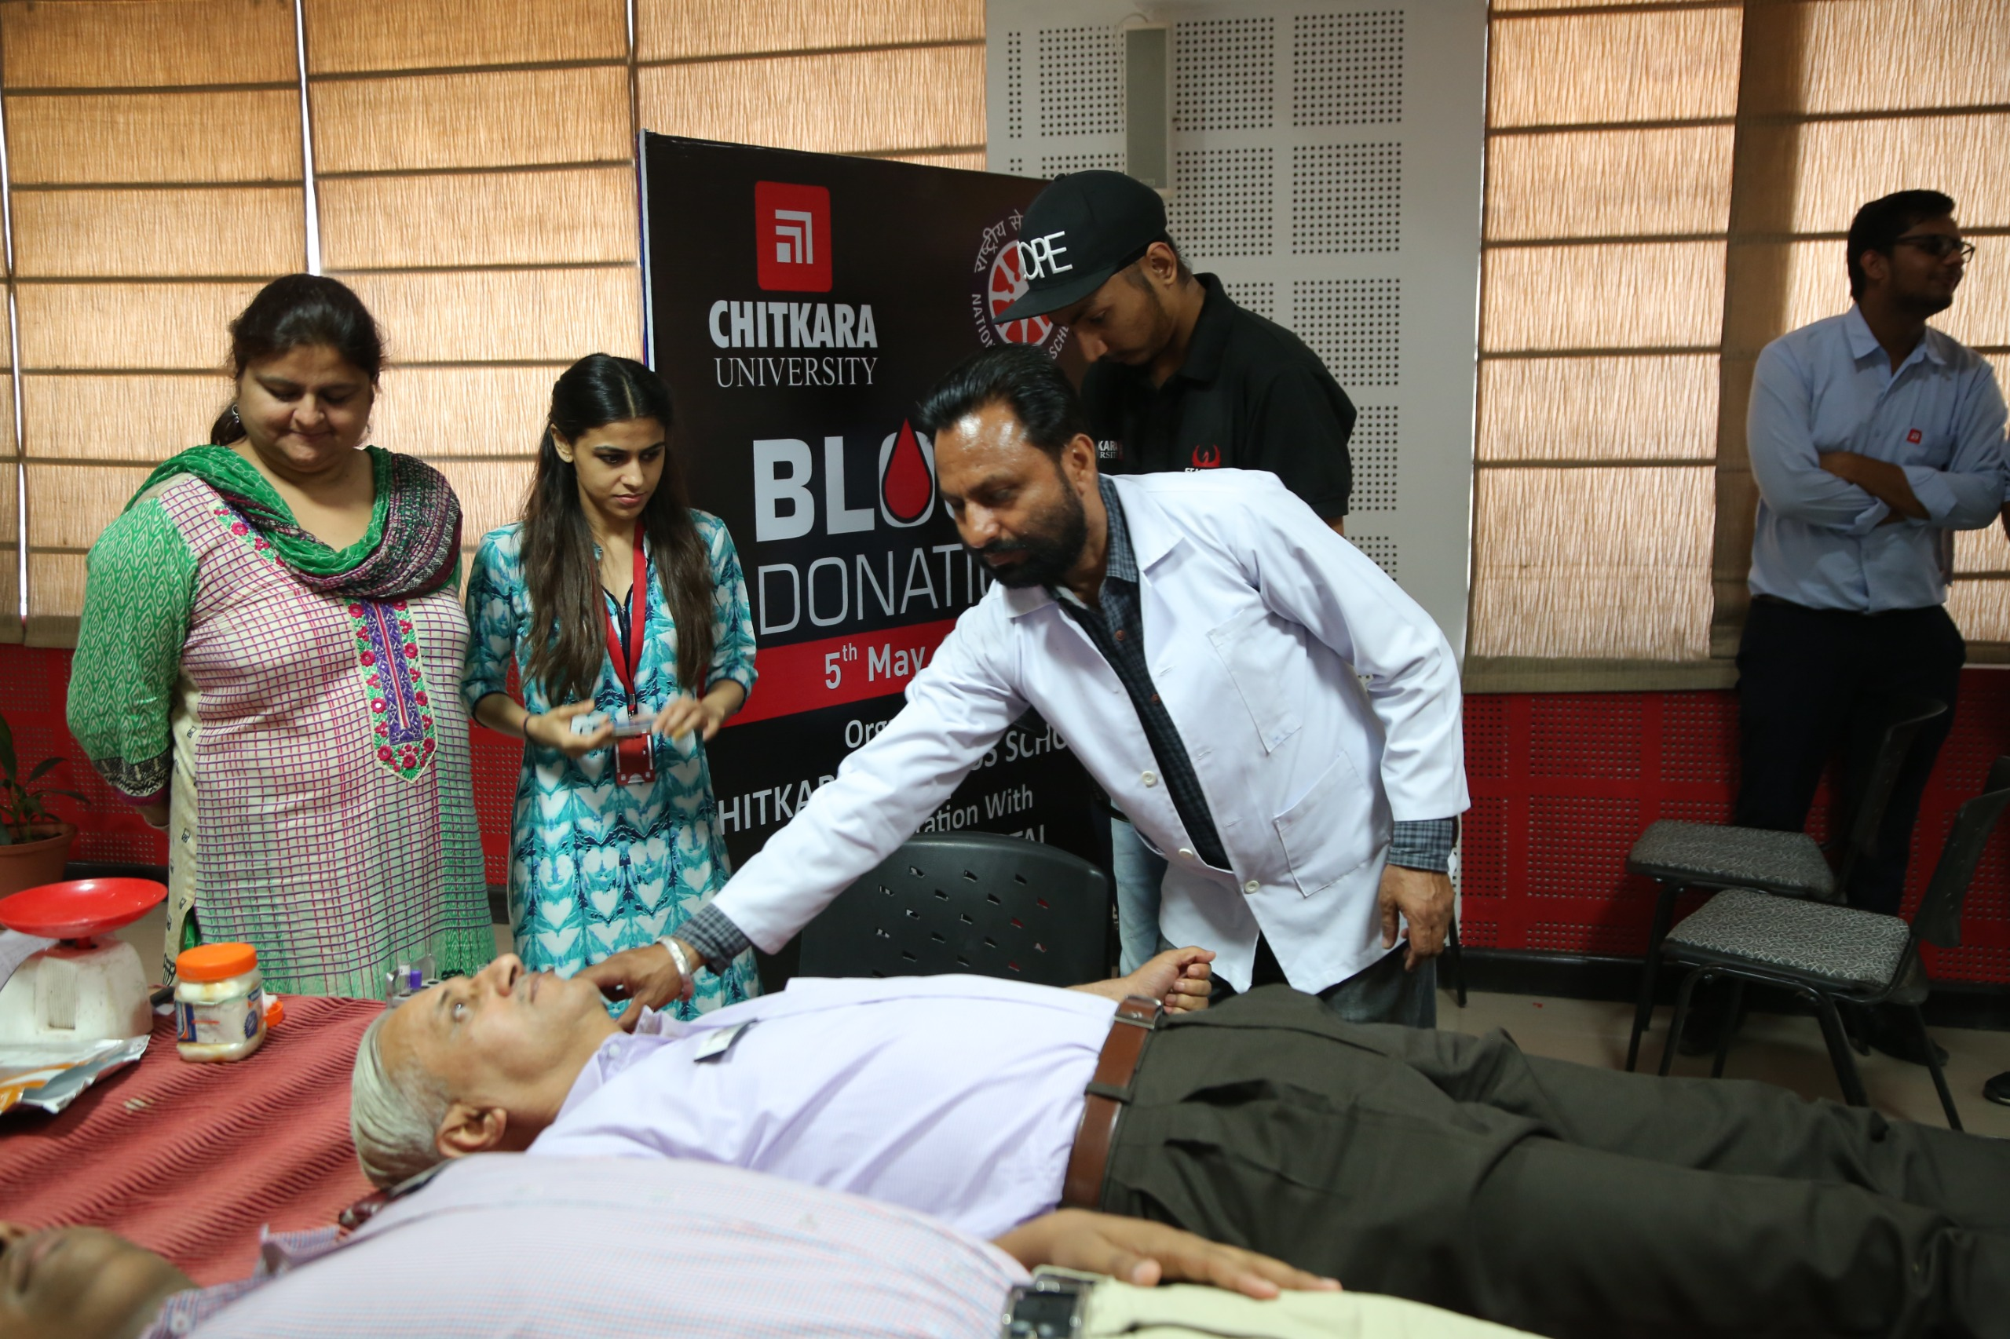
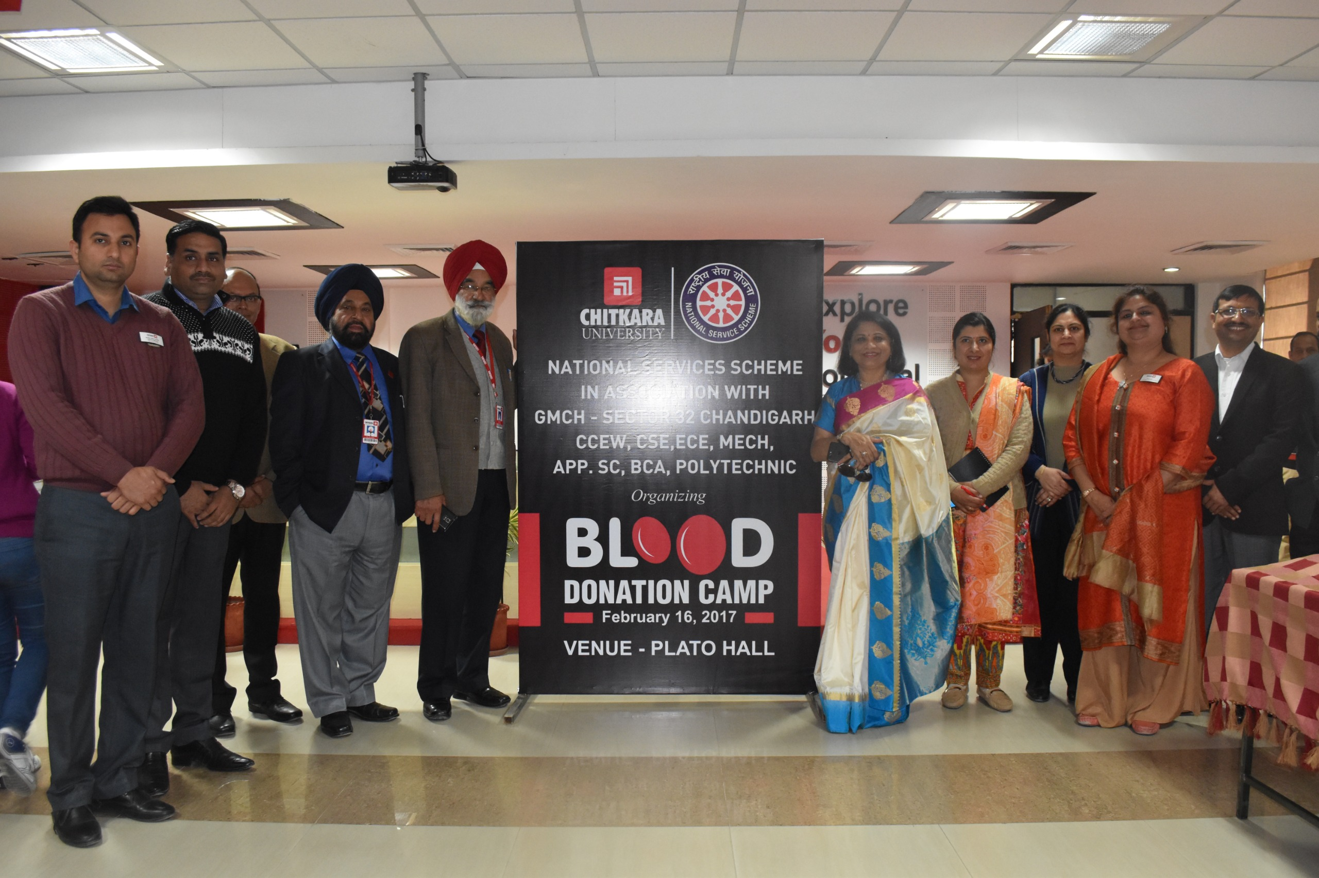
In association with
Rajindra Hospital, Patiala
31st Jan 2017
In association with
Govt. Medical College & Hospital
Sector 32,Chandigarh | 16th Feb 2017

Slide 7
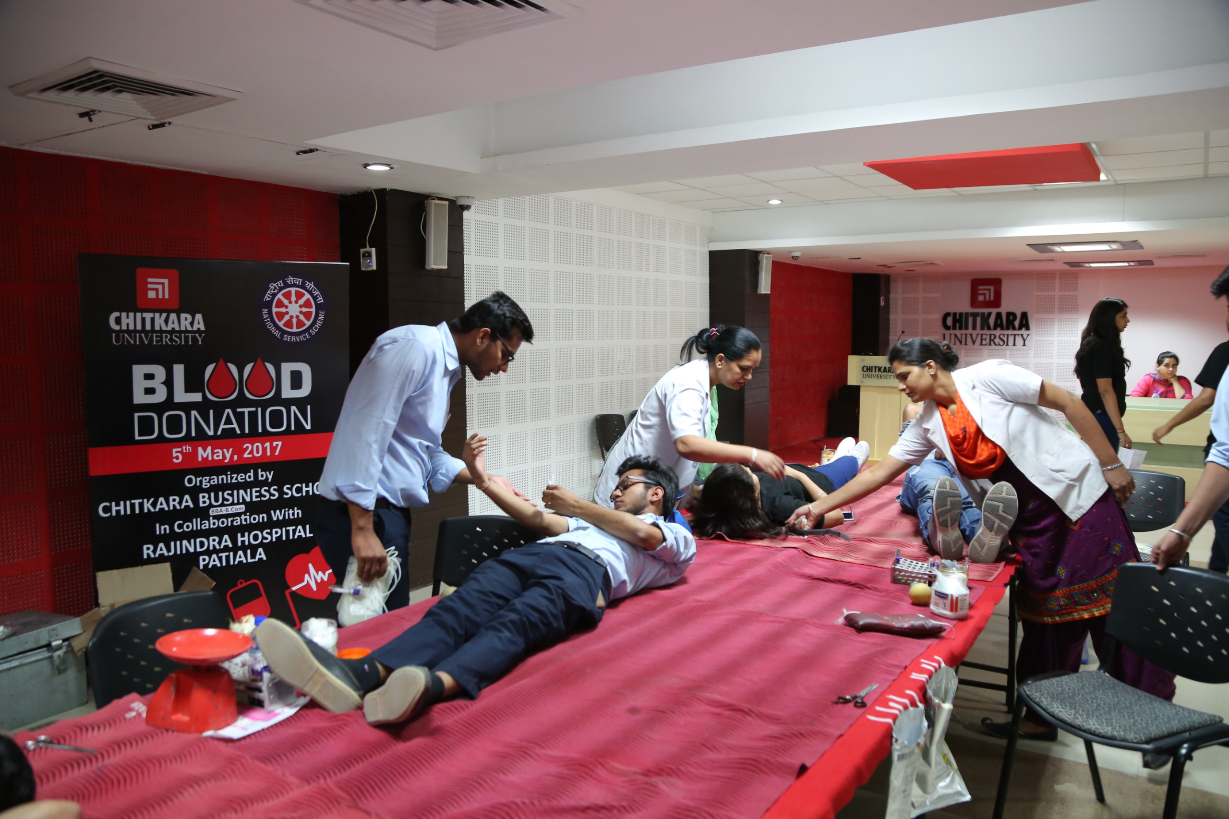
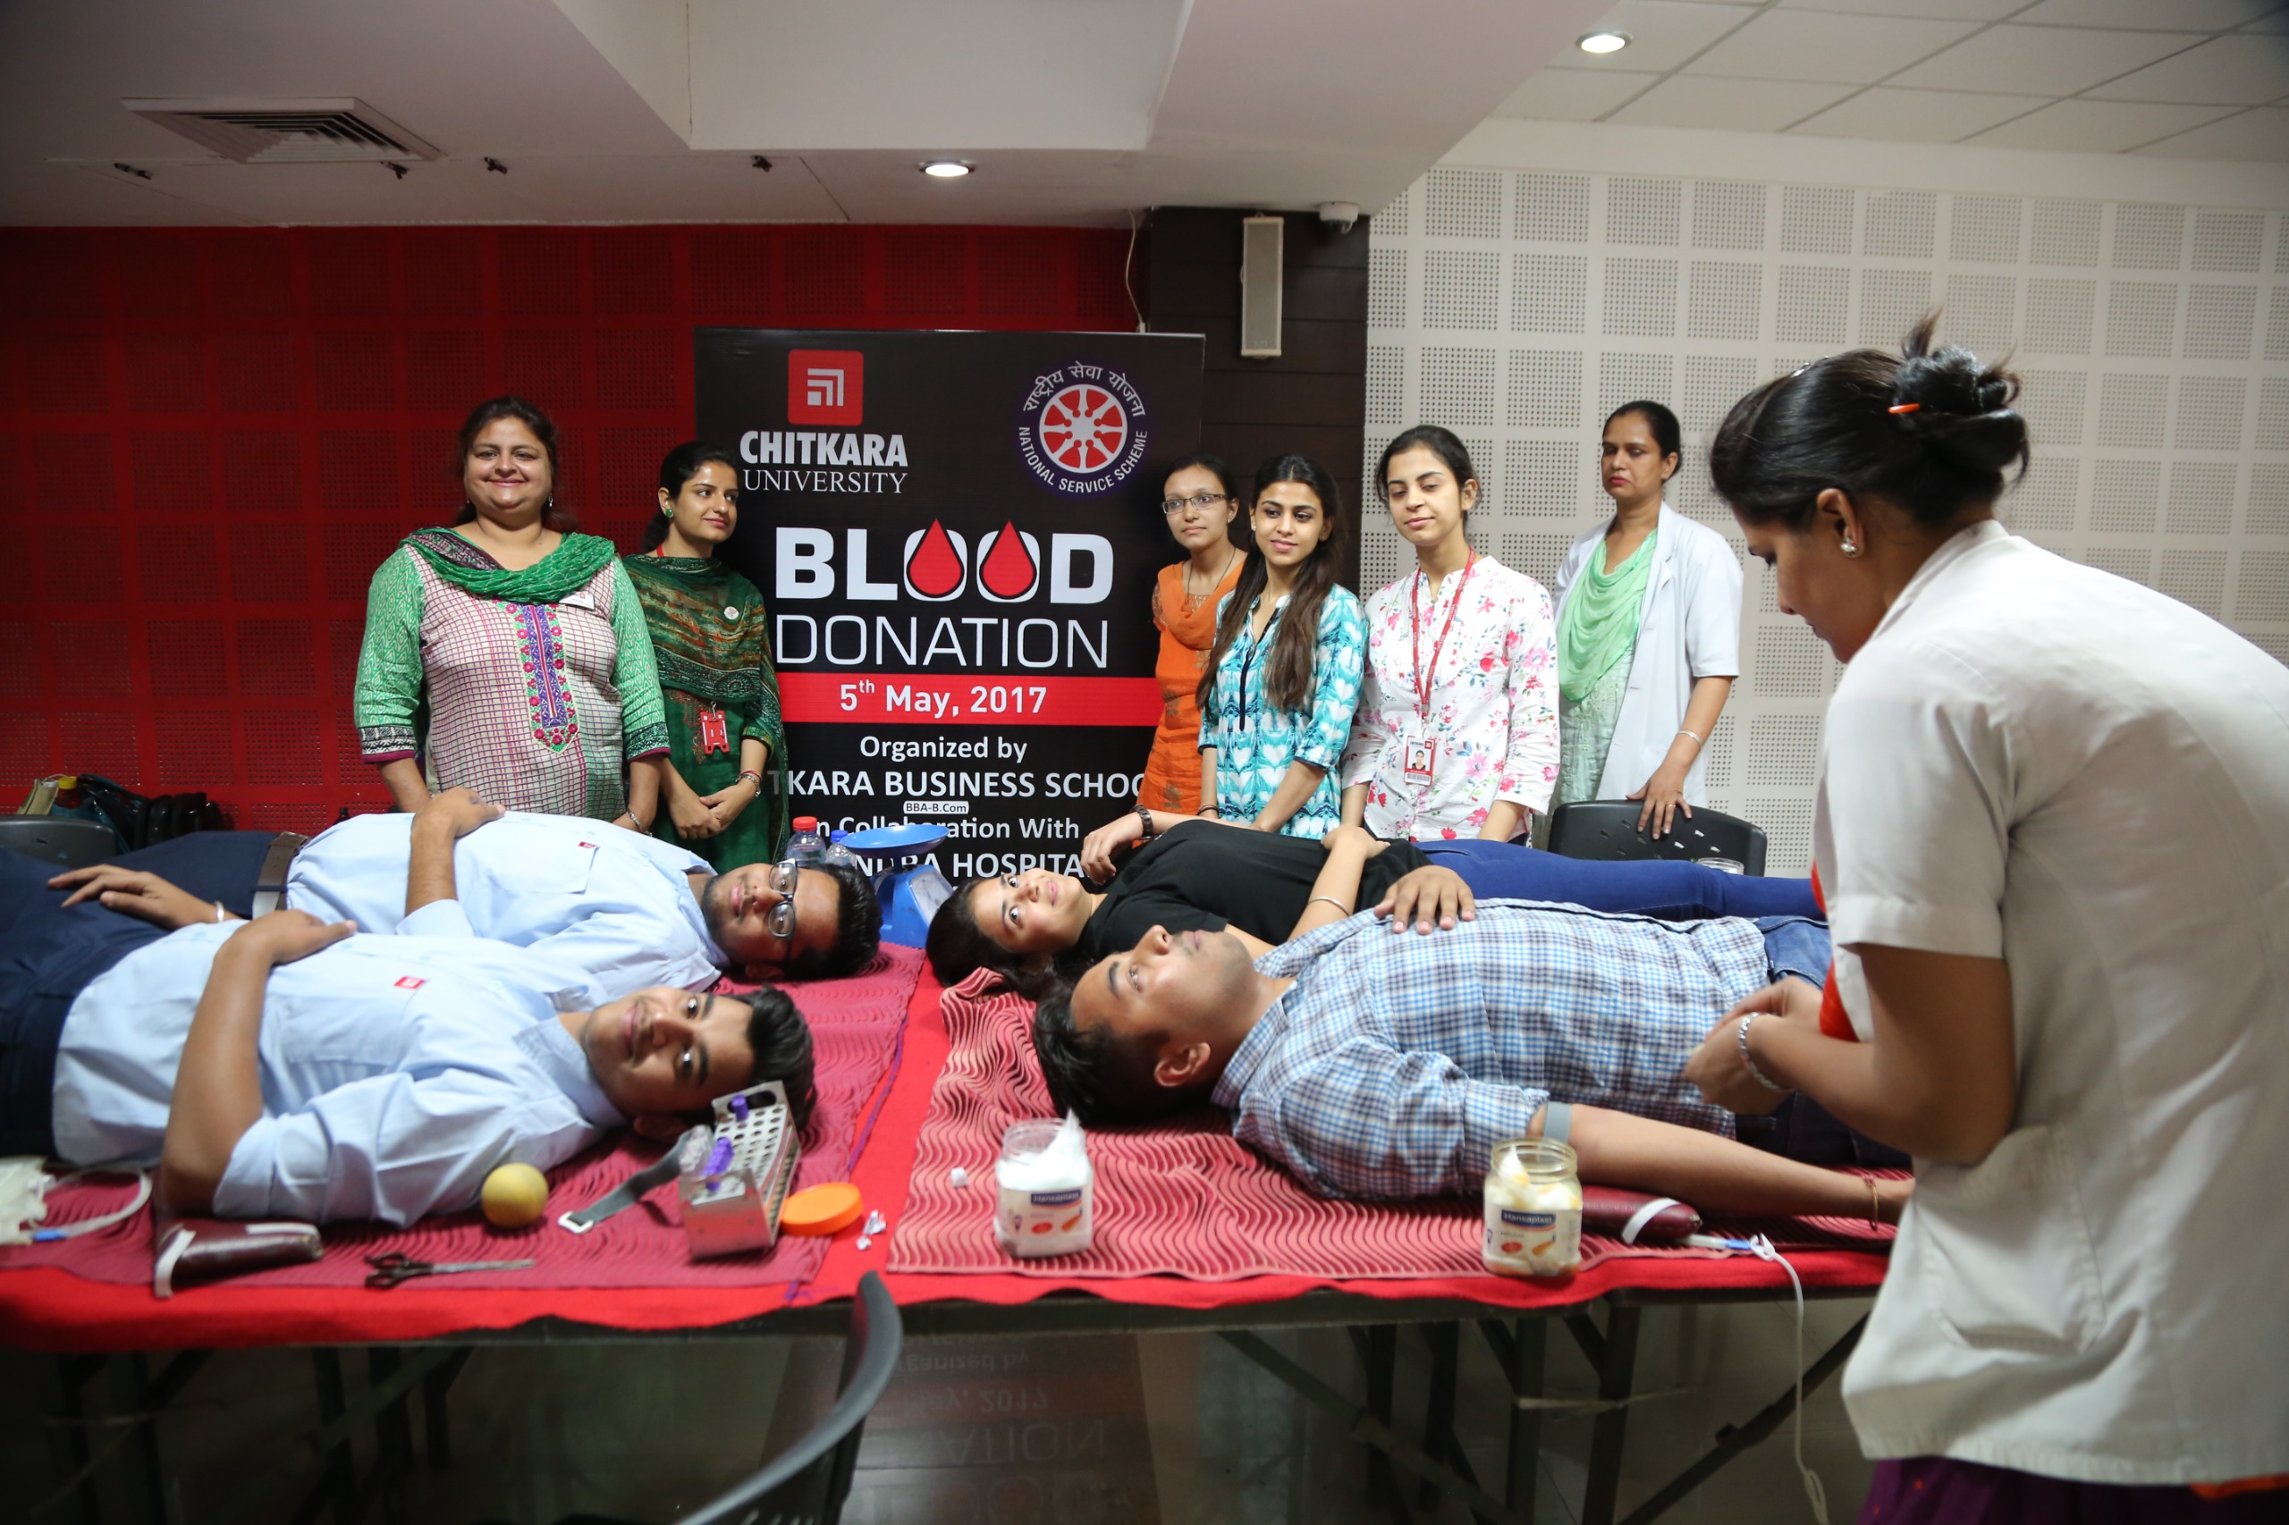
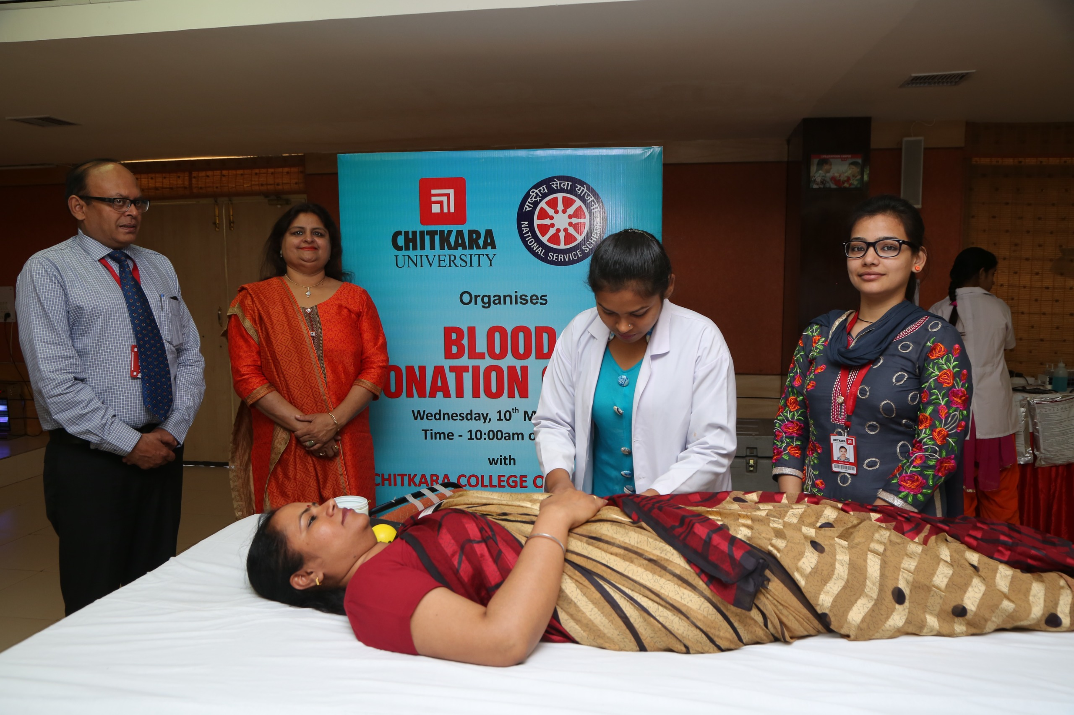
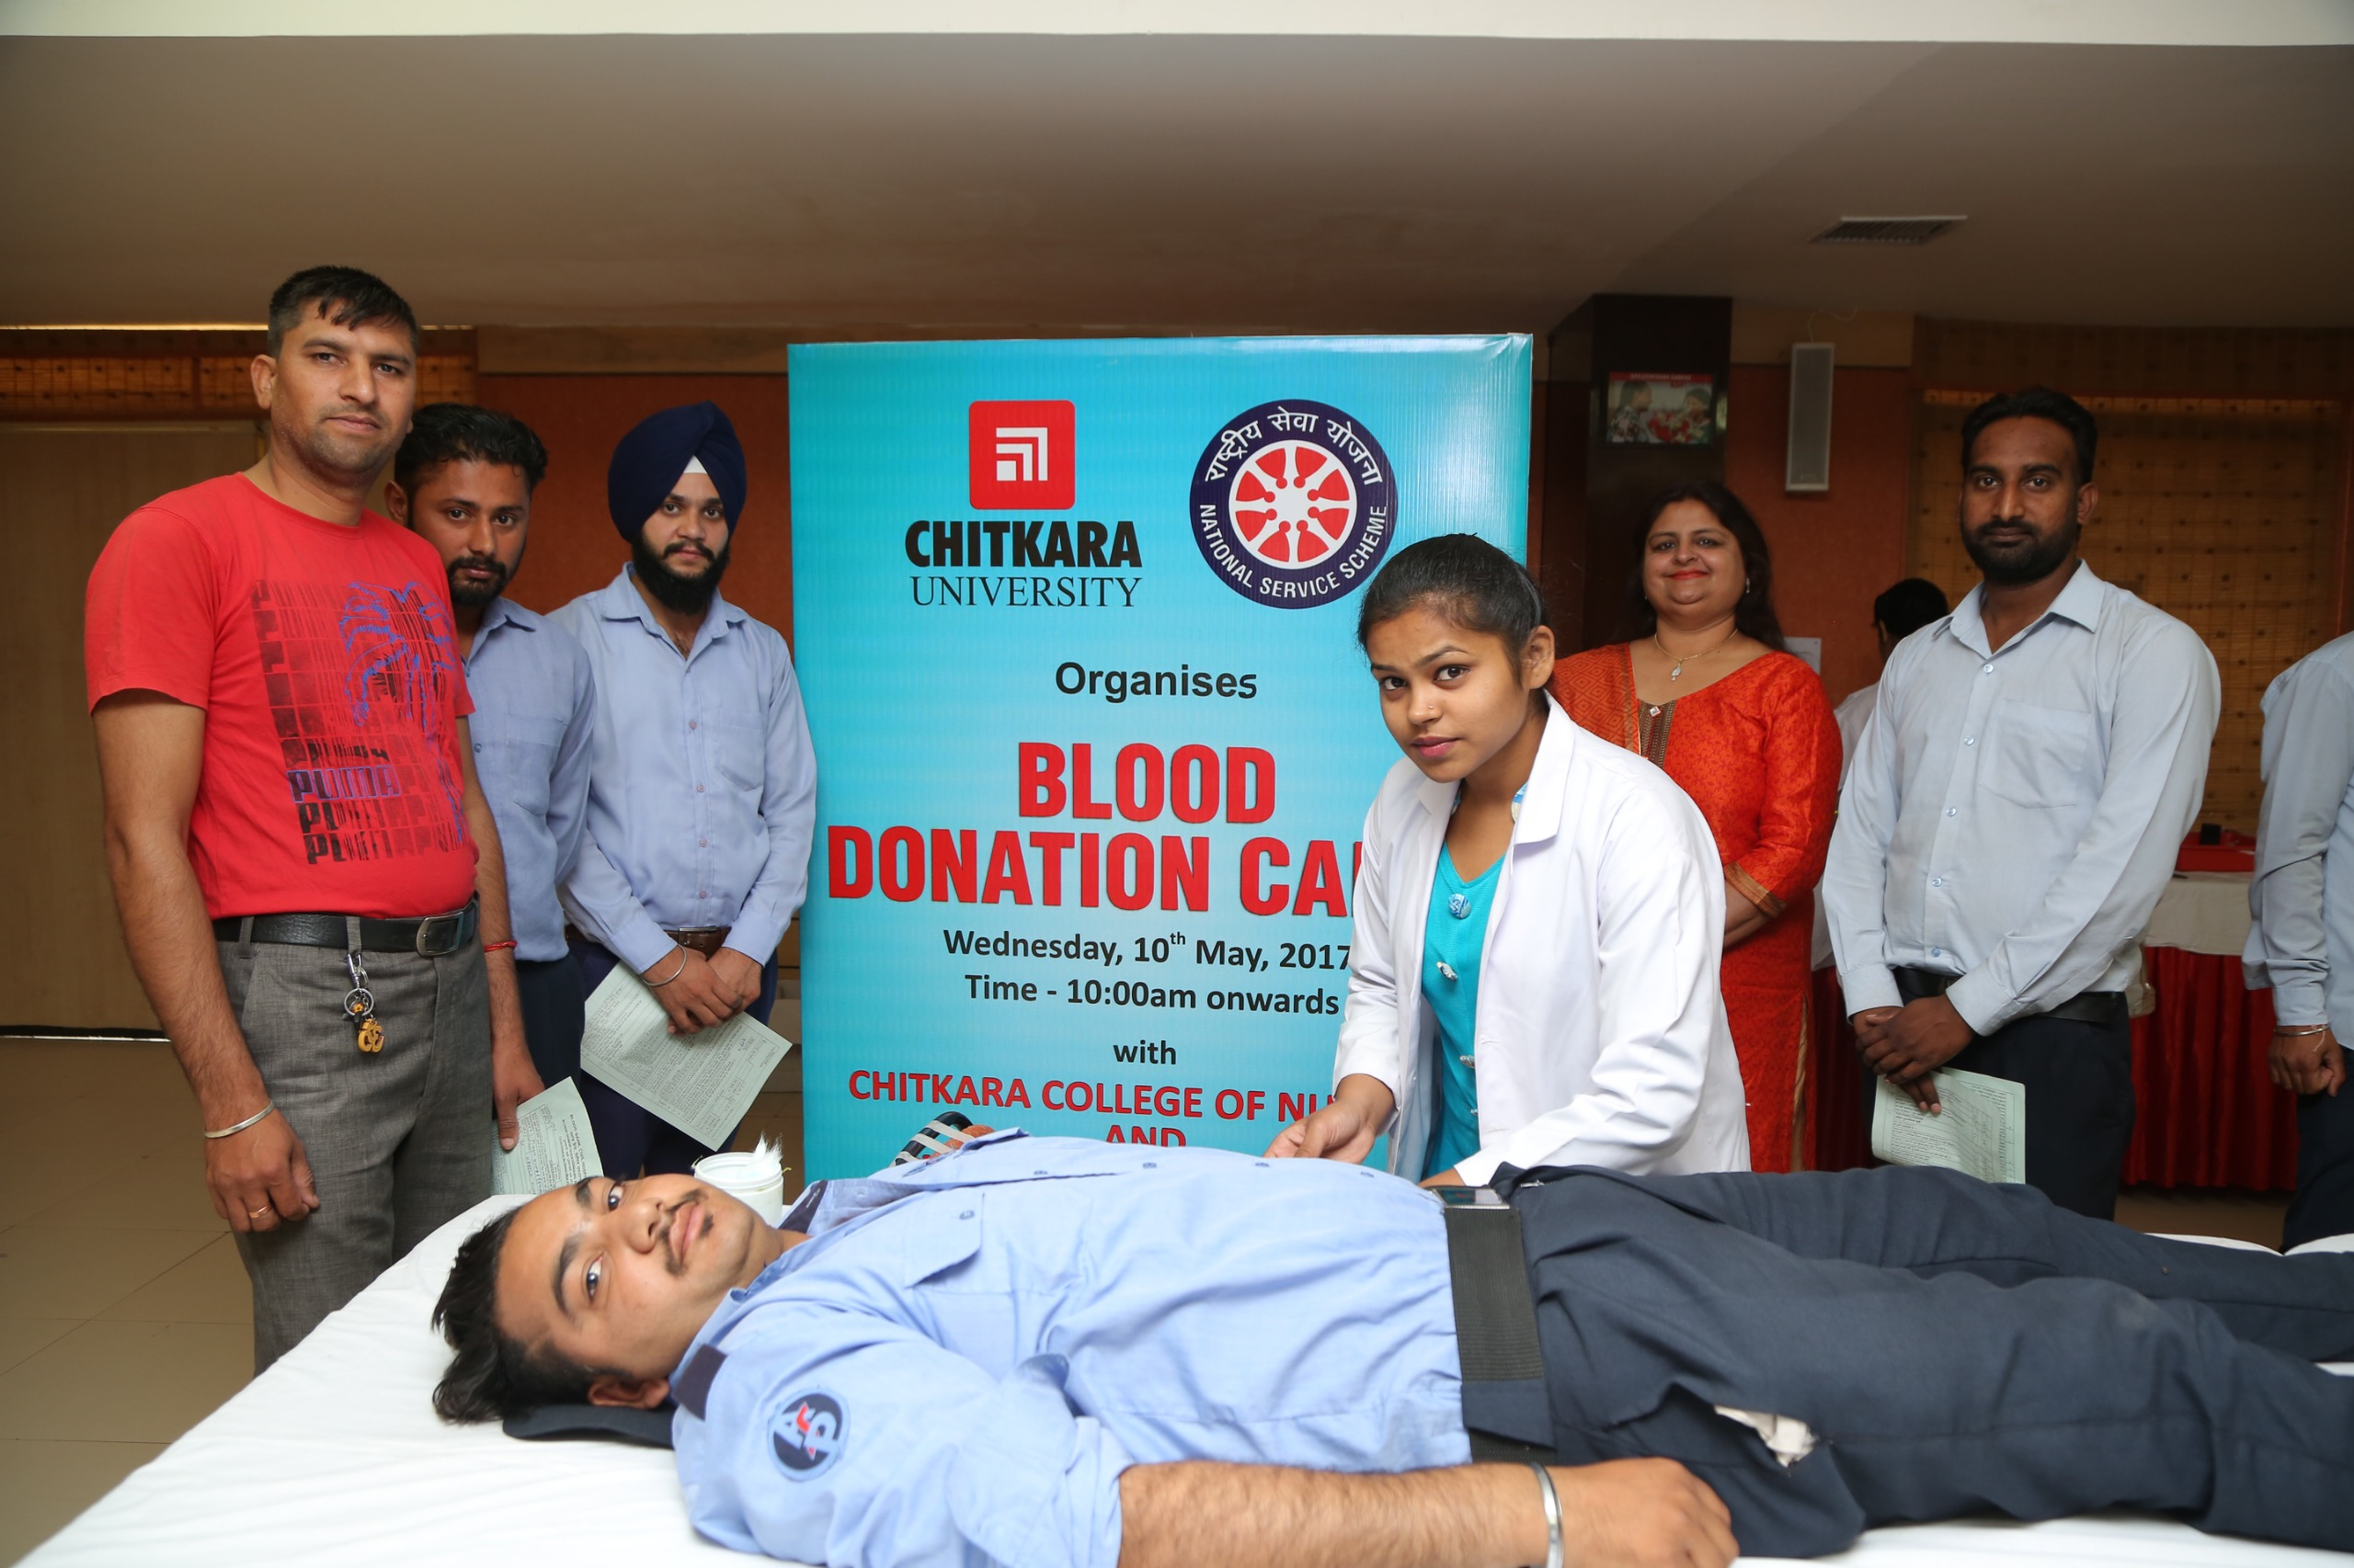
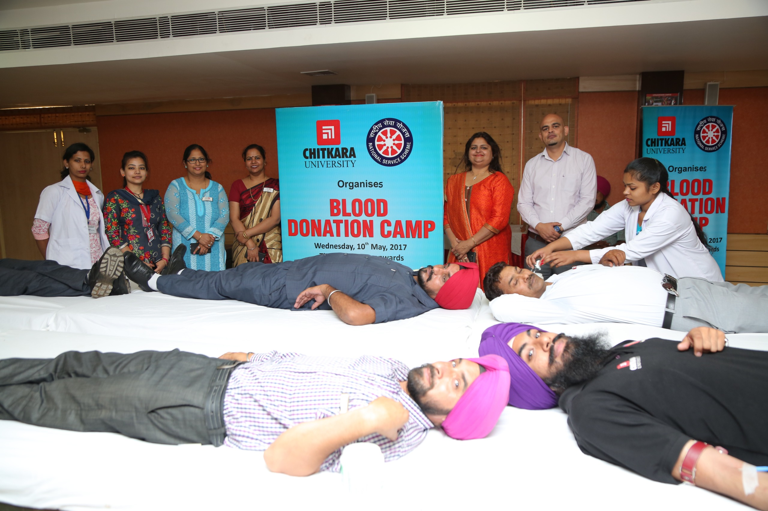
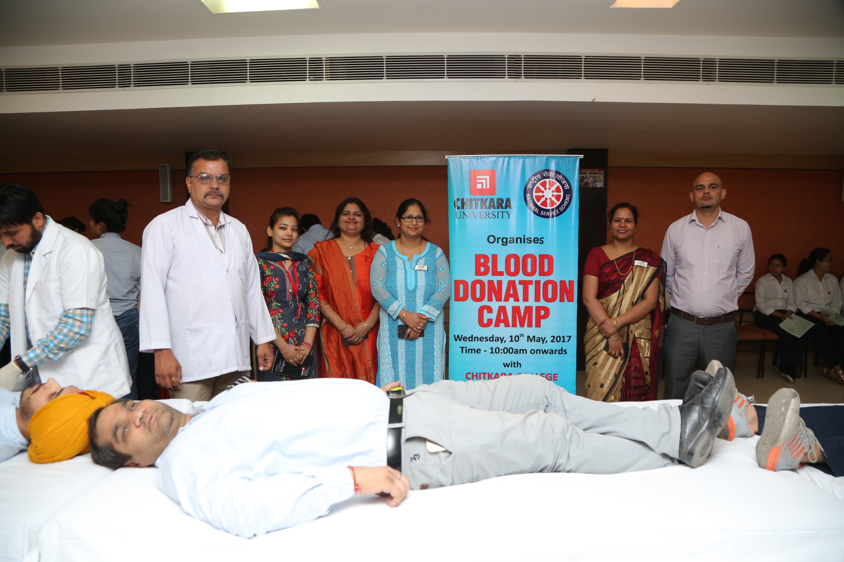
In association with
Rajindra Hospital, Patiala
5th May 2017
In association with
A P Jain Civil Hospital, Rajpura
10th May 2017

Slide 8
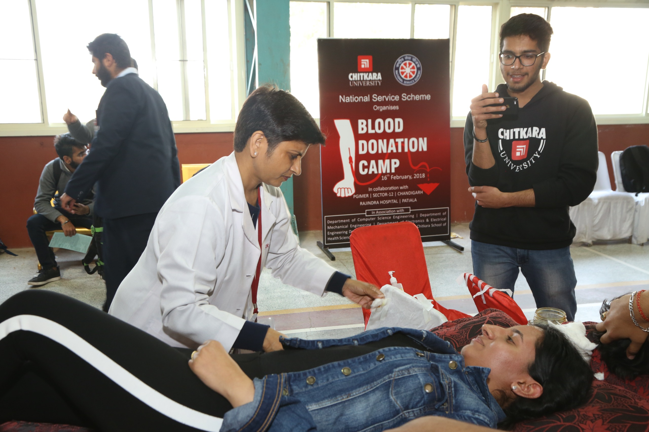
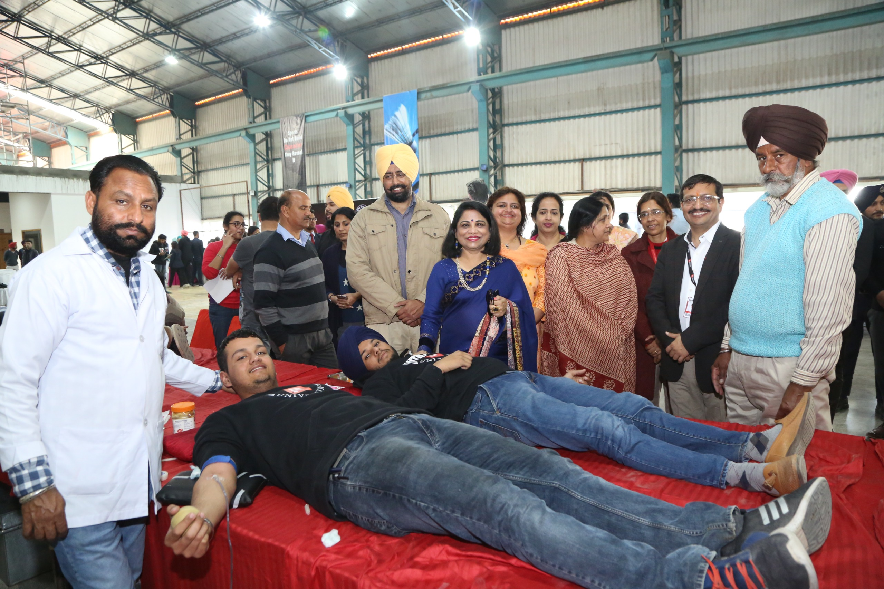
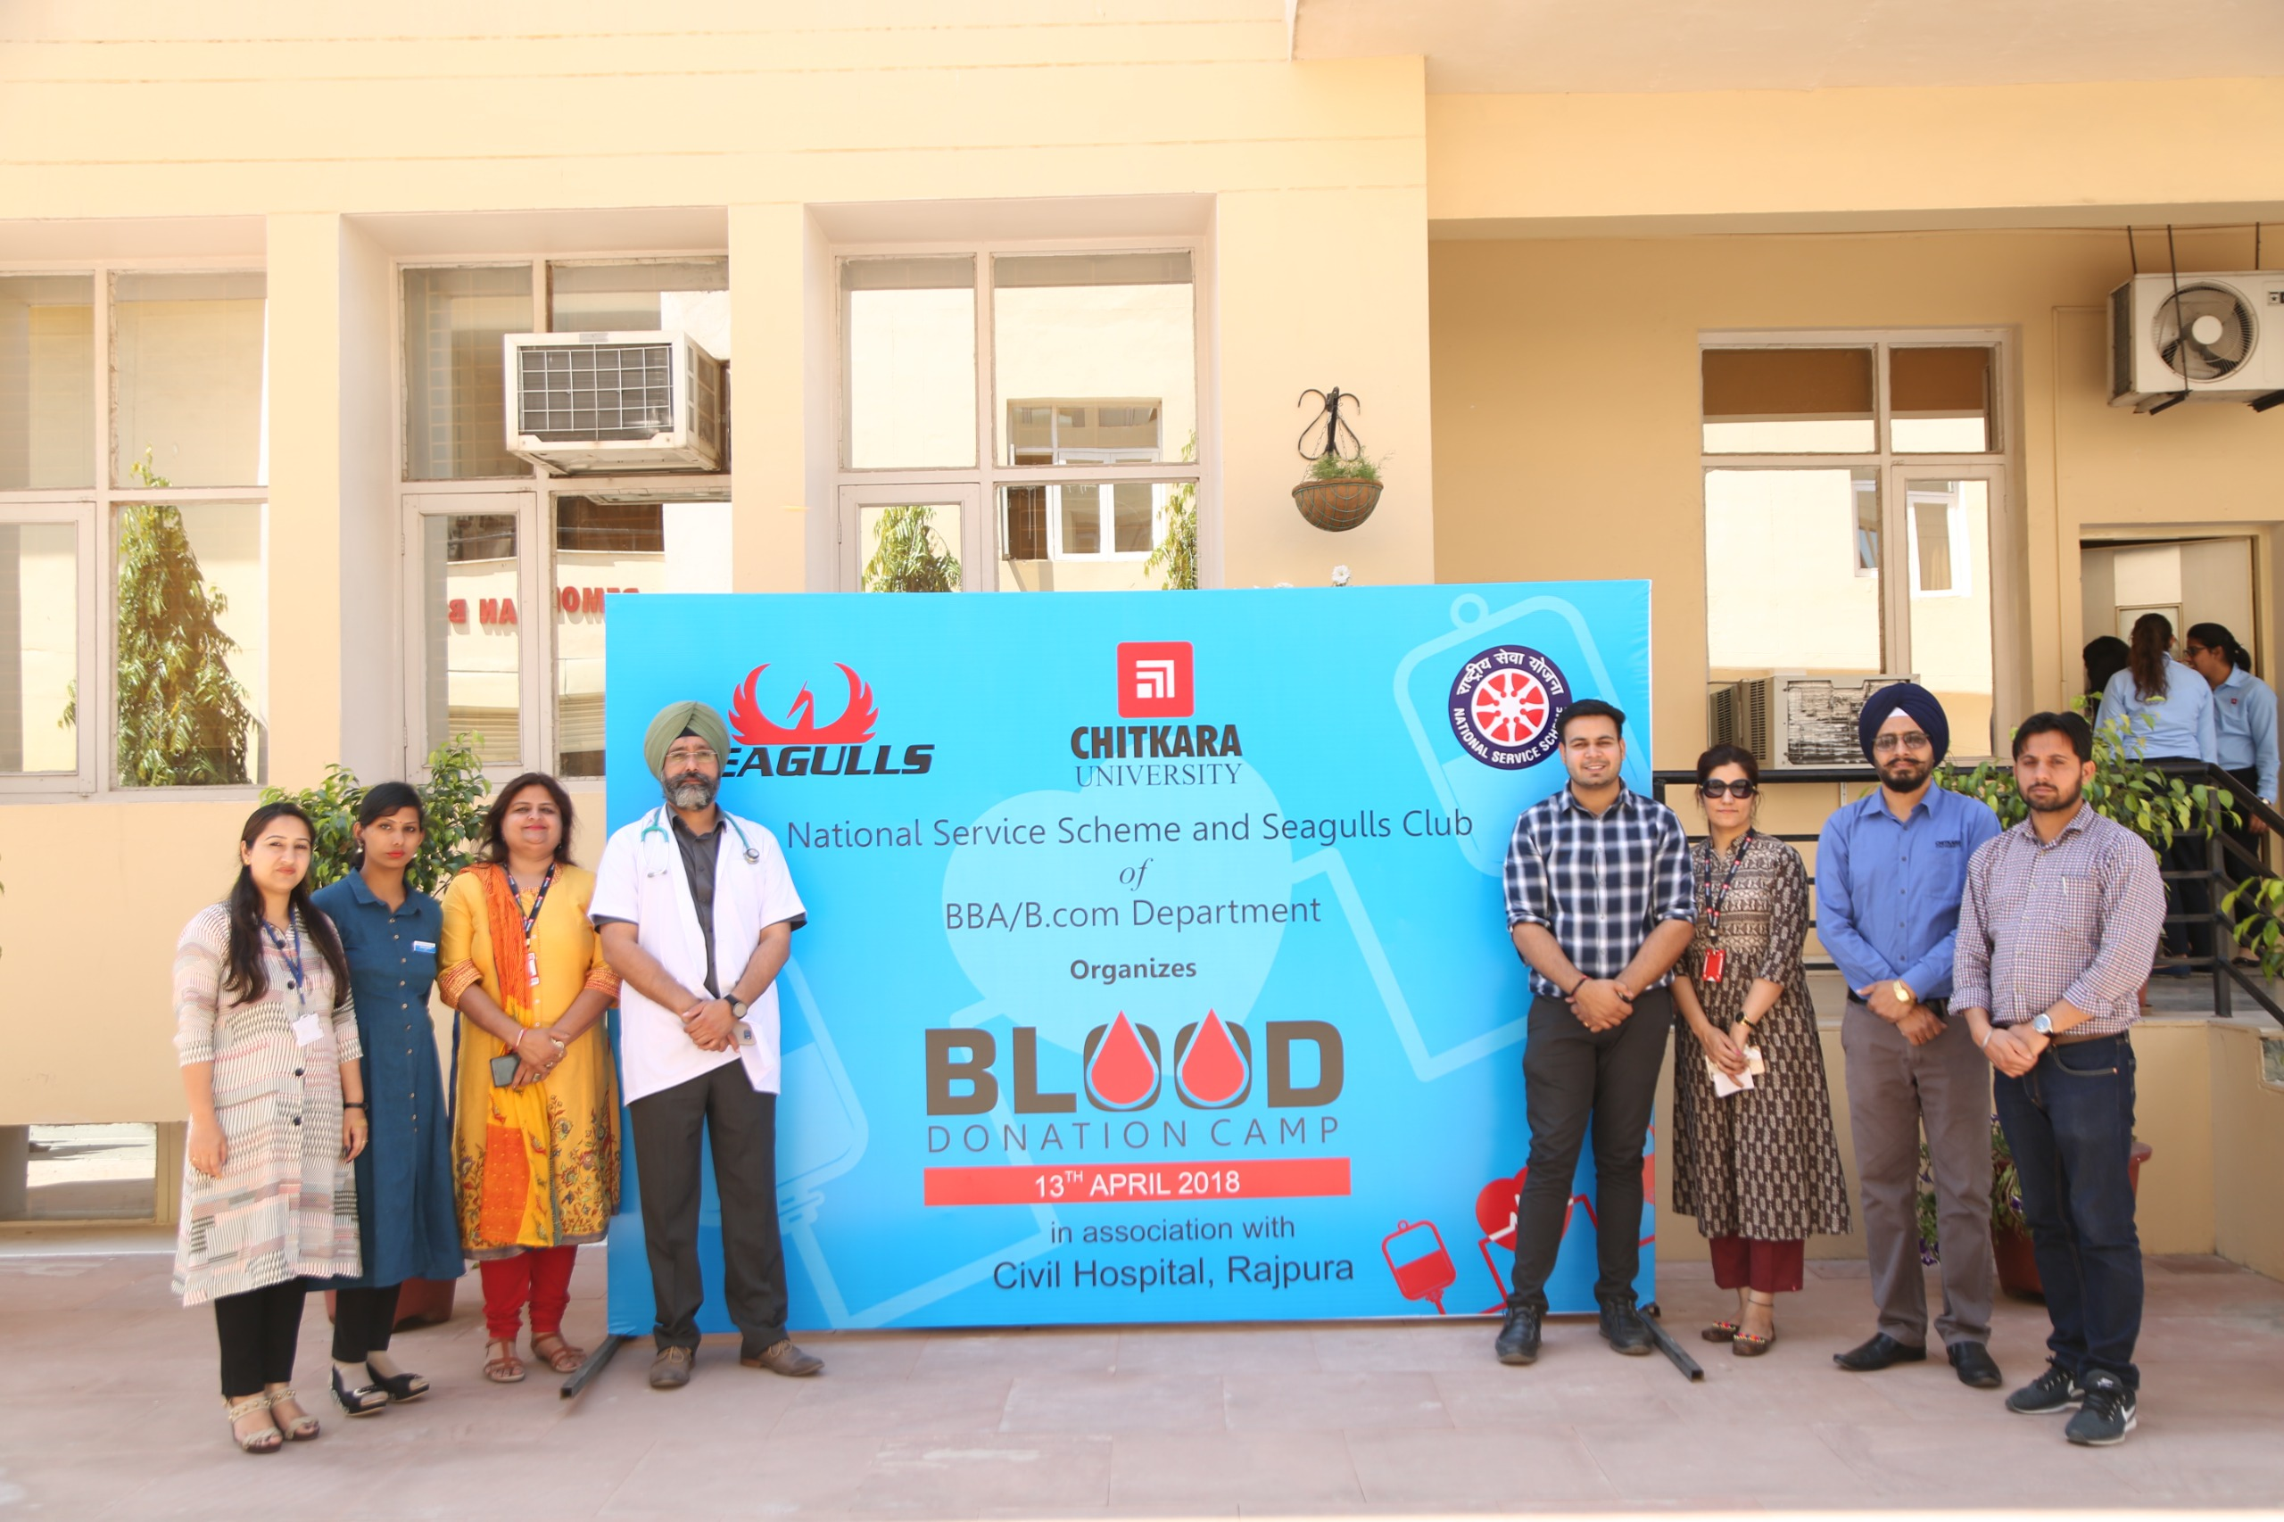
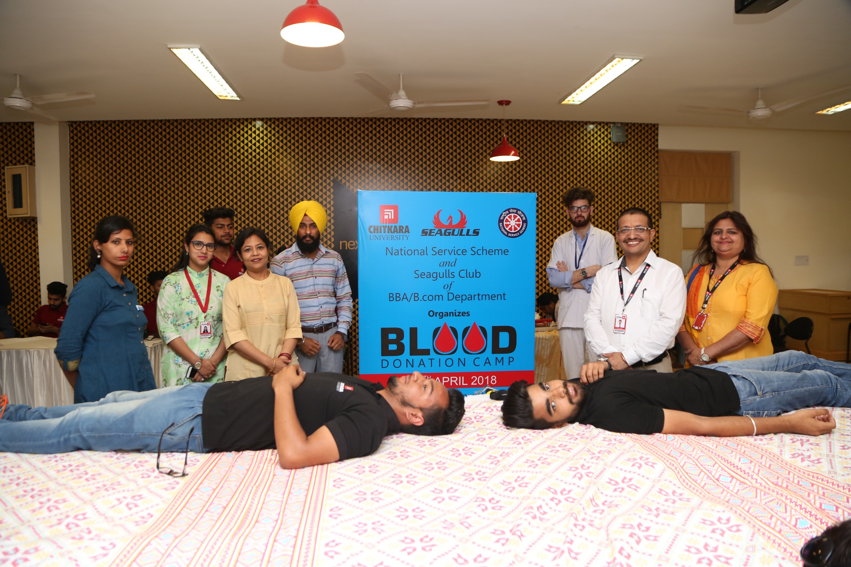
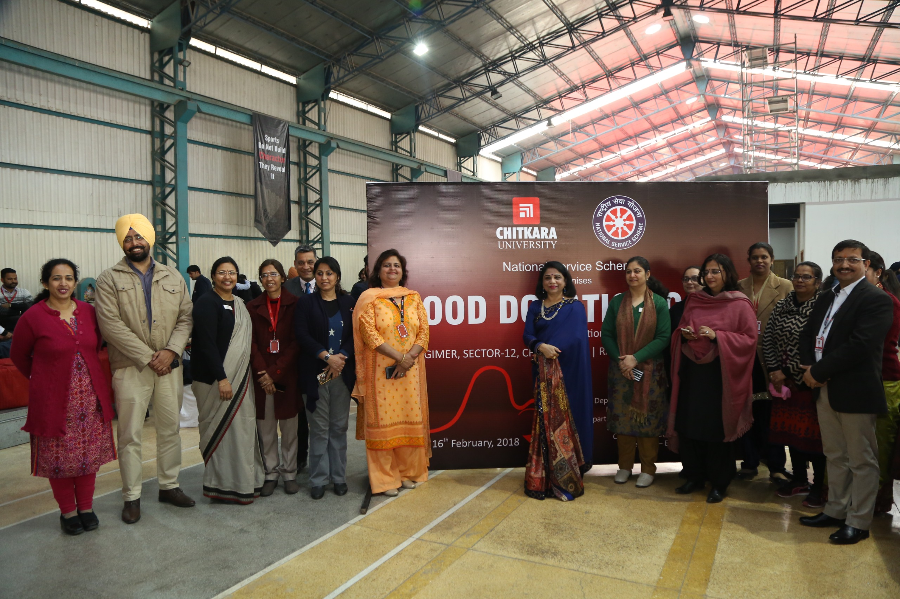
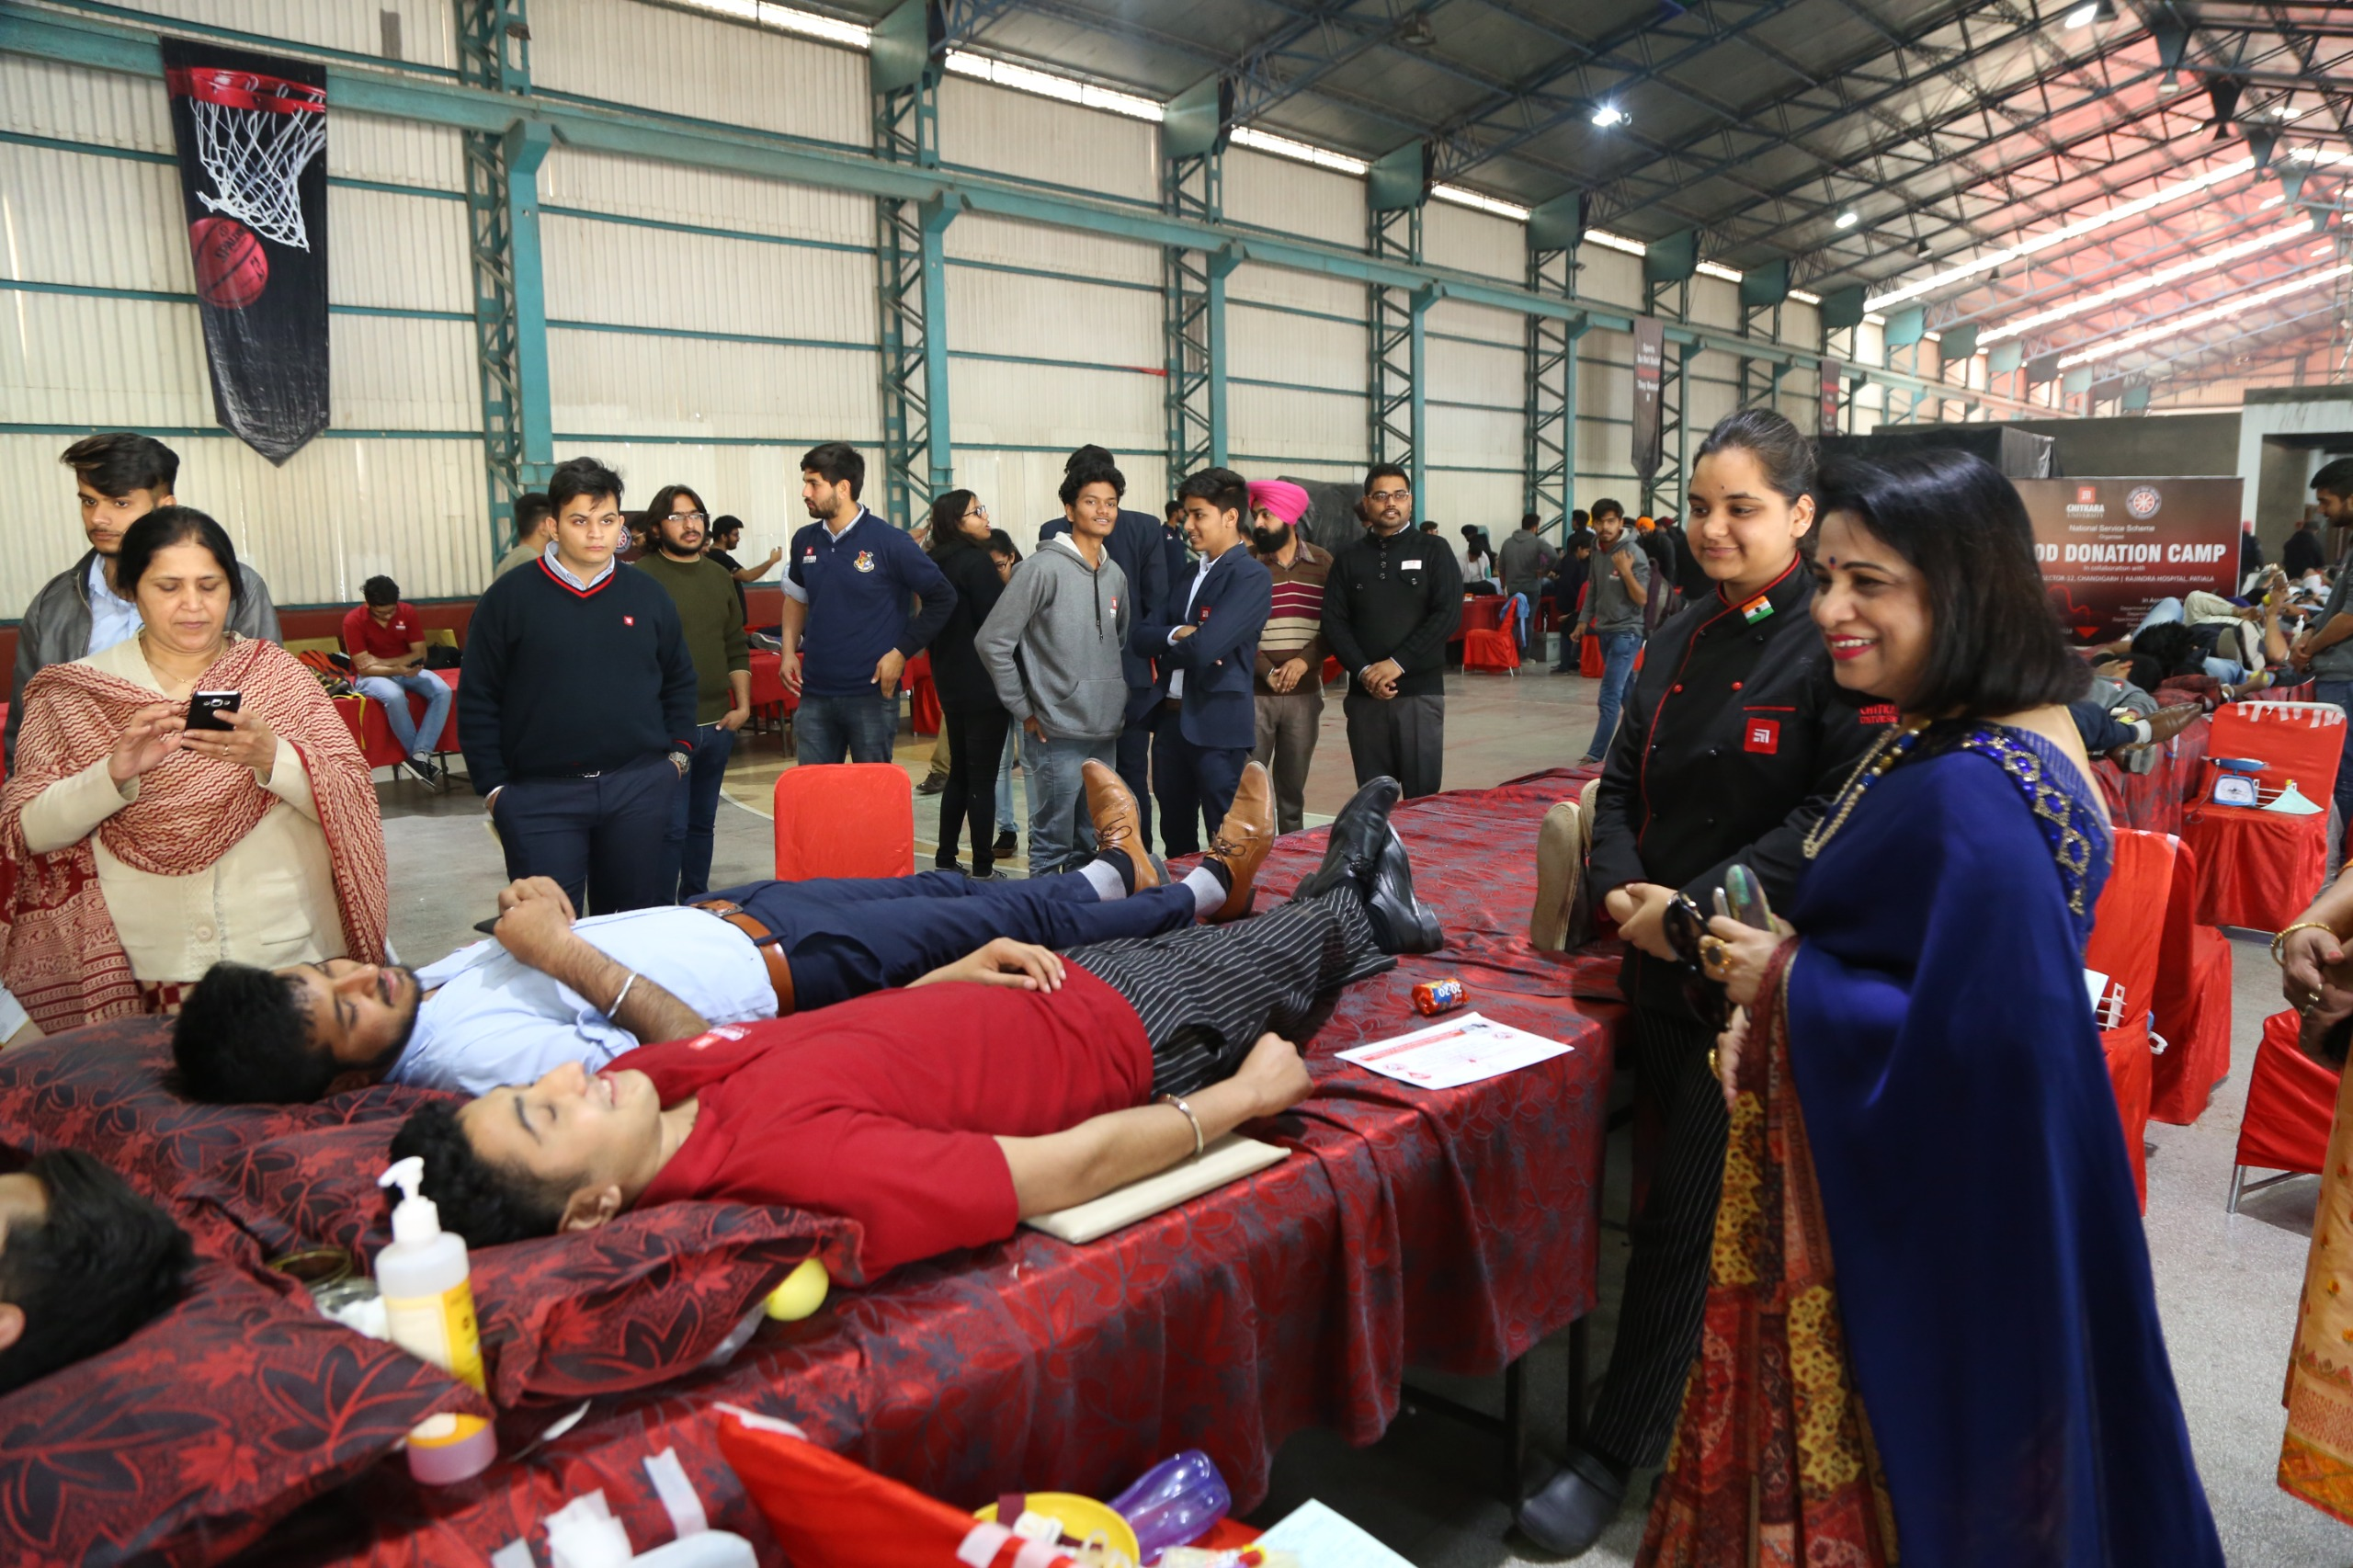
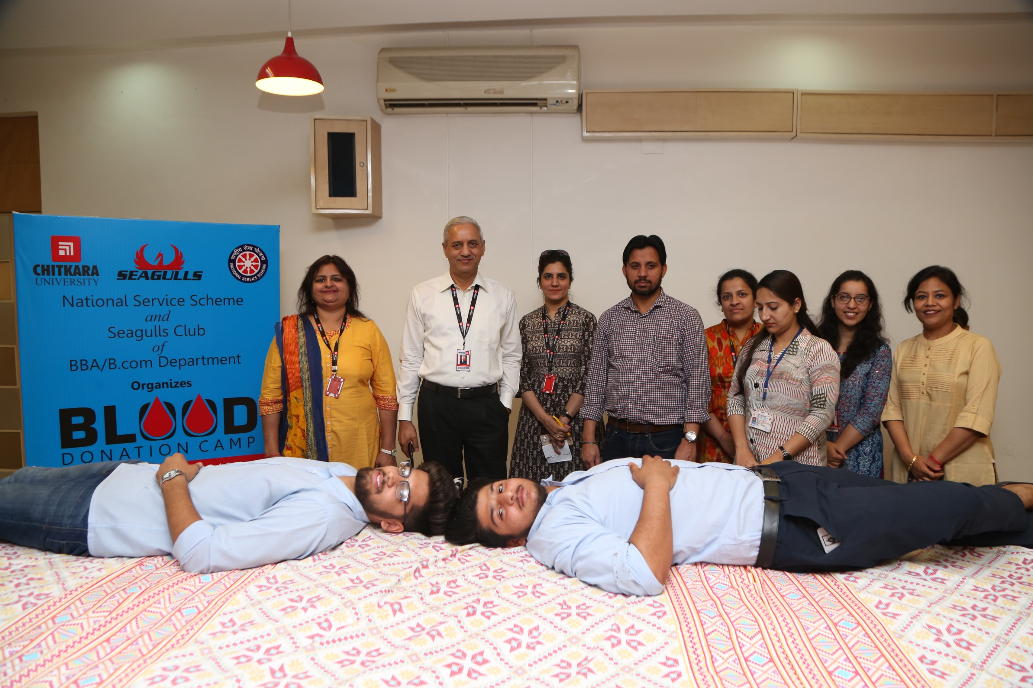
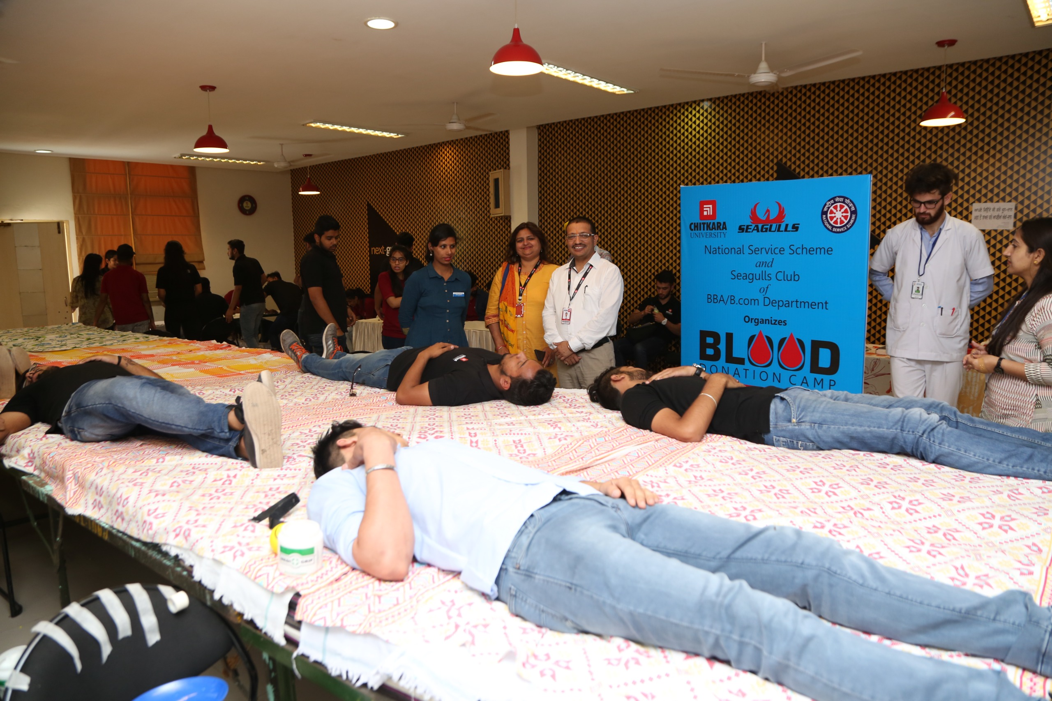
In association with
PGIMER, Chandigarh & Rajindra Hospital,
Paitala |16th Feb 2018
In association with
A P Jain Civil Hospital, Rajpura
13th April 2018

Slide 9
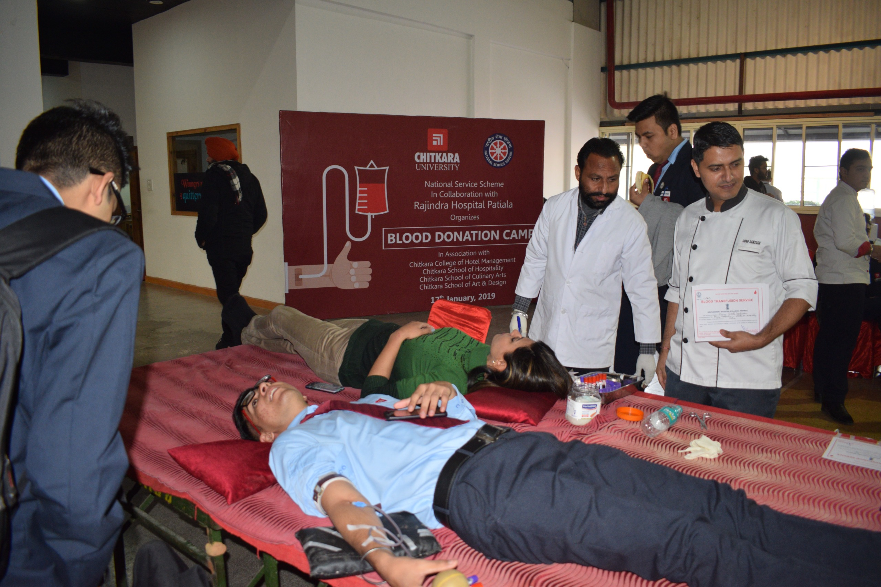
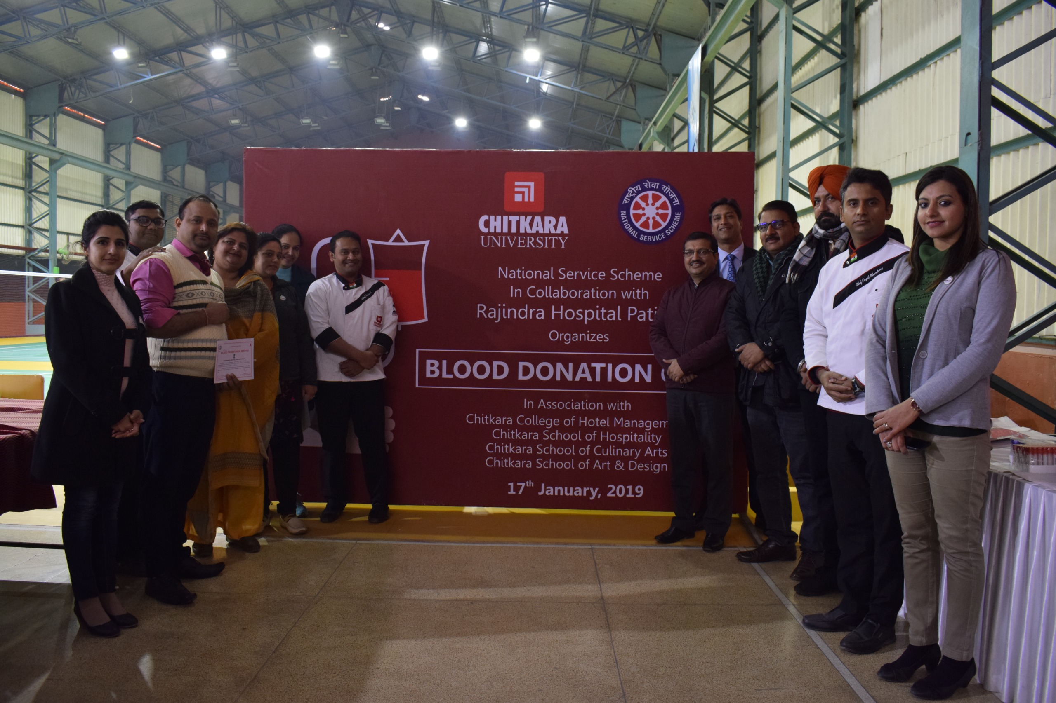
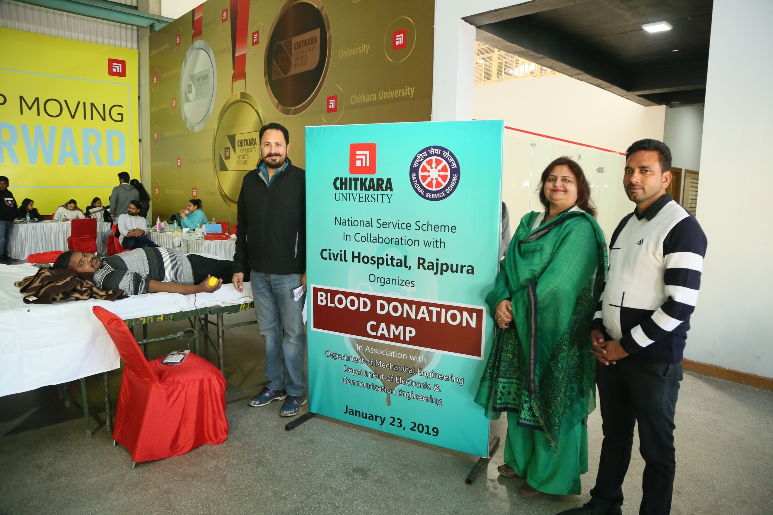
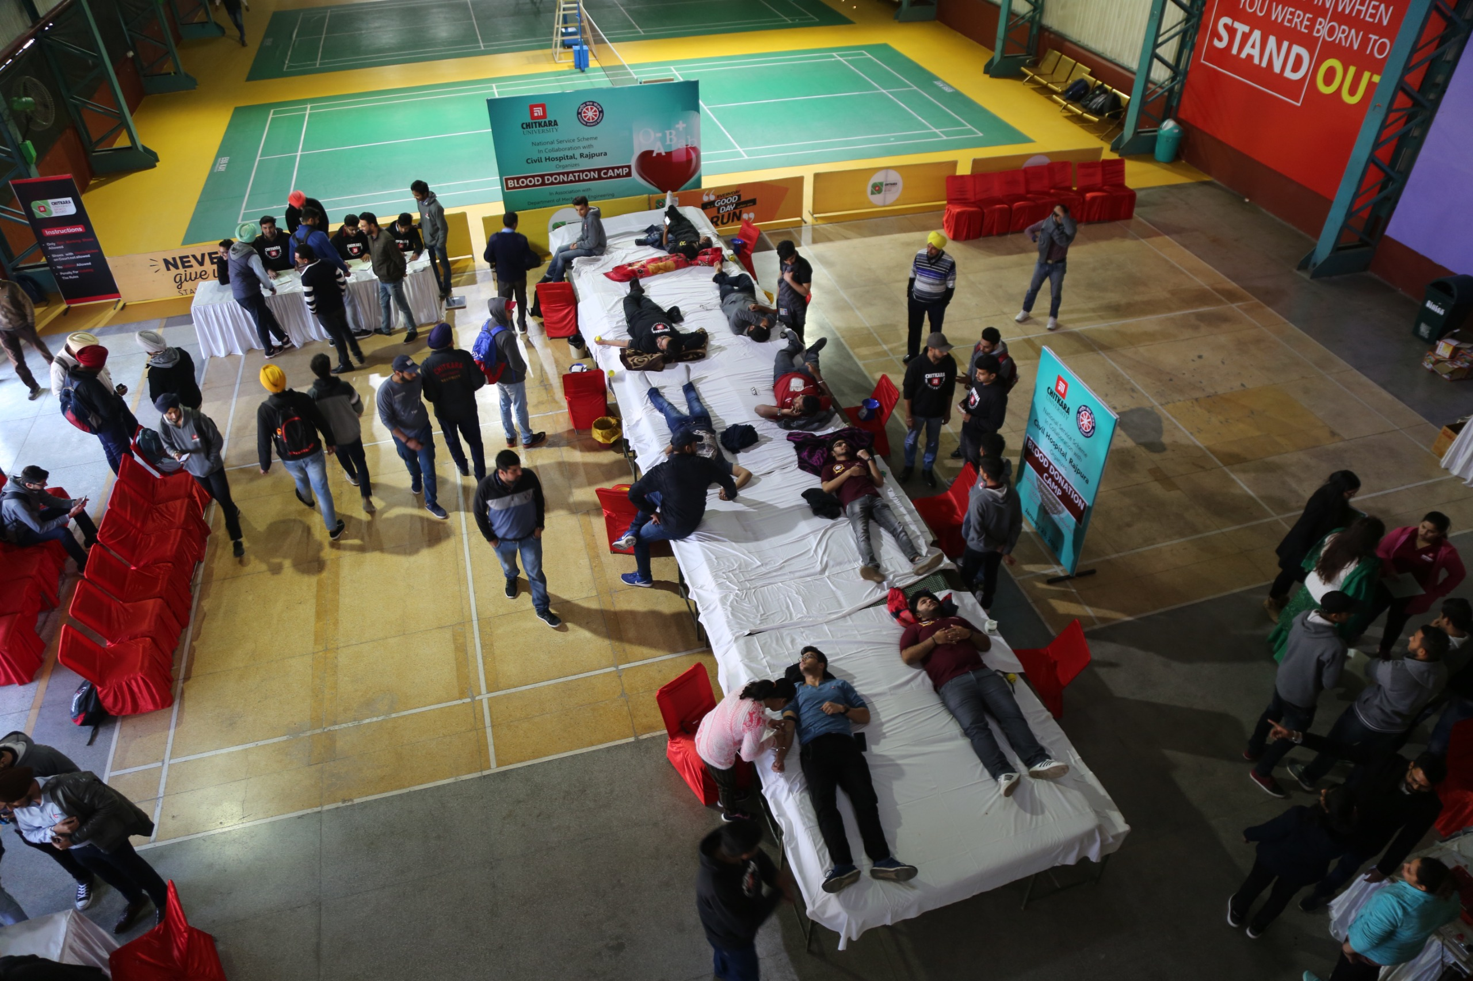
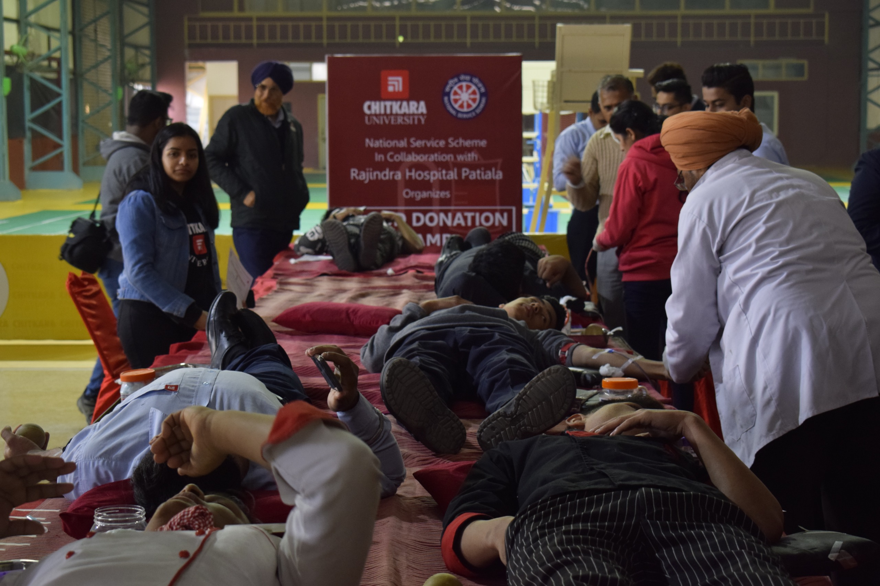
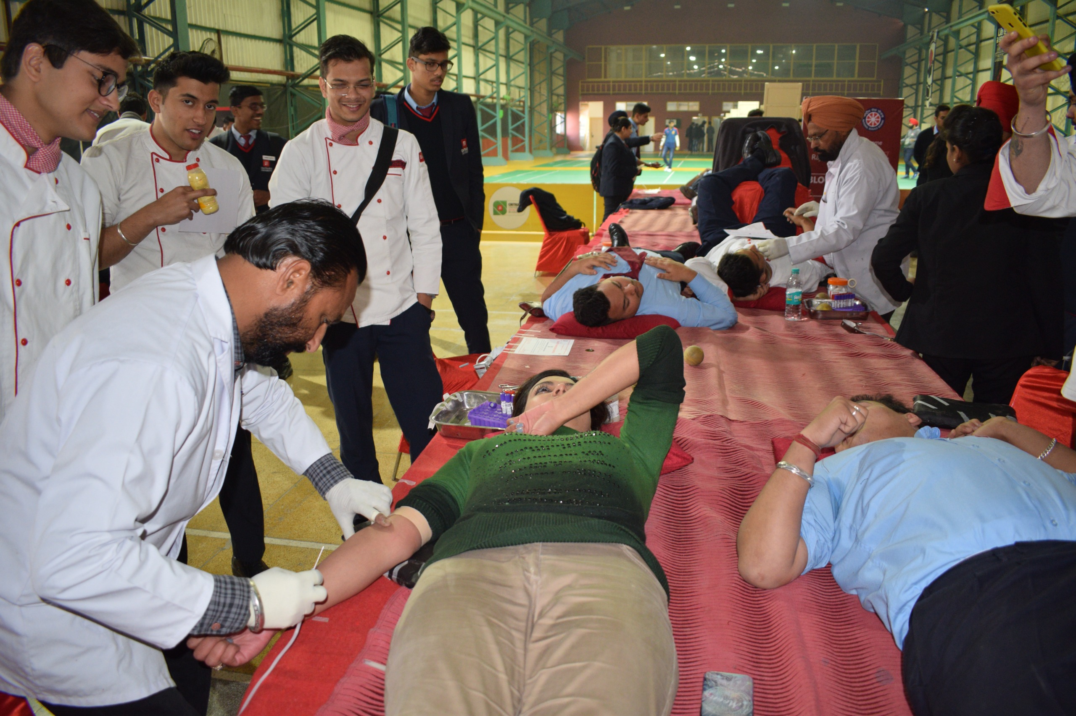
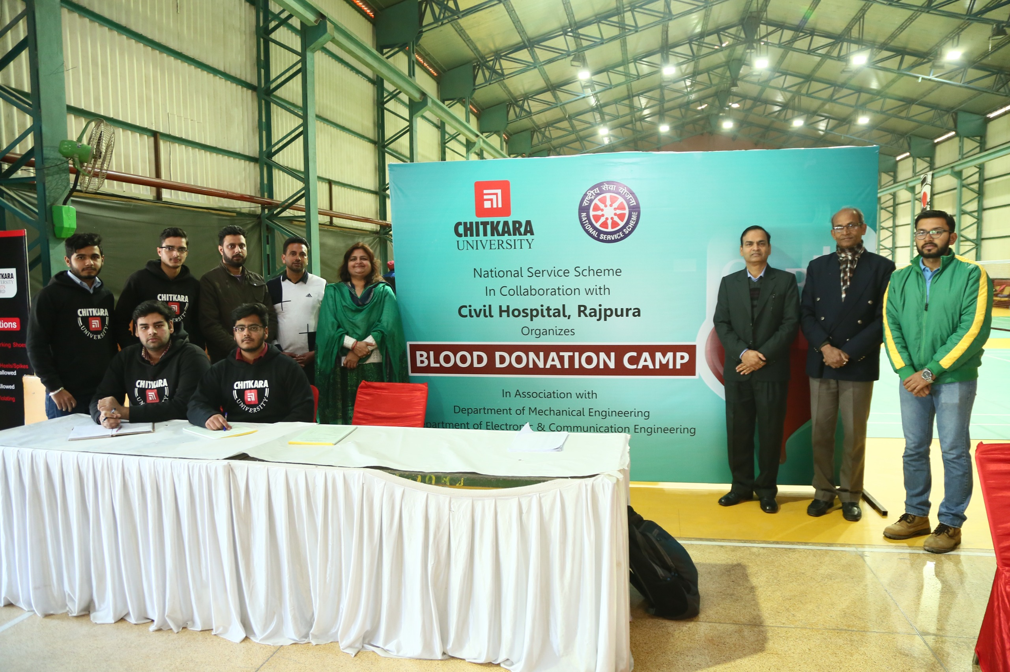
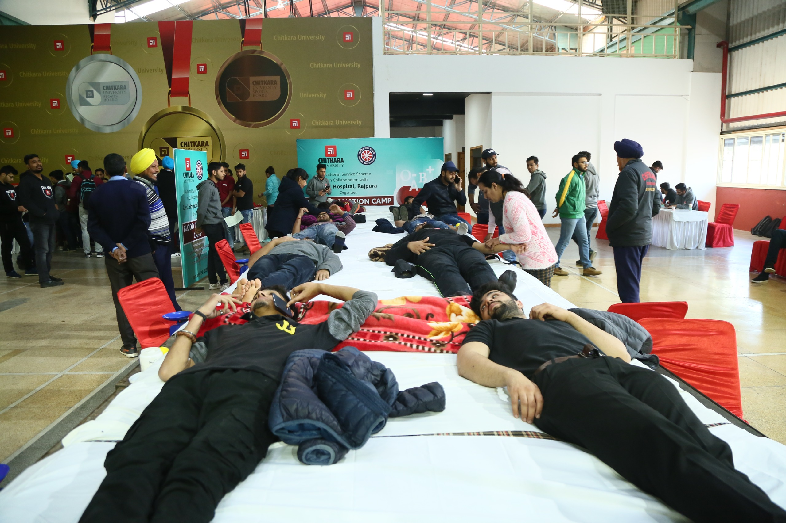
In association with
Rajindra Hospital, Patiala
17th Jan 2019
In association with
Rajindra Hospital, Patiala
23rd Jan 2019

Slide 10
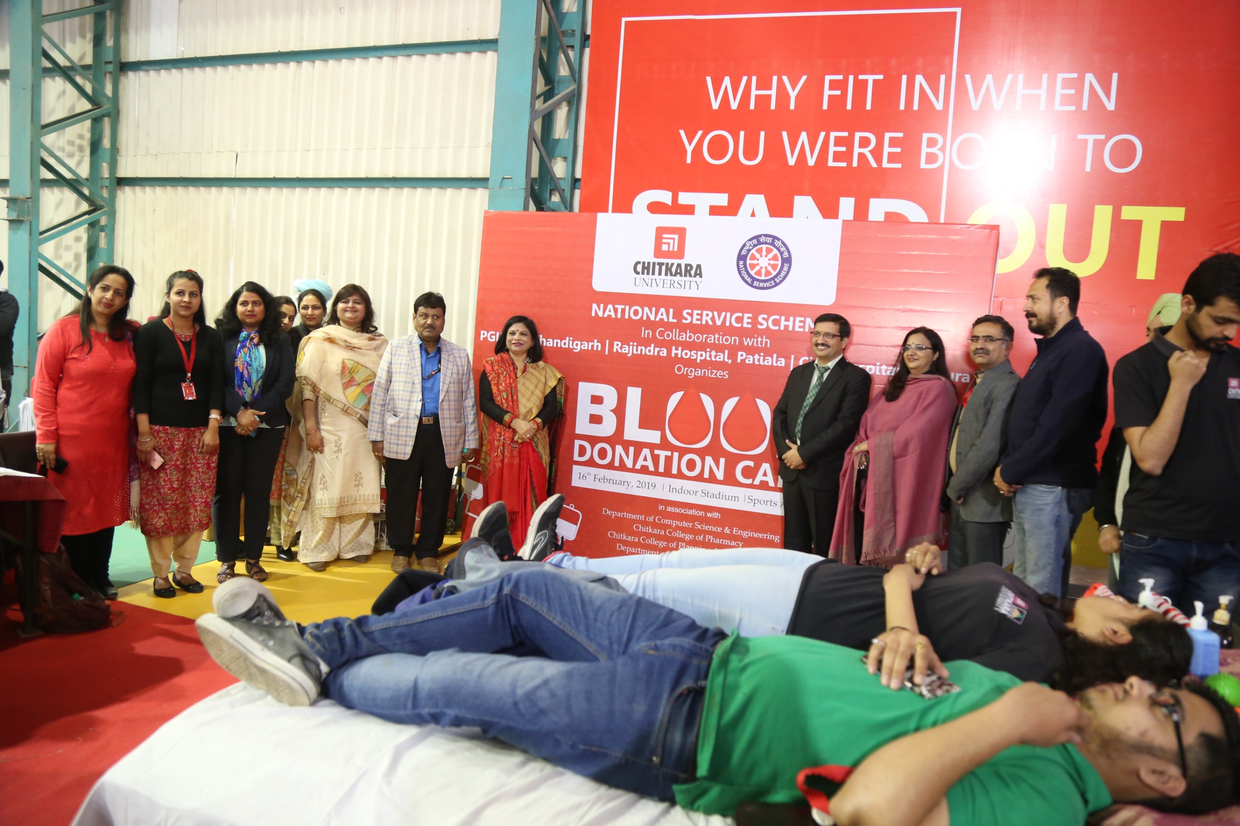
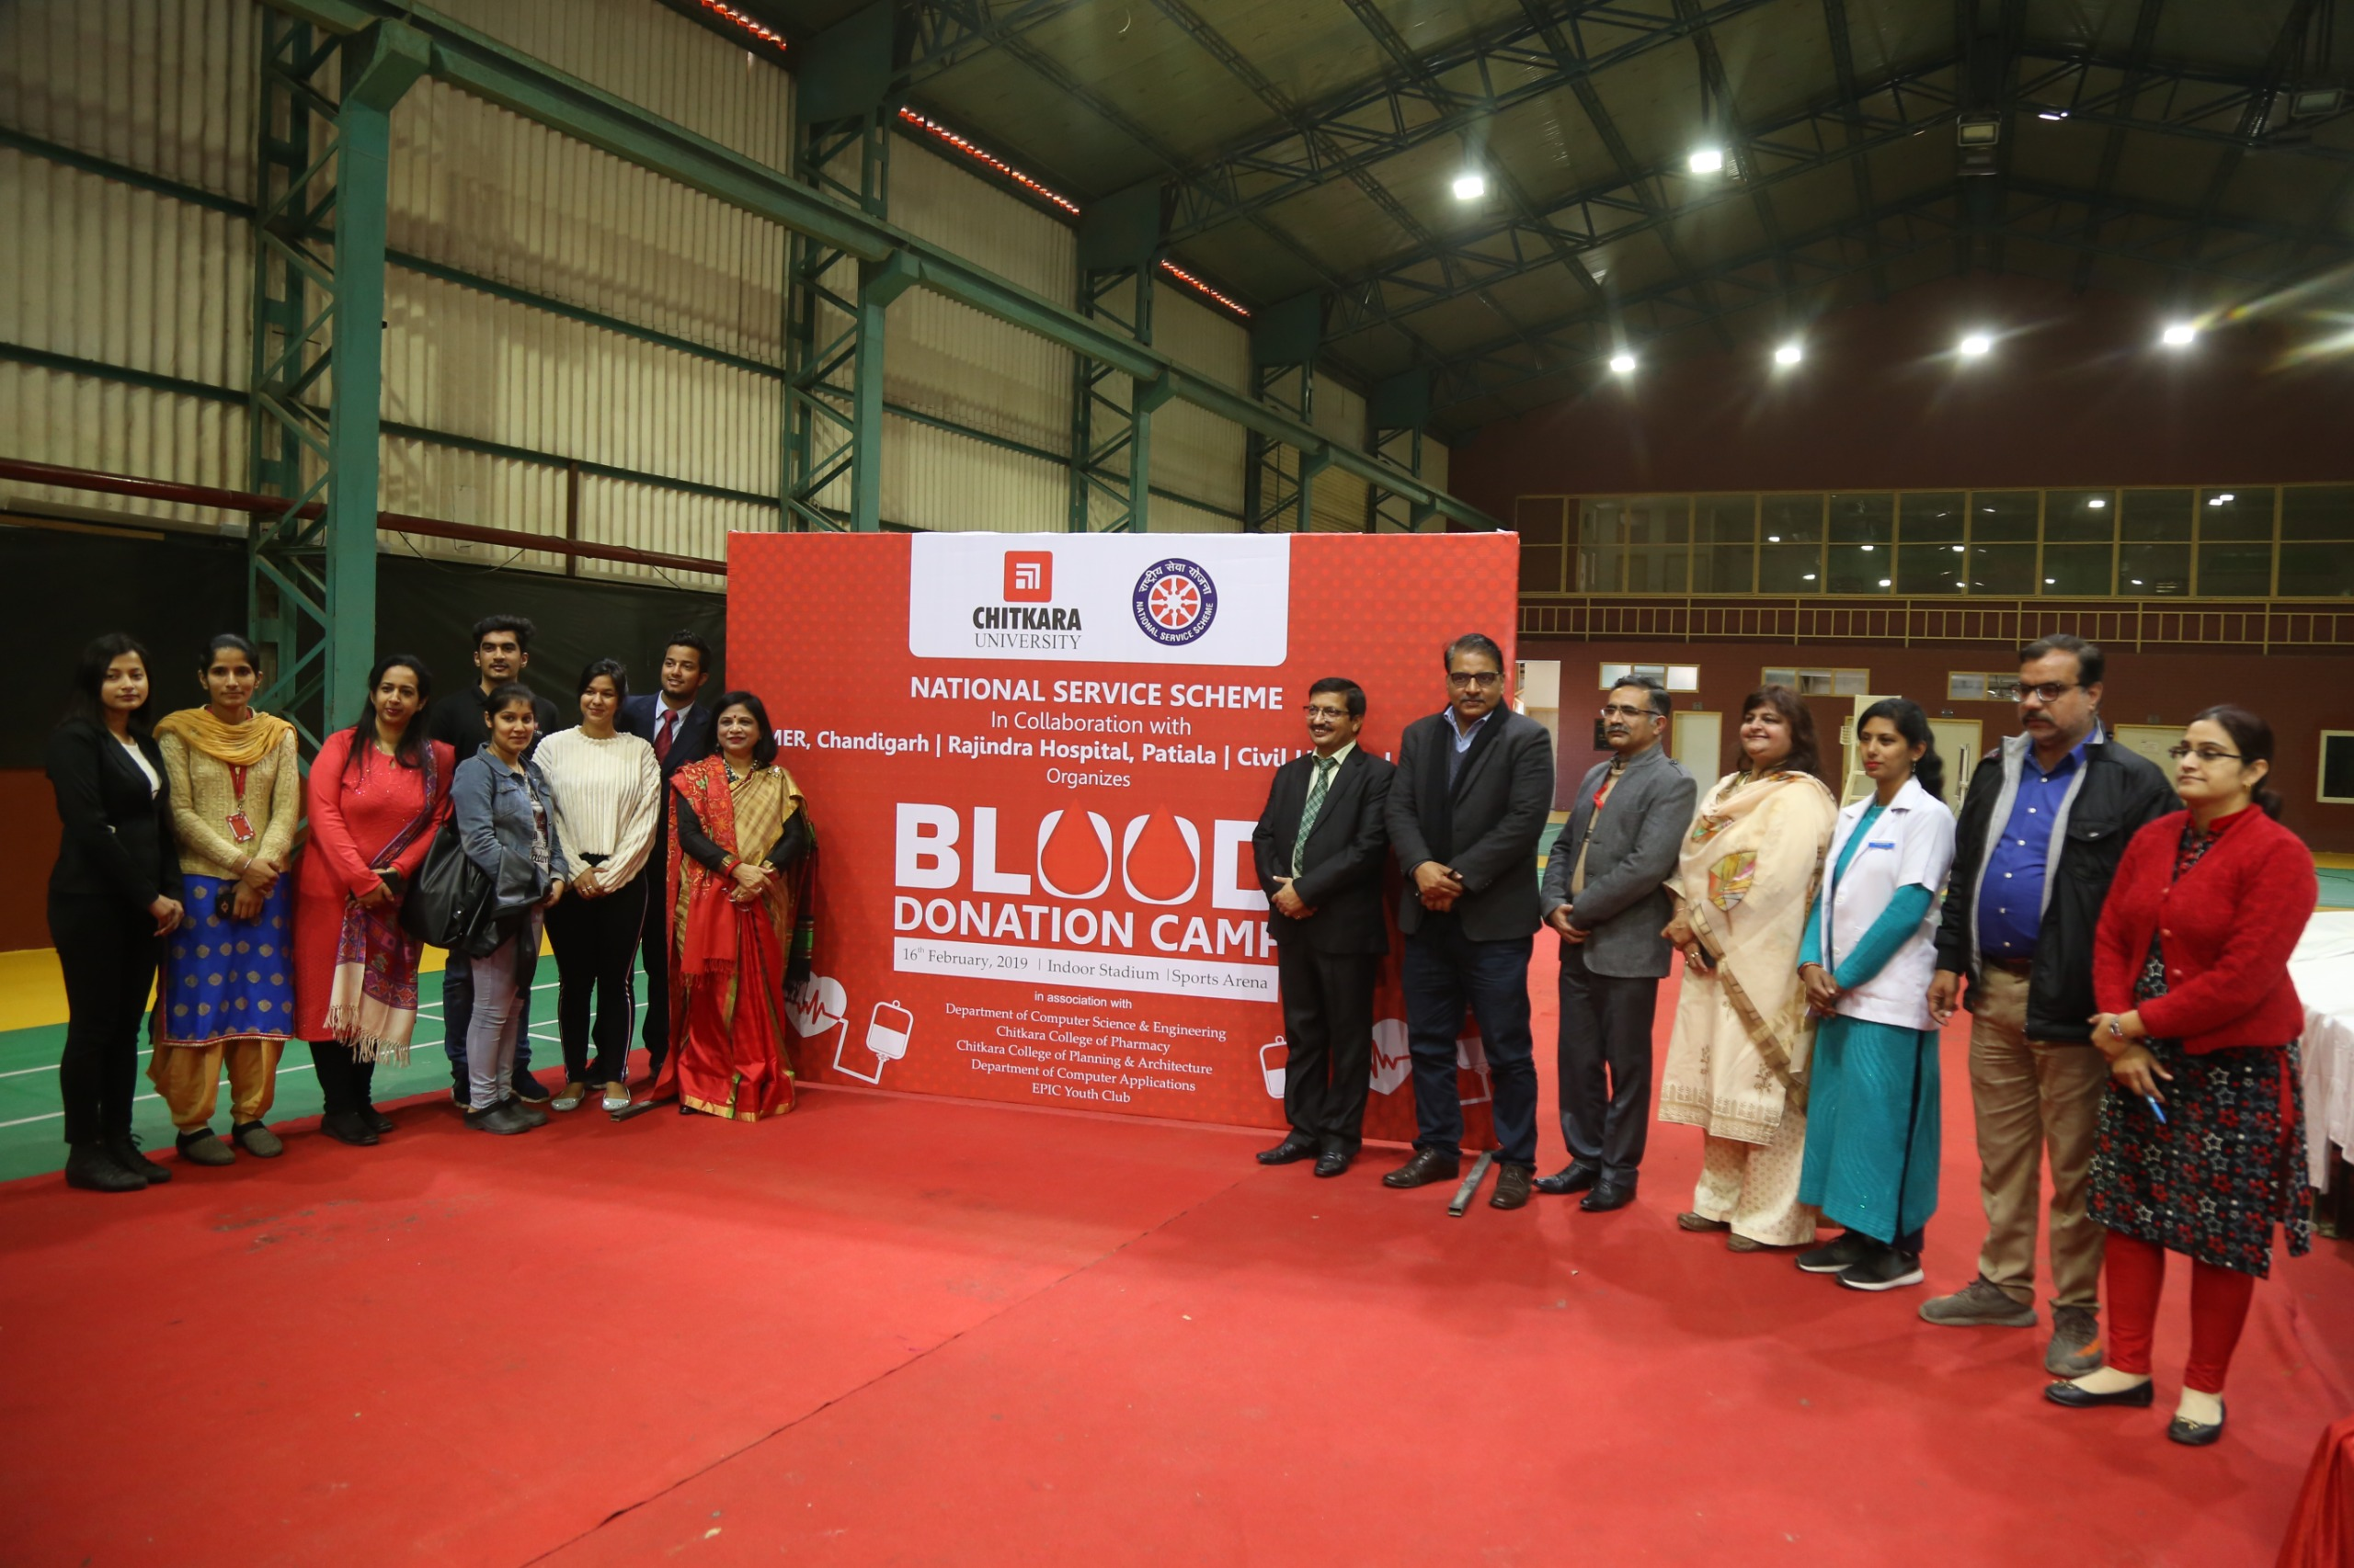
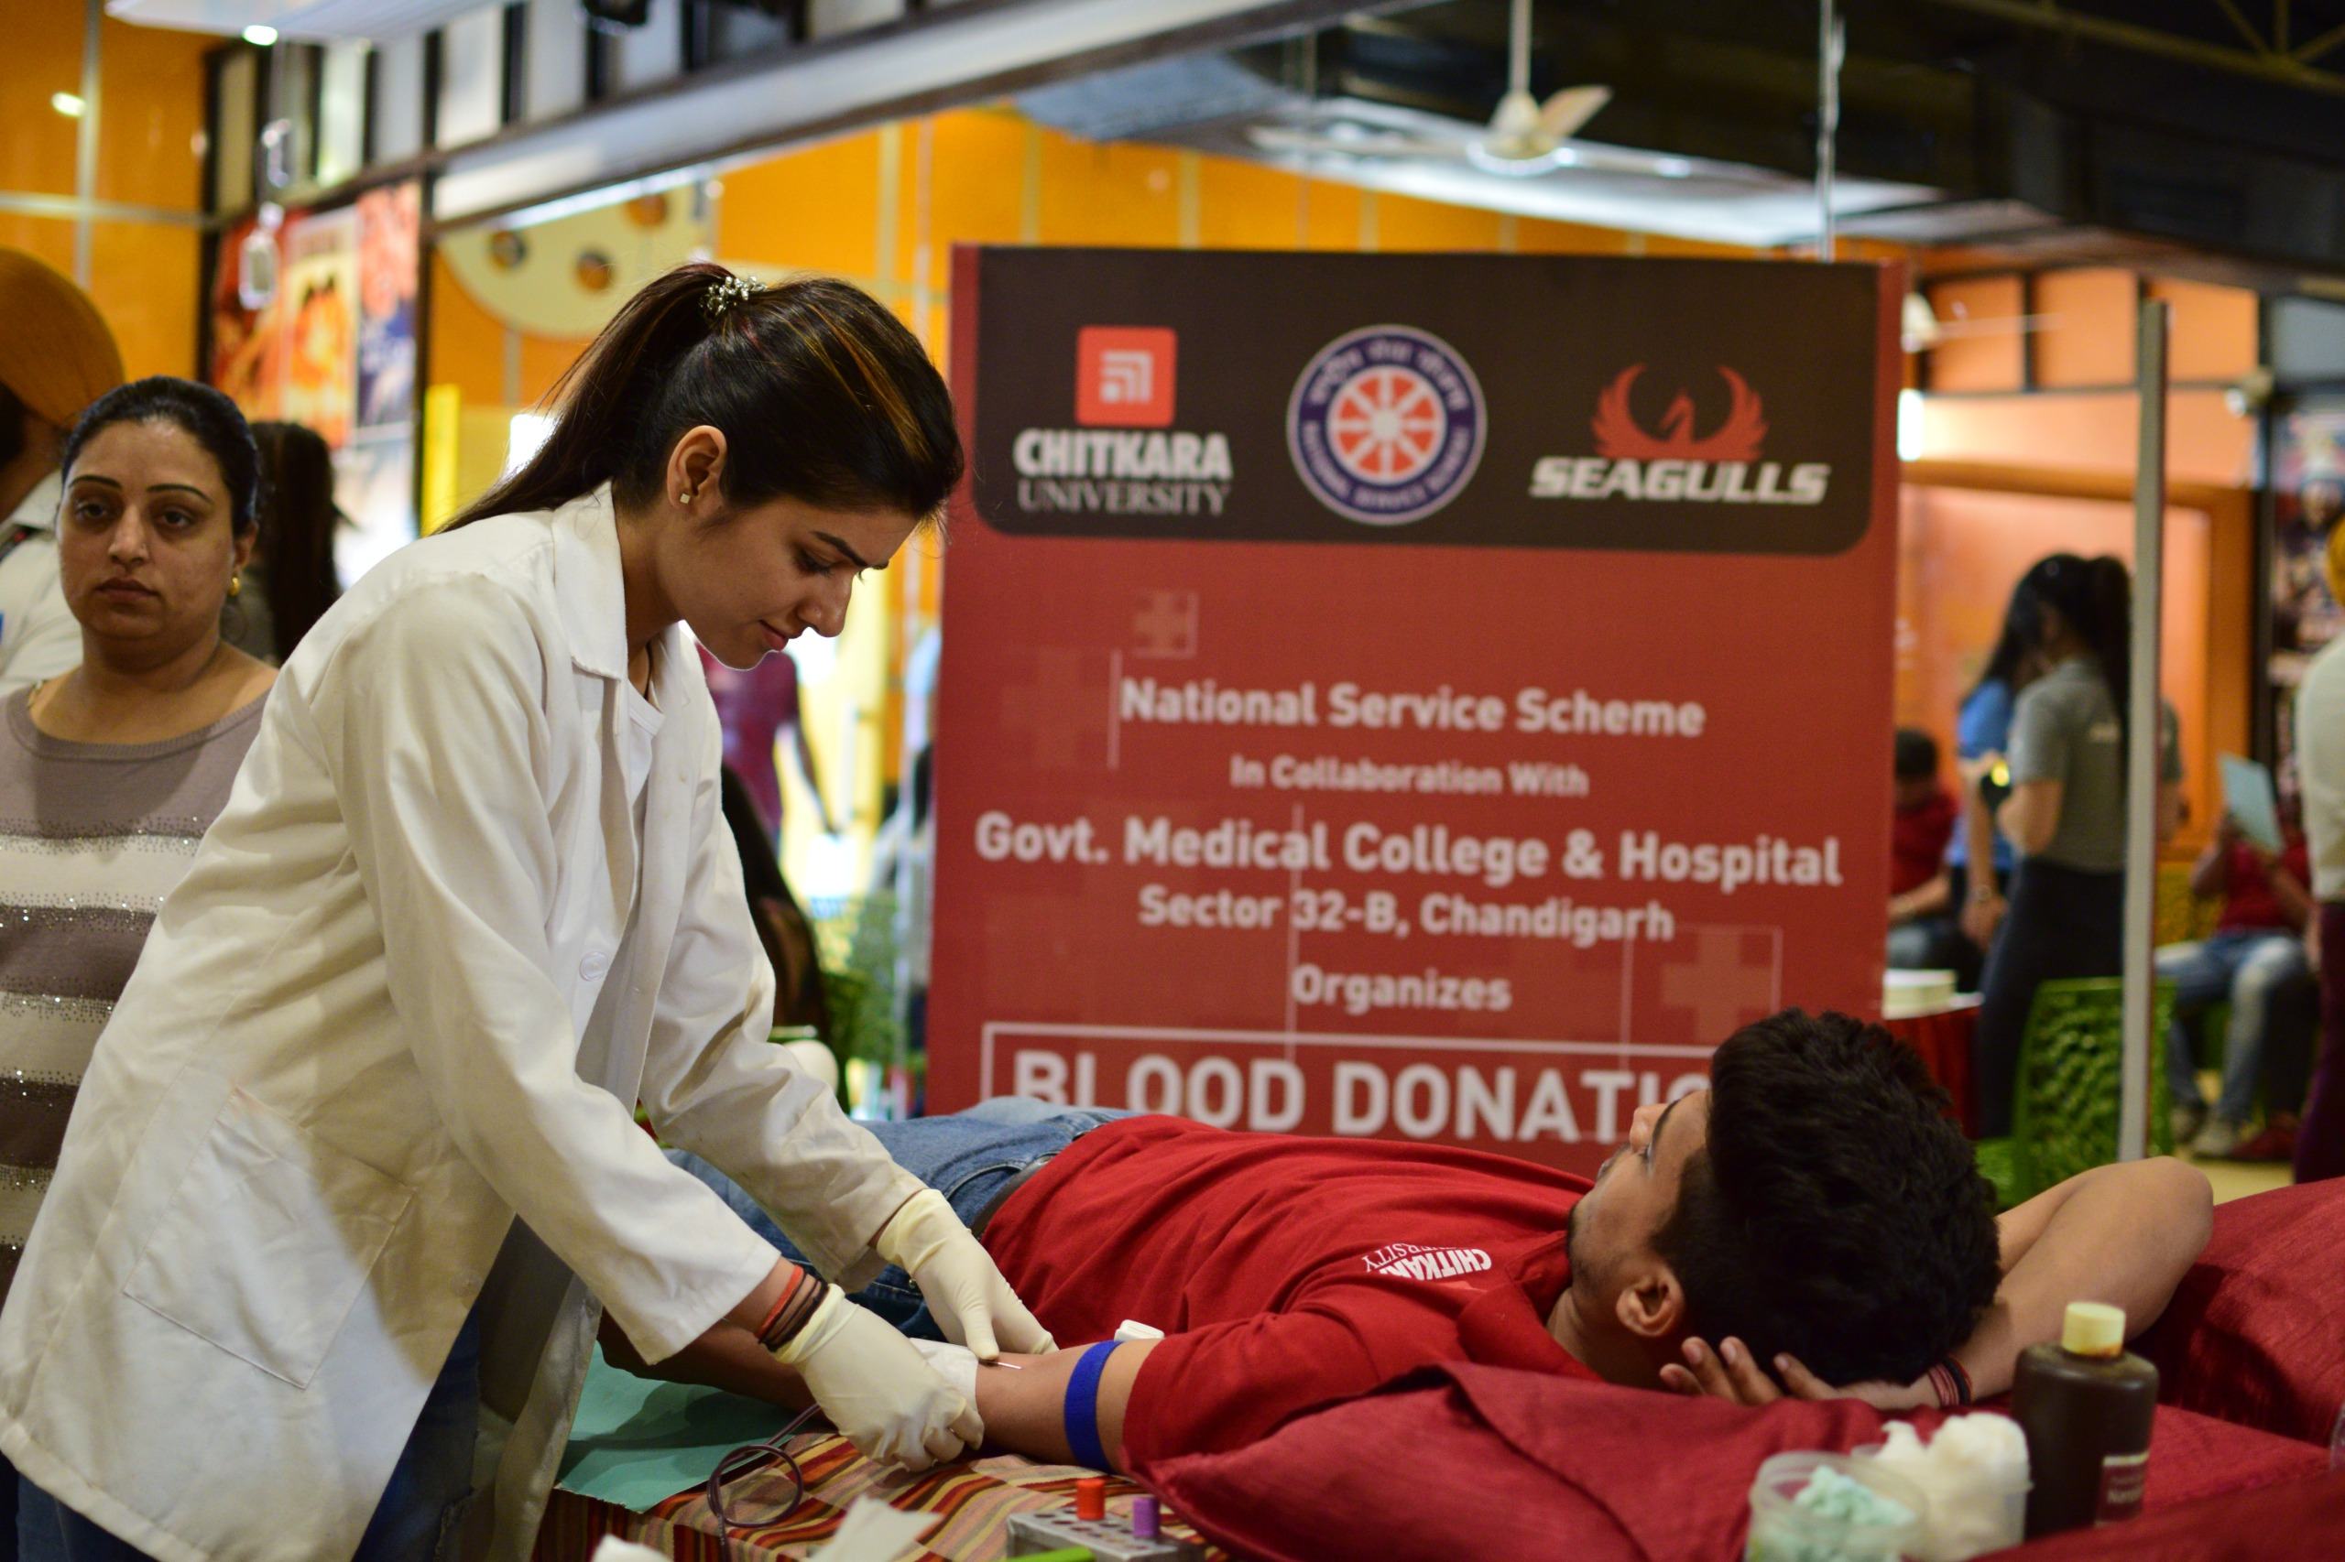
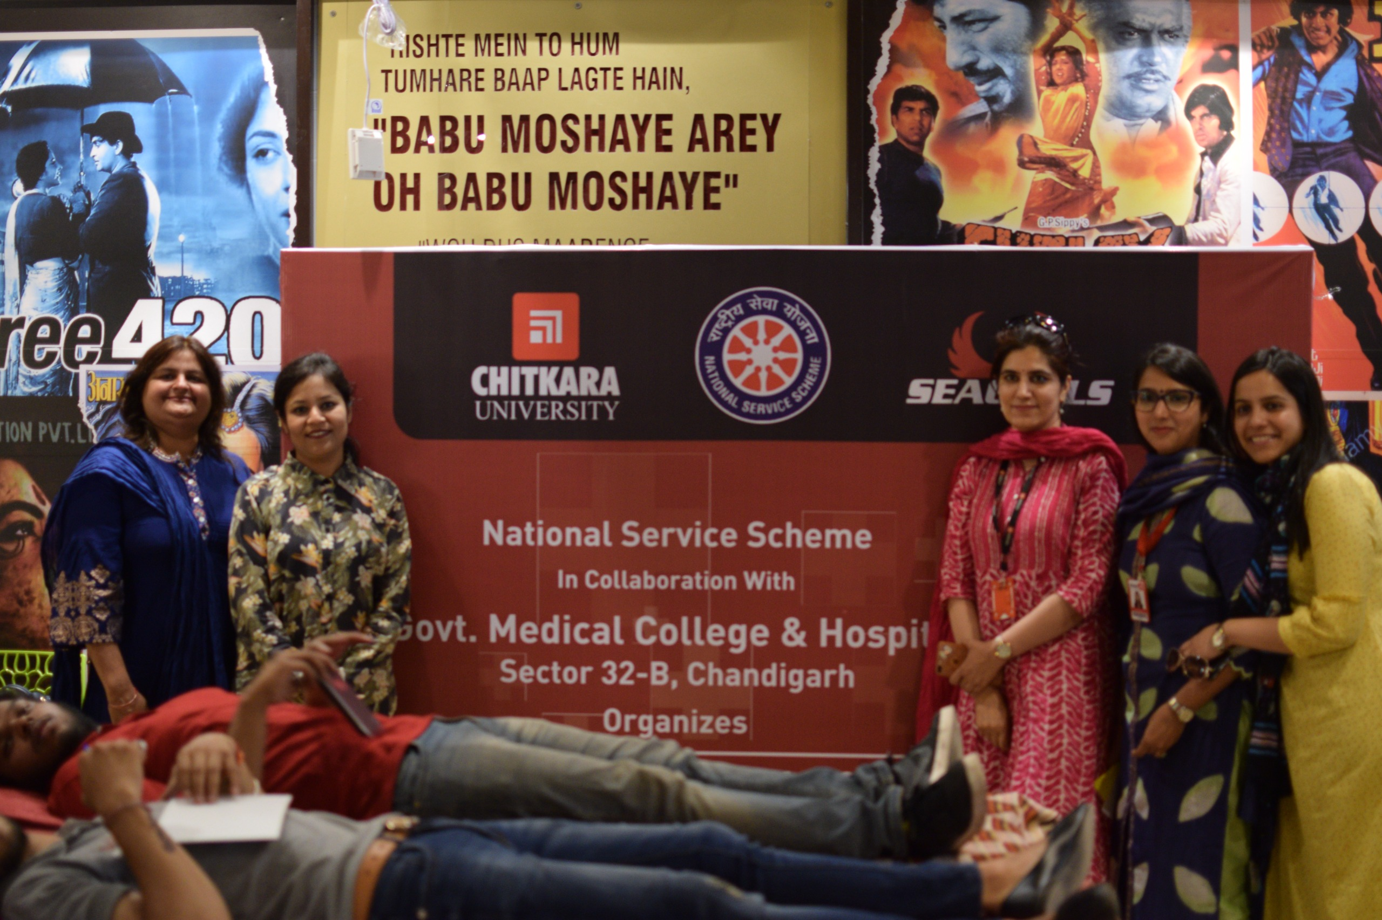
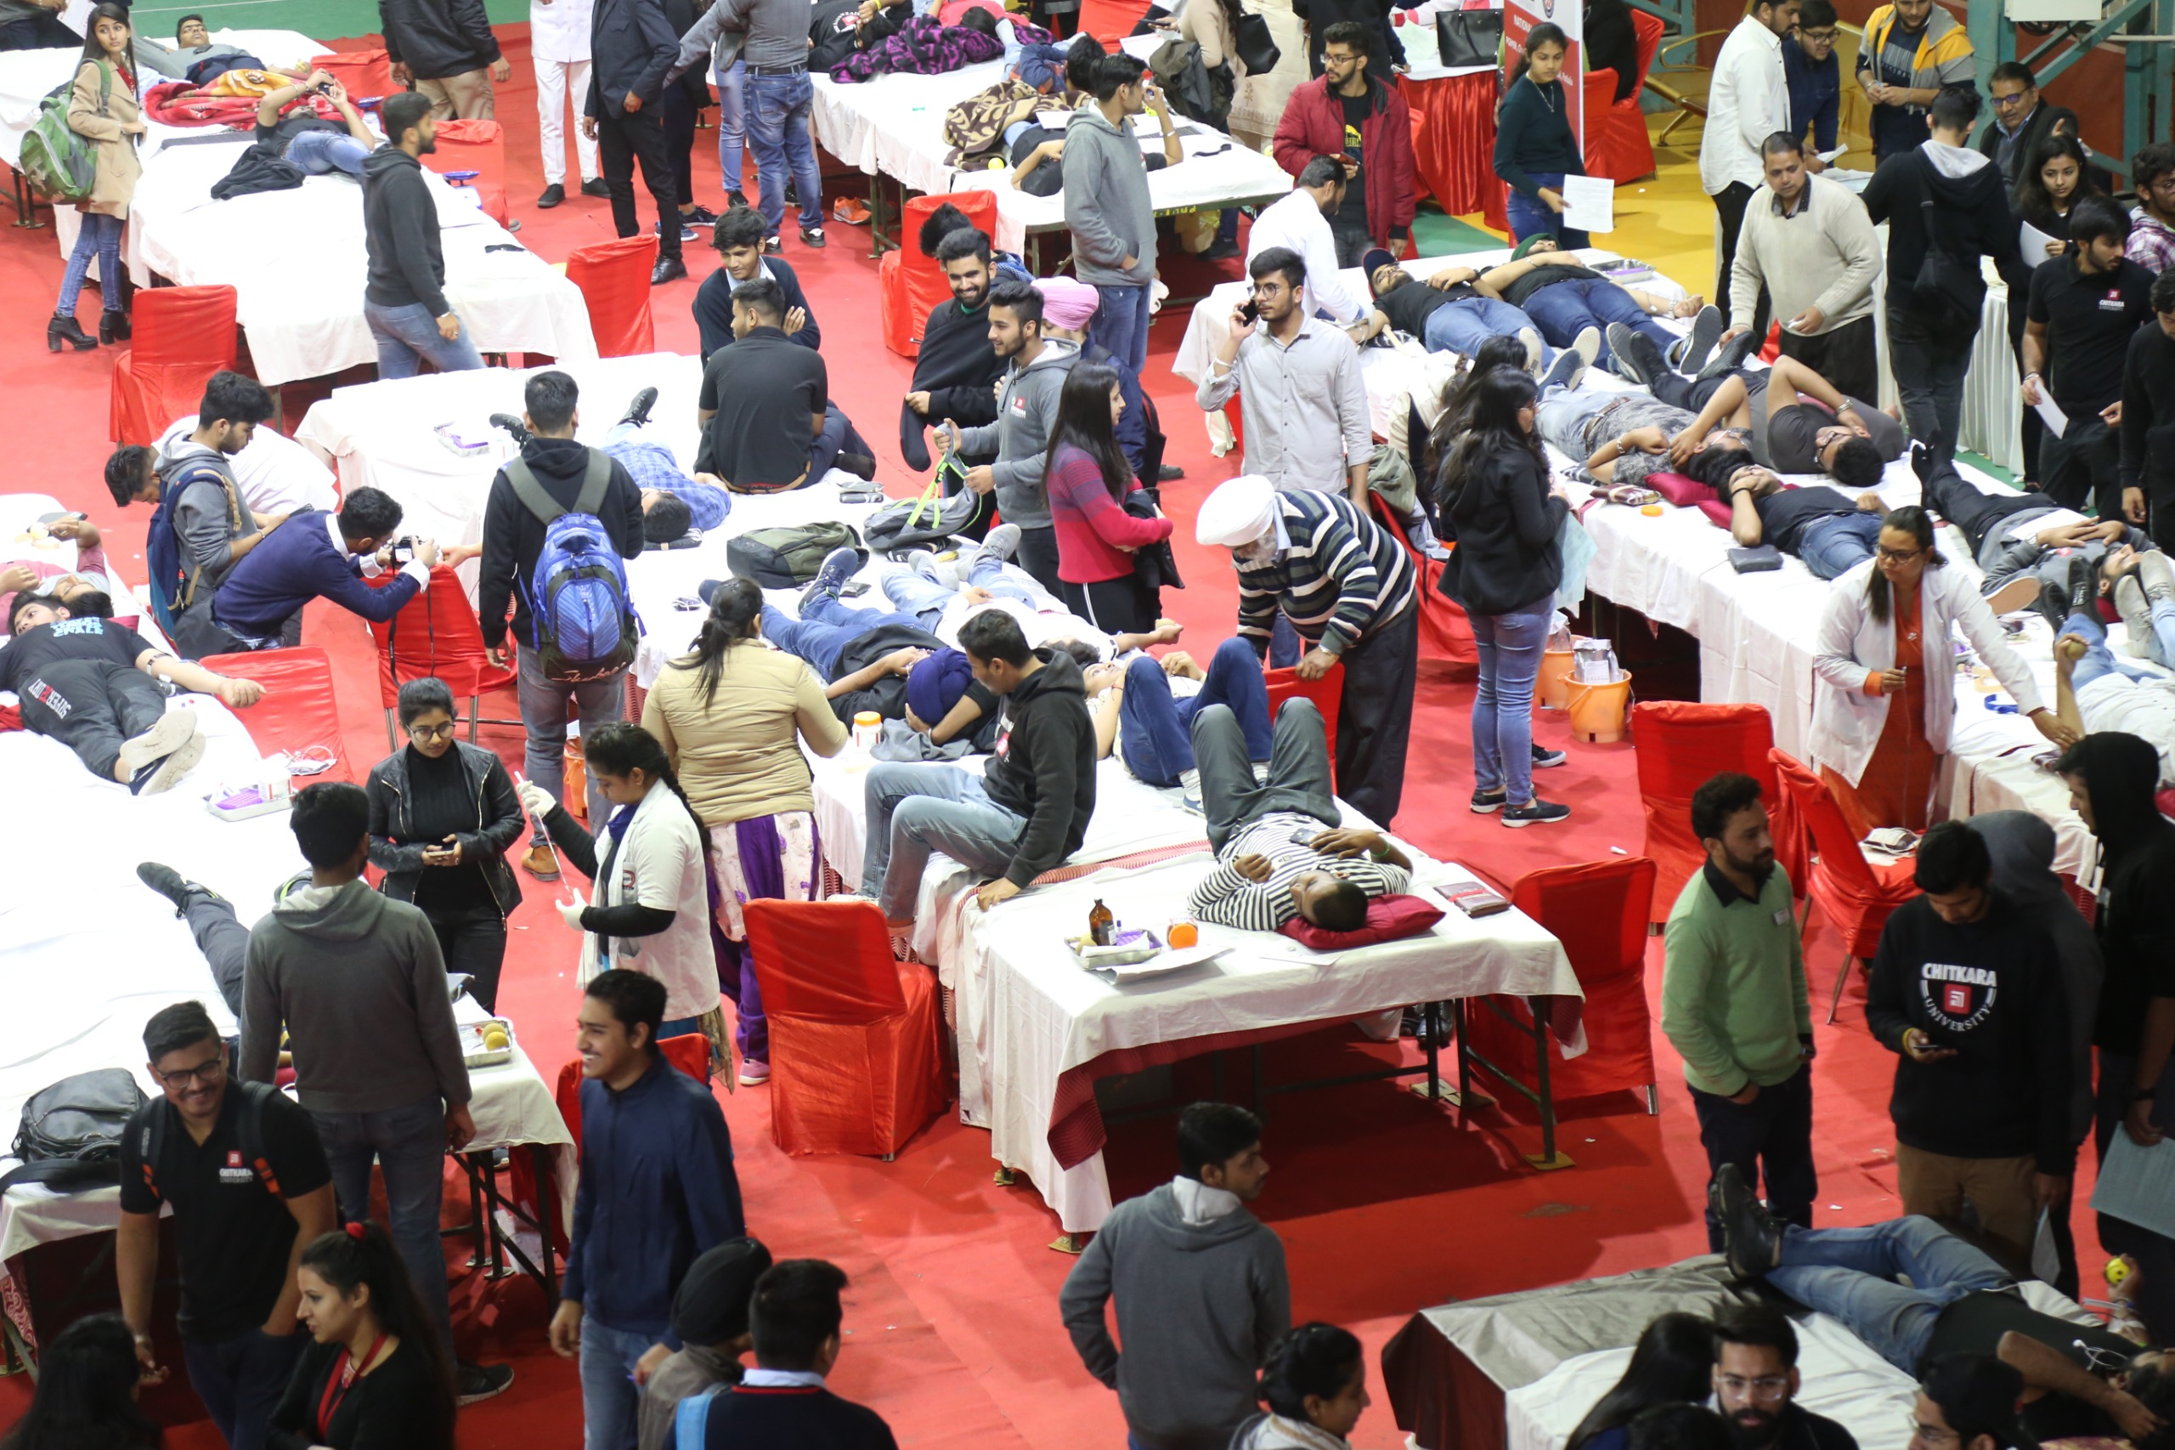
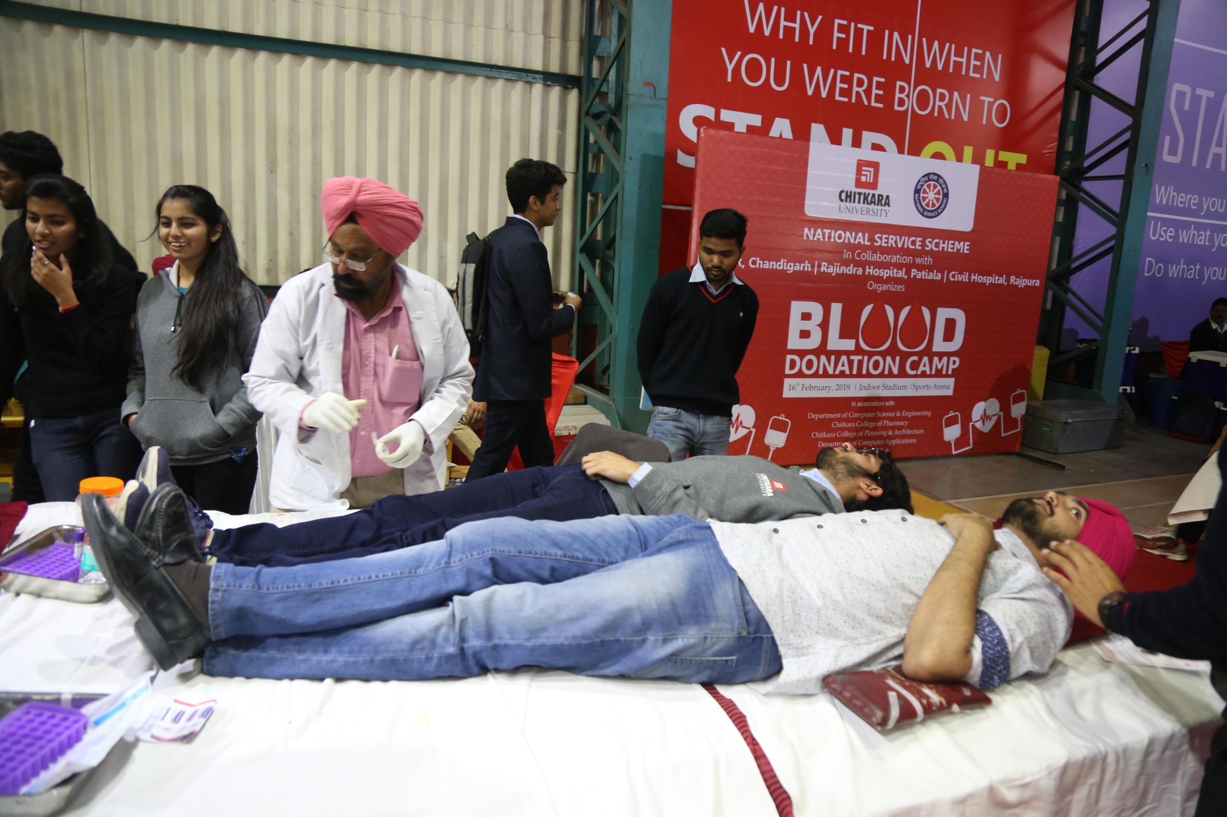
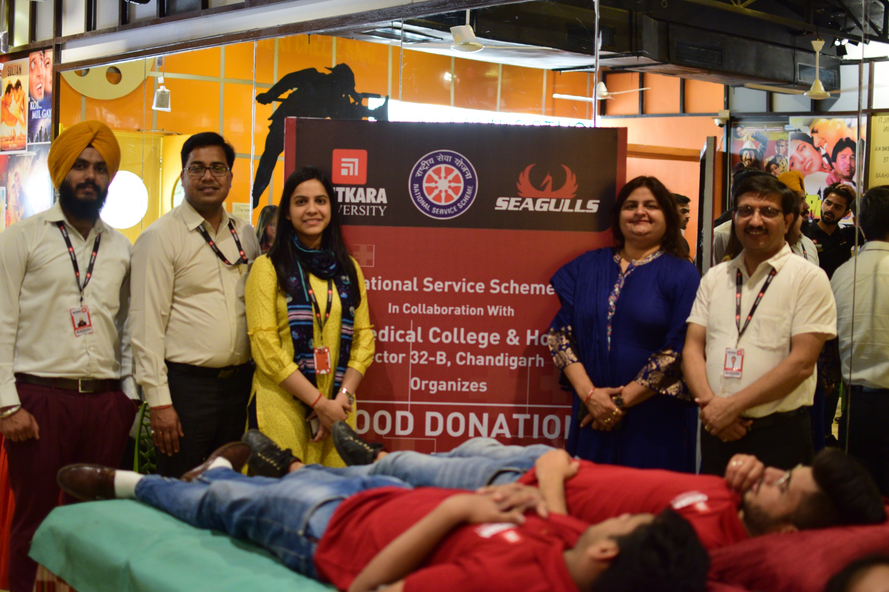
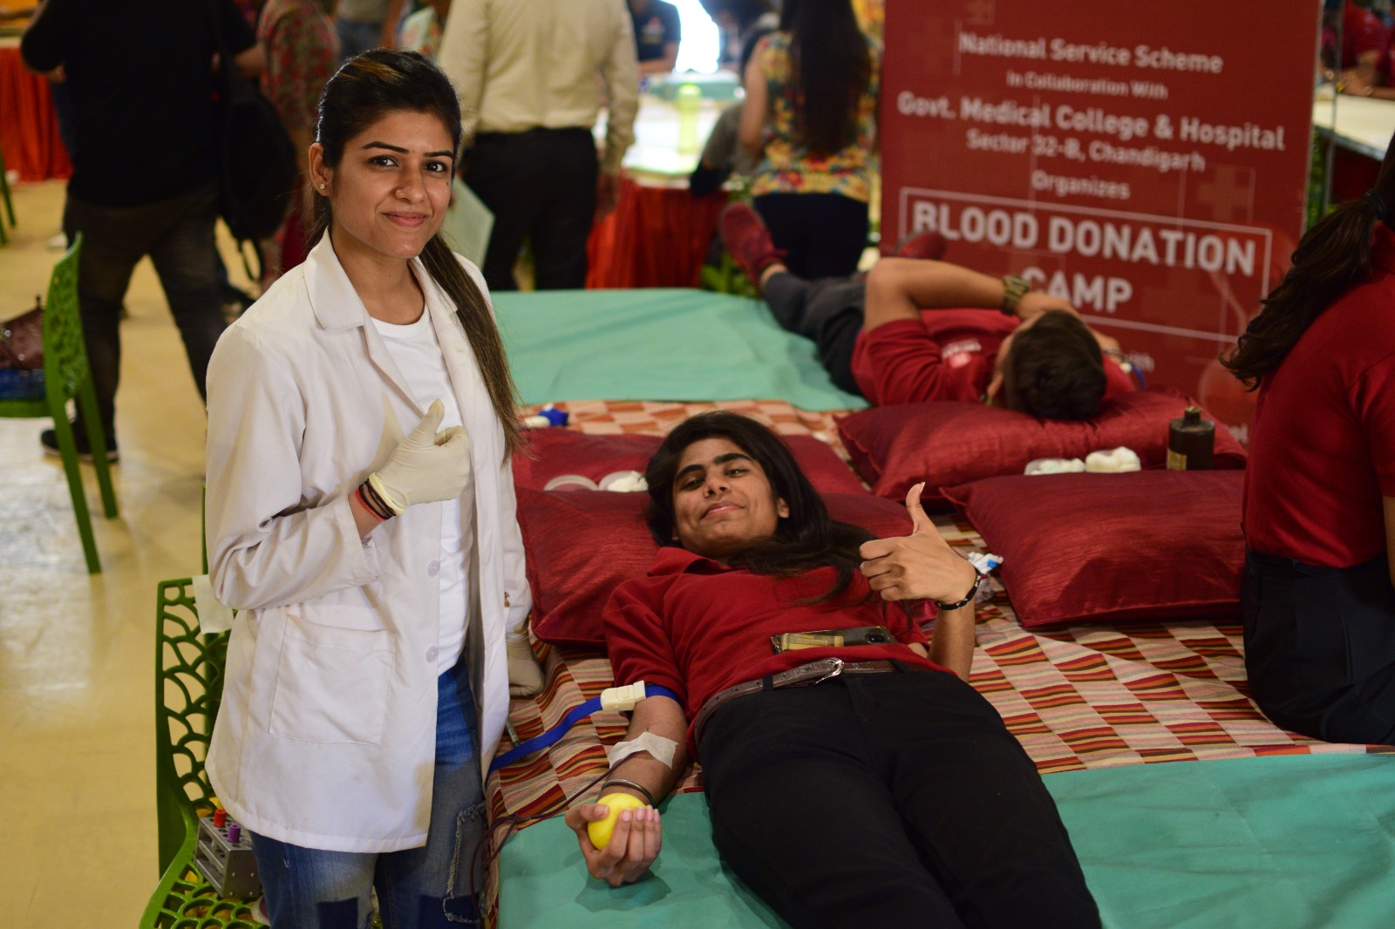
In association with
Rajindra Hospital, Patiala, PGIMER, Chandigarh & AP Jain Civil Hospital, Rajpura
16th Feb 2019
In association with
Govt. Medical College & Hospital
Sector 32,Chandigarh
25th April 2019

Slide 11
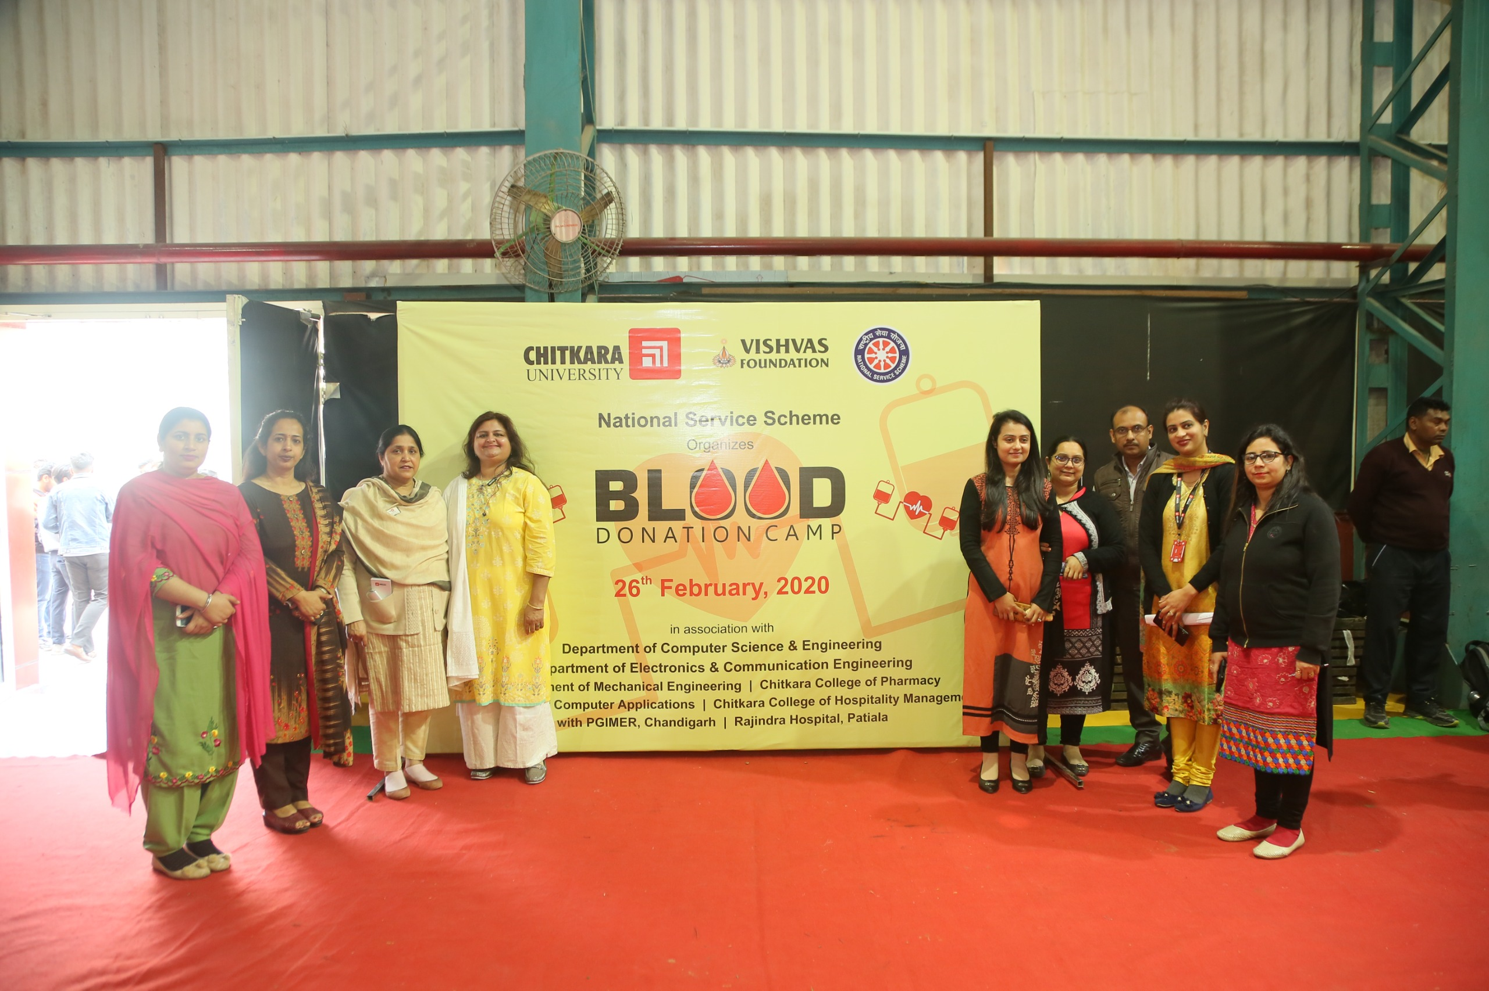
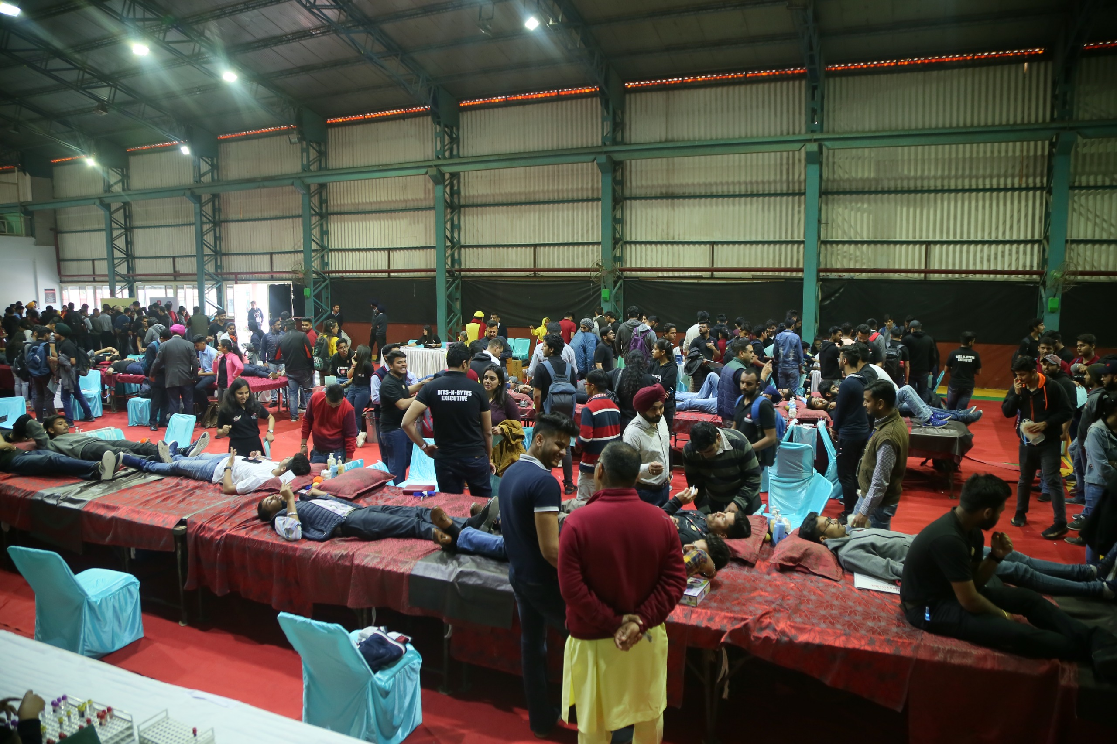
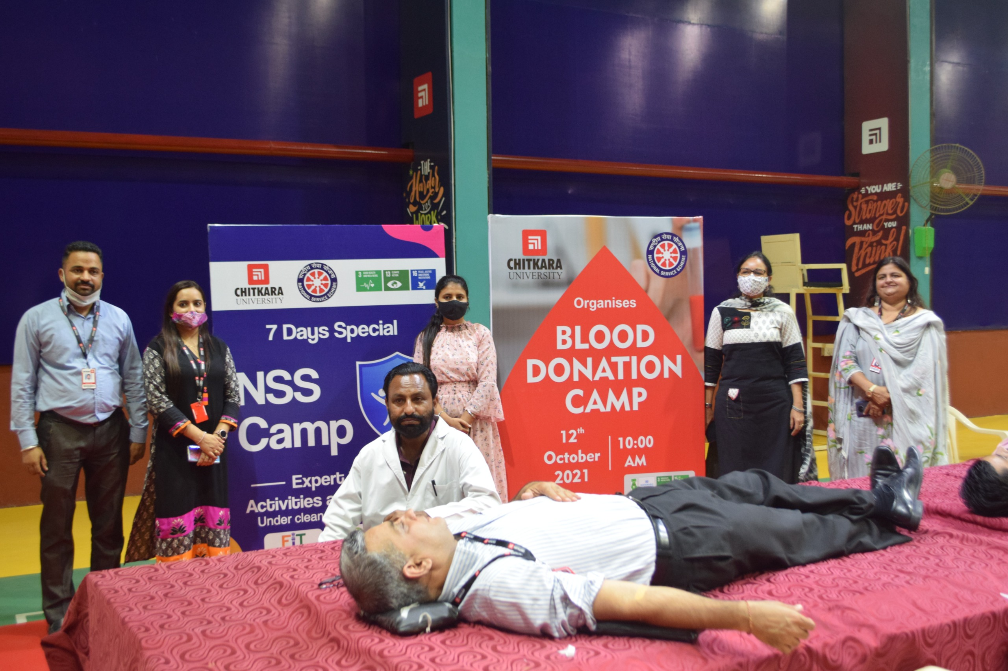
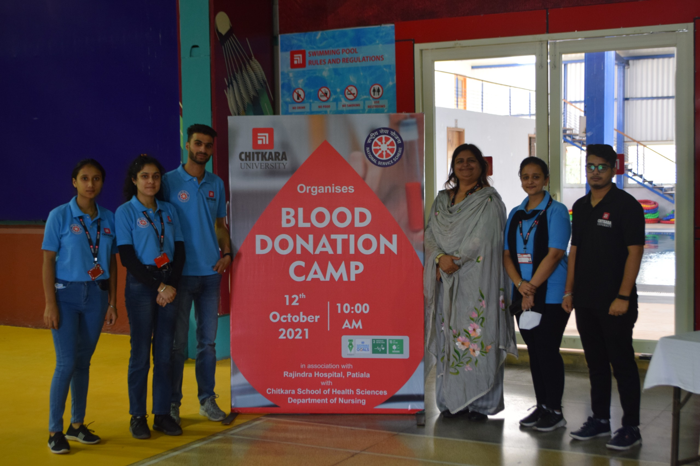
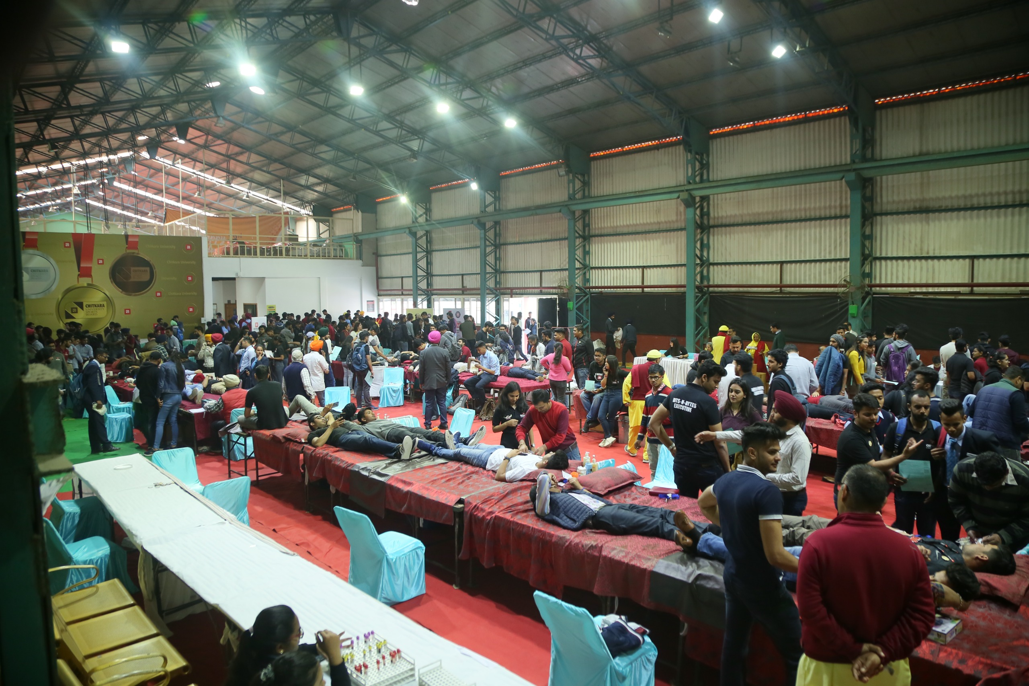
In association with
Rajindra Hospital, Patiala &
PGIMER, Chandigarh |26th Feb 2020
In association with
Rajindra Hospital, Patiala
12th October 2021

Slide 12
In association with
PGIMER, Chandigarh
16th Feb 2022
In association with
PGIMER, Chandigarh &
Rajindra Hospital, Patiala | 16th Feb 2023

Slide 13
In association with
AP Jain Civil Hospital, Rajpura
06th April 2023
In association with
Rajindra Hospital, Patiala
17th April 2023

Slide 14
In association with
Homi Bhabha Cancer Hospital and Research Centre, (Tata Memorial Centre) New Chandigarh | 11th Oct 2023
Year wise Blood Donation Data
From 2016 to 2023
Years 2021 & 2022 shows less number of units due to Covid-19 situation, in the meantime we motivated the students to donate more hence the graphs spiked in coming years

